Slide 1
Multi-arm Randomized Controlled Trial of SAPB
for pain management after VATS lobectomy
: A Single-Center, Single-Blind, Parallel Design Study

Slide 2
Purpose
Although video-assisted thoracoscopic surgery (VATS) has been shown to reduce pain and promote early recovery compared to conventional thoracotomy, optimal pain management after the surgery remains crucial for improving postoperative recovery, enhancing mobilization, and ultimately preventing the risk of pulmonary complications.
While various pain management strategies have been introduced, there remains a lack of consensus on the optimal approach to postoperative pain management following VATS anatomic lung resection, particularly lobectomy
Enhanced Recovery After Surgery (ERAS) protocols for thoracic surgery emphasize the importance of multimodal analgesia, incorporating regional anesthesia and local anesthetic techniques to effectively reduce opioid consumption
We designed a single-center, single-blinded, parallel-arm randomized controlled trial to evaluate whether an intercostal block (INB) , continuous serratus anterior plane block (SAPB), or a combination of INB with SAPB is most effective in our ERAS program with respect to postoperative pain, complications, and early recovery

Slide 3
Methods
Between June and August 2024, out of the 40 patients who underwent lung lobectomy, 34 patients qualified for the study. The surgical approach was conventional three-port VATS.
The Visual Analog Scale (VAS) was utilized for pain assessment, with scores ranging from 0 to 10 (0: no pain, <4: mild pain, 4–7: moderate pain, 7–10: severe pain). We hypothesized that a VAS score below 4 would indicate acceptable pain levels in the immediate postoperative period. Pain was measured at 1, 3, 6, 12, 24, 48, and 72 hours postoperatively.
The SAPB provides analgesia in the chest wall by blocking the lateral branches of the intercostal nerves, usually between the T2-T9 levels. After identification of the serratus anterior (SA) and latissimus dorsi (LD), the block needle was advanced between the interfacial plane of SA and LD using ultrasound in-plane technique. 40ml of 0.25% ropivacaine was injected.
Postoperatively, an INB was administered under thoracoscopic guidance across seven levels (T3-T9) using 2-3 ml of local anesthetic per intercostal space

Slide 4
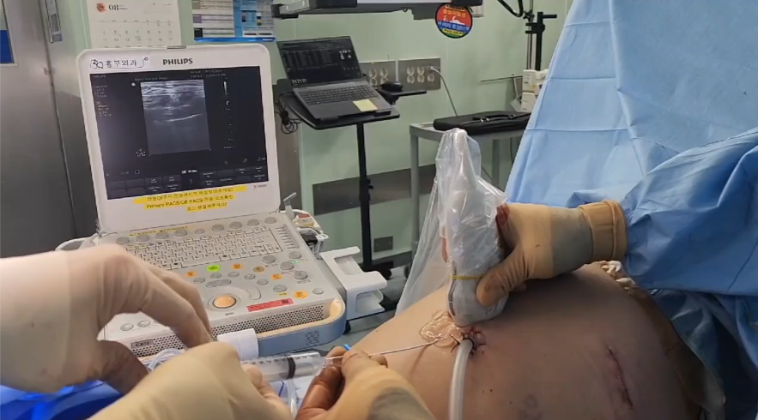
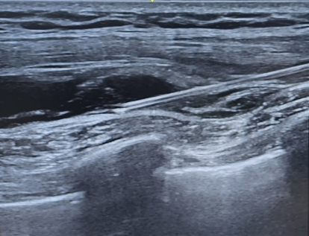
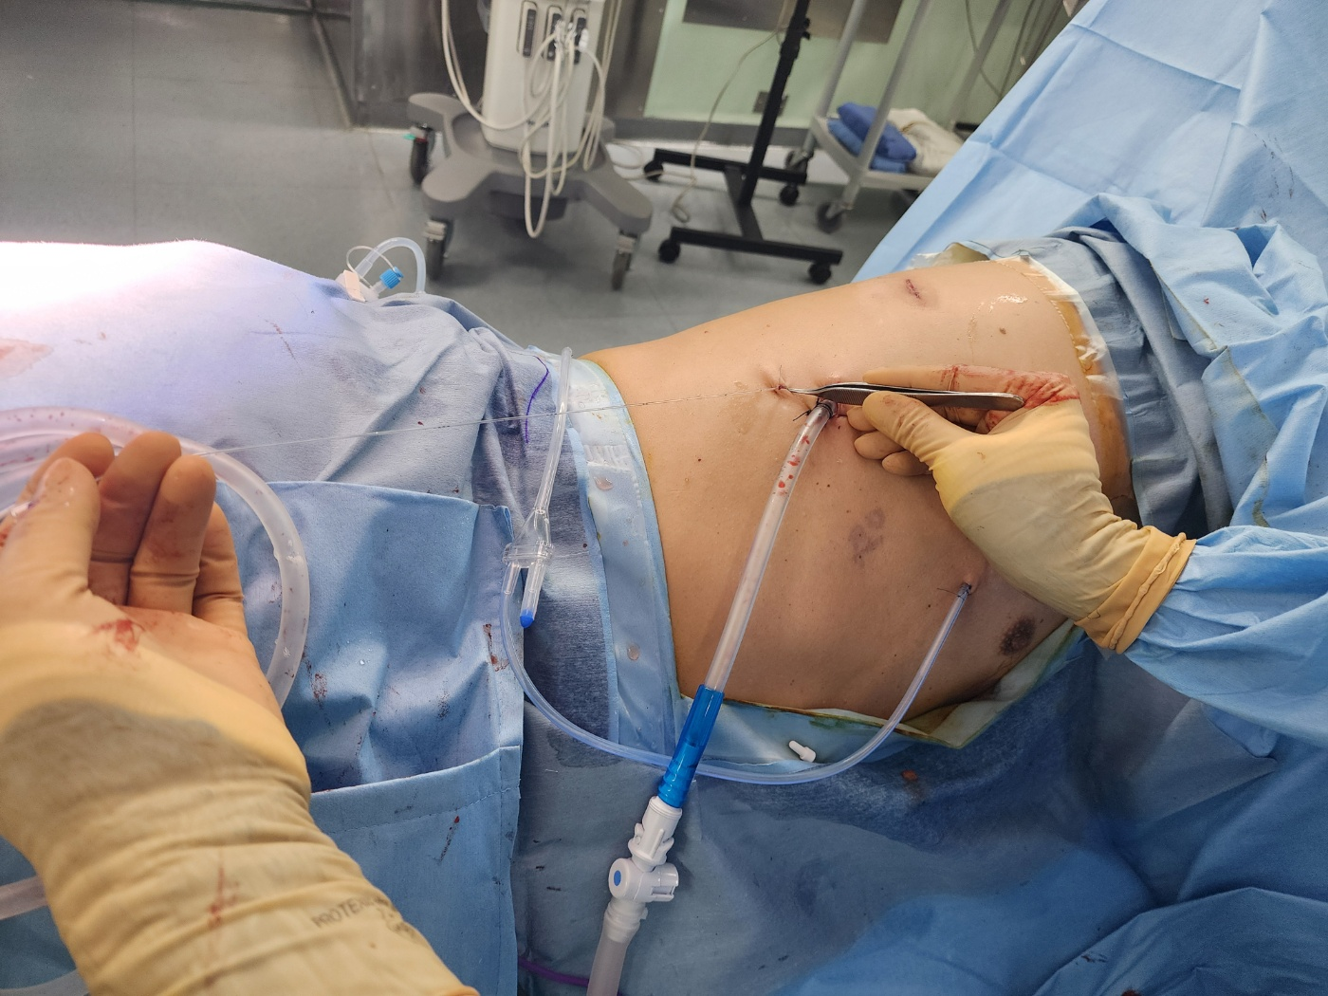
Methods
U/S guided SAPB
LD
Needle
Local anesthetics
Catheter
R4
SA
R6
Catheter
R5
Fig. 1. U/S guided SAPB was performed following VATS lobectomy, and a continuous infusion catheter was subsequently placed.
The three groups are assigned as Group S (SAPB) (n=10) and Group I (Intercostal nerve block) (n=14) and Group H (SAPB + Intercostal nerve block) (n=10).

Slide 5
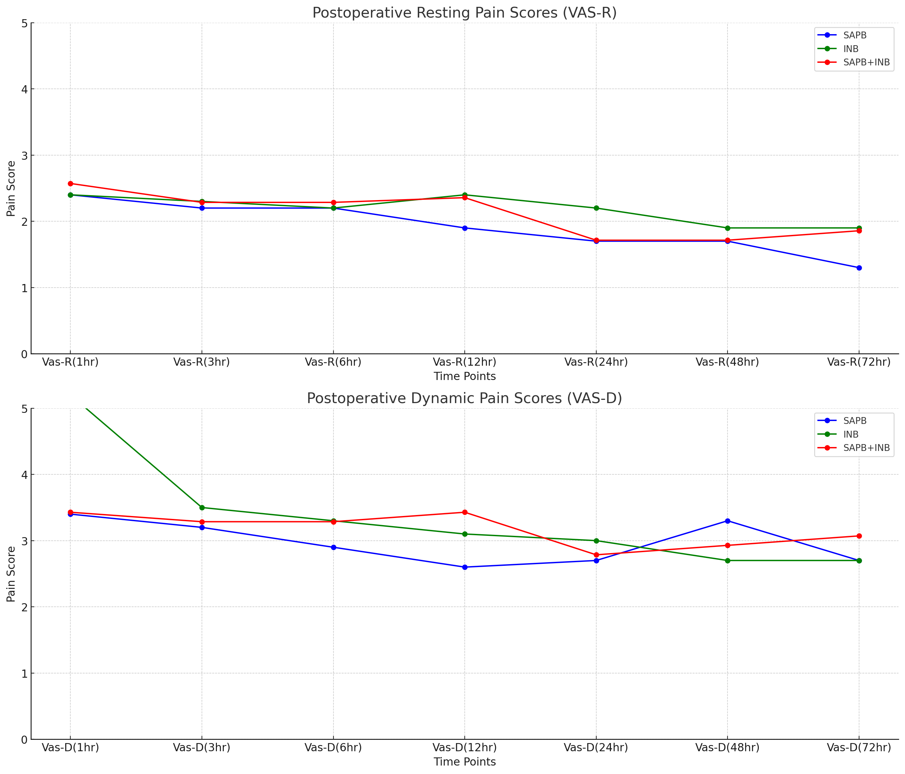
Results
All the enrolled patients were primary lung caner patients who underwent VATS lobectomy. Mean age, gender, performance status, and operation time showed no difference.
The three groups did not show statistically significant differences in postoperative resting pain (VAS-R) or dynamic pain (VAS-D) across the study periods. Except for the 1-hour postoperative mark in the INB group, all groups maintained pain scores below 4 throughout the study period, indicating a tolerable level of pain.
All three groups showed very small amount of rescue analgesic consumptions, which showed no difference between three groups.

Slide 6
Conclusion
Preliminary Data Analysis of SAPB, INB, and SAPB+INB in Pain Management Following VATS Lobectomy
In this prospective, randomized, single-blinded small cohort study, the preliminary data analysis comparing SAPB, INB, and SAPB+INB showed no significant differences in pain levels during the study periods, with all methods maintaining a tolerable state of pain (VAS 0–4).
A known limitation of INB or SAPB is the relatively short duration of analgesic effects, attributable to the characteristics of local anesthetics. To address this issue, we designed this study to evaluate the efficacy of a continuous SAPB for pain management following VATS lobectomy.
Although this study is ongoing and the data presented are preliminary, our findings suggest that continuous SAPB is effective in controlling postoperative pain after VATS lobectomy.
SAPB is technically straightforward and less invasive compared to epidural or paravertebral blocks. While INB is more commonly utilized by thoracic surgeons, we propose that continuous SAPB serves as a viable alternative modality for pain management. Further investigation is underway, with a target of enrolling 25 participants in each group.

