Slide 1
The clinical outcomes of marginal donor hearts: a single center experience

Slide 2
Purpose
The average donor heart utilization rate is known to be 31.4% in South Korea, although reported to improve to 42.9% in 2019, still very low compared with other countries
More than 60% of donor hearts are discarded for the reason of their age or medical condition
However, were the donors truly marginal, and doomed to have poor outcomes?
Herein, we suggest an answer to the questions with reporting outcomes of single heart transplant (HTx) center, which actively utilizes the marginal donors

Slide 3
Methods
from June 2014 to March 2021
Consecutive 66 isolated HTx in a single tertiary center
Marginal criteria:
- Donor age > 55yrs,
- Left ventricular ejection fraction < 50% or Structural heart disease
- Cold ischemic time >240min
- Declined more than 5 times by the listed candidates
Marginal donors (MD, N=29) vs. Non-marginal donors (Non-MD, N=37)
Perioperative profiles, postoperative hemodynamic data, primary graft dysfunction (PGD), and the survival rate were analyzed.

Slide 4
Results: preoperative profiles
Recipient profiles | Non-MD group (n=37) | MD group (n=29) | P-value
Male | 21 (56.8%) | 16 (55.2%) | 0.99
Age, years | 51.0 ± 13.9 | 55.8 ± 11.8 | 0.14
Weight, kg | 62.1 ± 11.9 | 61.9 ± 12.2 | 0.94
Height, cm | 164.3 ± 8.5 | 163.8 ± 9.4 | 0.85
HTN | 19 (51.4%) | 20 (69.0%) | 0.23
DM | 10 (27.0%) | 11 (37.9%) | 0.50
Redo Surgery | 8 (21.6%) | 5 (17.2%) | 0.89
Severe COPD | 0 | 1 (3.4%) | 0.90
Dialysis | 0 | 1 (3.4%) | 0.90
Hemoglobin | 10.4 ± 1.8 | 10.2 ± 1.7 | 0.63
Bilirubin | 2.4 ± 2.1 | 1.8 ± 3.0 | 0.34
ICU | 27 (73.0%) | 10 (34.5%) | 0.004
ECMO | 25 (67.6%) | 10 (34.5%) | 0.015
KODA status 0 | 26 (70.3%) | 10 (34.5%) | 0.033
Waiting day | 6 [3; 9] | 19 [12; 39] | 0.001
Donor profiles | Non-MD group (n=37) | MD group (n=29) | P-value
Male | 26 (70.3%) | 19 (65.5%) | 0.89
Age | 36.5 ± 10.9 | 44.4 ± 13.9 | 0.011
Weight | 68.3 ± 10.8 | 71.2 ± 21.6 | 0.51
Height | 168.6 ± 7.2 | 169.8 ± 6.4 | 0.50
Last LVEF | 60.6 ± 5.6 | 52.4 ± 11.6 | 0.001
Inotropic agent | 34 (91.9%) | 27 (93.1%) | 0.99
more than NE | 10 (27.0%) | 9 (31.0%) | 0.93
Cold IT | 121.8 ± 66.7 | 151.6 ± 73.4 | 0.089
Cause of Marginal |  | 29 (100%)
Age ≥55 years |  | 11(37.9%)
LVEF ≤ 50% |  | 15 (51.7%)
Cold IT ≥ 240 min |  | 4 (13.8%)
Refuse ≥ 5 times |  | 7 (24.1%)
HTN, hypertension; DM, diabetes mellitus; COPD, chronic obstruction pulmonary disease; ICU, intensive care unit; ECMO, extracorporeal membrane oxygenation; KODA, Korean organ donation agency
LVEF, left ventricular ejection fraction; NE, norepinephrine; IT, ischemic time

Slide 5
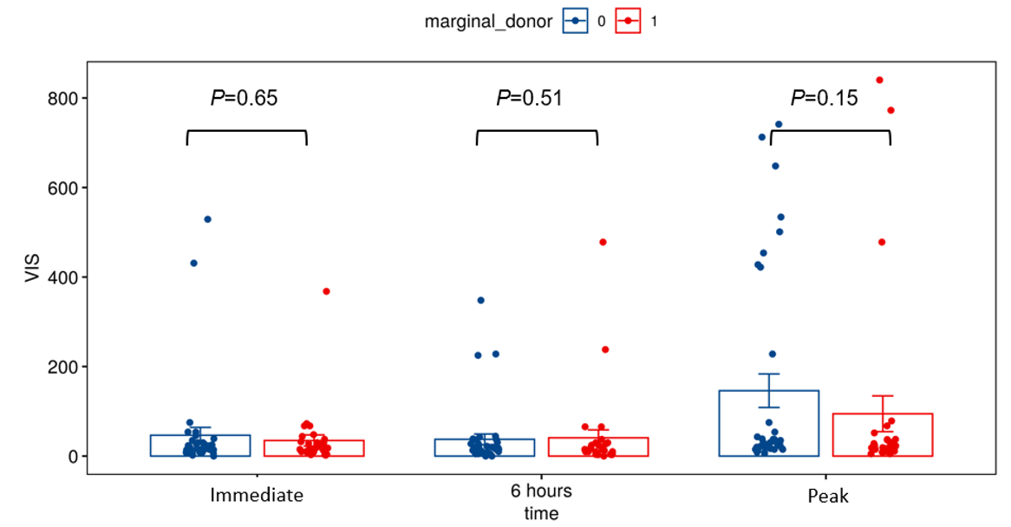
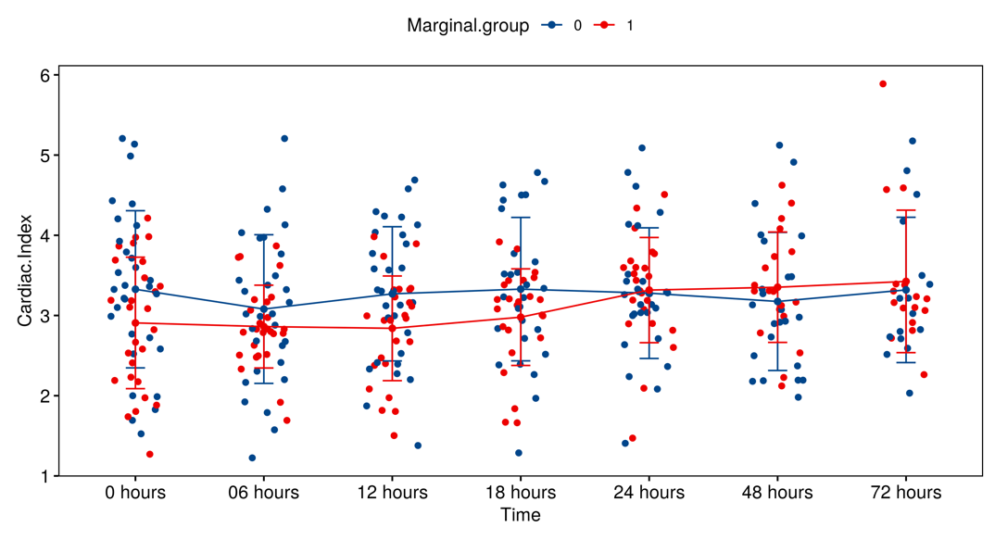
Results: perioperative profiles
 | Non-MD group (n=37) | MD group (n=29) | P-value
Total IT | 189.8 ± 68.3 | 219.1 ± 75.5 | 0.10
Warm IT | 68.0 ± 19.7 | 67.4 ± 21.7 | 0.91
CPB times | 157.2 ± 43.5 | 167.7 ± 63.0 | 0.45
Post ECMO | 3 (8.1%) | 0 | 0.33
Bleeding operation | 4 (10.8%) | 3 (10.3%) | 0.99
Vent > 24 hours | 12 (32.4%) | 7 (24.1%) | 0.64
PGD | 6 (16.2%) | 7 (24.1%) | 0.62
New onset Dialysis | 0 | 2 (6.9%) | 0.37
CVA | 1 (2.7%) | 0 | 0.99
Pneumonia | 3 (8.1%) | 0 | 0.33
ICU stay, days | 7 [4; 14] | 6 [4; 8] | 0.19
30days mortality | 1 (2.7%) | 1 (3.4%) | 0.99
IT, ischemic time; CPB, cardiopulmonary bypass; ECMO, extracorporeal membrane oxygenation; Vent, ventilator; PGD, primary graft dysfunction; CVA, cerebrovascular accident; ICU, intensive care unit

Slide 6
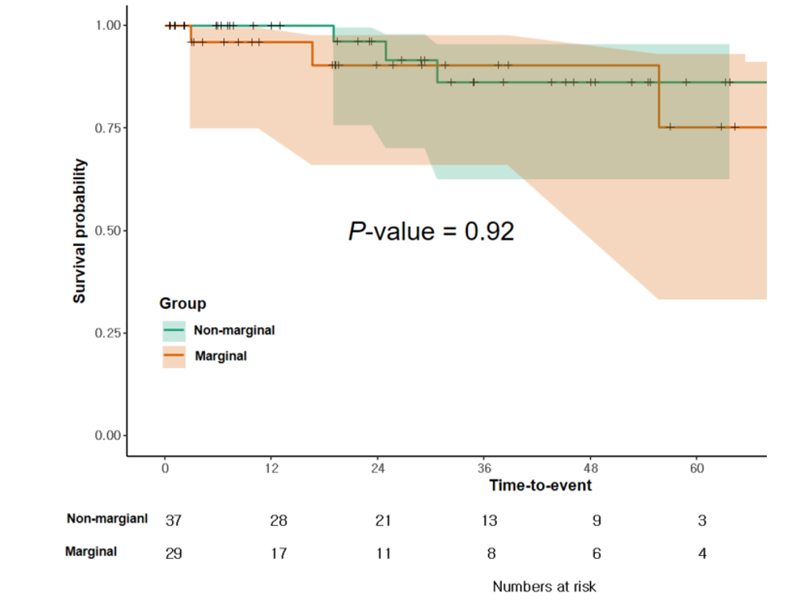
Results: Long-term results

Slide 7
Conclusion
There was no statistically significant difference in any-PGD (24.1% vs 16.2%, p=.623)
The cardiac index recorded immediate postop, 6hr, 12hrs, 18hrs showed slightly lower in MD group, however, caught-up NMD group after 24hrs
Long-term results represented by 5yr survival showed no significant difference between the two groups (survival rates 86.2% vs 75.3%, p = 0.92)
Appropriately selected donor hearts declined as ‘marginal donor’ hearts may increase organ utilization without an increase in post-transplant PGD and mortality

