Slide 1
The impact of bicuspid pulmonary valve in aortic position after arterial switch for transposition of the great arteries on neoaortic root and neoaortic valve function; Propensity score matched analysis
공지사항
  소속기관이나 저자명이 드러나지 않도록 해주세요.
  제목 슬라이드 제외 최대 6장, Font size 20 이상
  사진/illustration등으로 인해 용량이 큰 경우 PDF로 전환해서 접수

Slide 2
Purpose
Neoaortic valve regurgitation which might be related to root dilatation is one of the major concerns following arterial switch operation (ASO) for transposition of the great arteries (TGA).
However, the future of native bicuspid pulmonary valve (BPV) in aortic position remains unclear.
This study investigated the effect of bicuspid neoaortic valve on neoaortic root morphology, function, and the long-term clinical outcomes after ASO for TGA using propensity score matching (PSM).

Slide 3
Methods
From January 1997 to December 2018, 442 patients underwent ASO for TGA.
ASO for TGA
(n=442)
*Excluded patients
Staged repair (n=15)
Early mortality (n=46)
Lack of echo data (n=20)
Age > 1yr (n=9)
(n=352)
Bicuspid PV (n=18)
Tricuspid PV (n=334)
1:4 PSM
Bicuspid PV (n=15)
Tricuspid PV (n=60)

Slide 4
Methods
Study population after PSM (n=75)
  15 patients with BPV and 60 corresponding patients with tricuspid pulmonary valve (TPV)
  Matching variables; age, sex, VSD, Taussig-Bing anomaly, arch obstruction
Serial echocardiography was performed to assess the morphology and function of neoaortic root.

Slide 5
Results
Baseline characteristics in both groups were similar.
The median duration of follow-up was 9.9 years (4 months ~ 22.3 years).
Freedom from reoperation (at 10yr)
  BPV group; 93.3±6.4 %
  TPV group; 88.7±4.4 %
  No statistical significance (p=0.84)
 | Tricuspid PV (n=60) | Bicuspid PV (n=15) | P value
Variable
Preoperative variables
Age(days, range) | 12 (8-17) | 12 (7-20) | 0.682
Birth weight (kg, mean±SD) | 3.27±0.74 | 3.22±0.60 | 0.786
Sex (male) (n, %) | 31 (51.7) | 8 (53.3) | 0.871
VSD | 36 (60.0) | 9 (60.0) | 1.000
Taussig-Bing anomaly | 10 (16.7) | 3 (20.0) | 0.994
Arch obstruction | 0 (0.0) | 0 (0.0) | -
Operative variables
CPB time(min) (median, IQR) | 161 (137-196) | 197 (167-230) | 0.063
ACC time(min) (median, IQR) | 95 (81-115) | 121 (91-157) | 0.009
Hospital days (median, IQR) | 10 (9-15) | 13 (9-19) | 0.240
Late mortality | 1 (1.67) | 0 (0.0) | 0.611
*PV; pulmonary valve, VSD; ventricular septal defect, CPB; cardiopulmonary bypass time, ACC; aortic cross clamp time

Slide 6
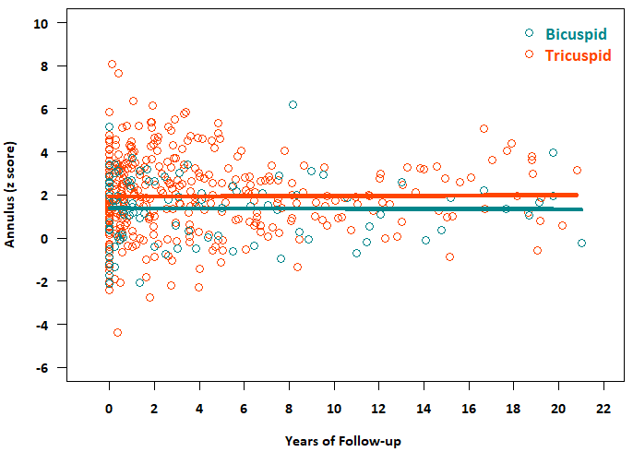
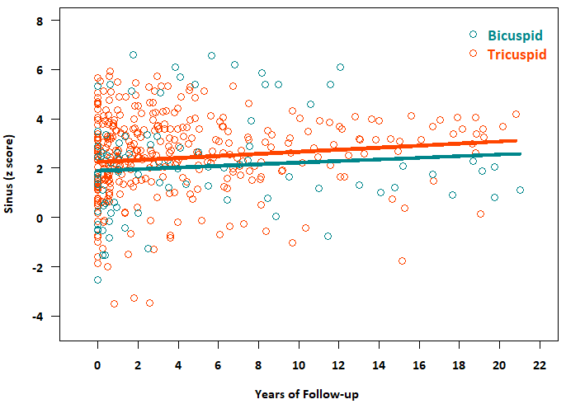
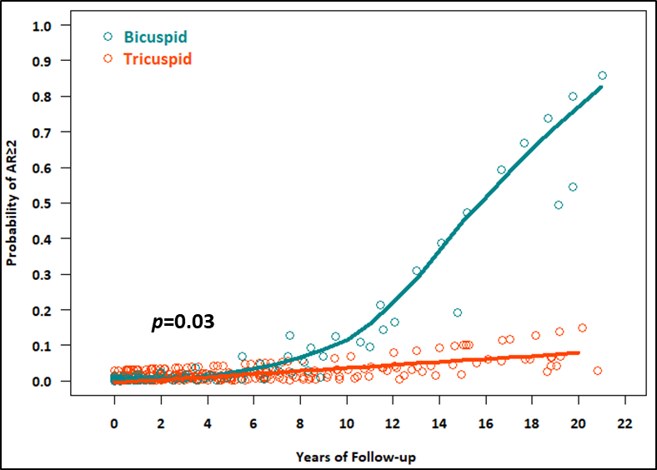
Results
Indexed dimension (z-score) of neoaortic annulus was not increased in both groups (p=0.57) (Figure A), although there was a little increasing tendency in z-score of neoaortic sinus without intergroup difference (p=0.69) (Figure 1B).
Deterioration in neoaortic valve function was more prominent in bicuspid group (common odds ratio; 1.40 in bicuspid group [p<0.01], and 1.12 in tricuspid group [p=0.03], p=0.03) (Figure 1C).
A
B
C

Slide 7
Conclusion
Arterial switch operation could be a safe option in selected patients with TGA associated with BPV without increasing the risk of reoperation.
Neoaortic root dilatation was similar in both groups, although deterioration of aortic valve function was more prominent in bicuspid group, which suggests that the neoaortic valve function would be deteriorated mainly by valve itself not root pathology.

