Slide 1
Aortic Valve Repair in Young Patients with Aortic Regurgitation: a Single Patch Design for Leaflet Extension

Slide 2
Purpose
The surgical treatment option for young patients with aortic regurgitation has limitation and has not been standardized. We introduce our recent techniques and results of aortic valve repair.

Slide 3
Methods
From October 2017 to June 2020, we performed aortic valve repair with leaflet extension technique in 15 consecutive patients.
The effective height and the necessary additional height for each leaflet to obtain the target effective height (usually 11mm or 12mm) is measured on the calliper.
A strip with 5mm height and length equal to the circumference of sinotubular junction is divided into three equal parts and each part is extended below with fan-shape with measured necessary additional height for each leaflet.

Slide 4
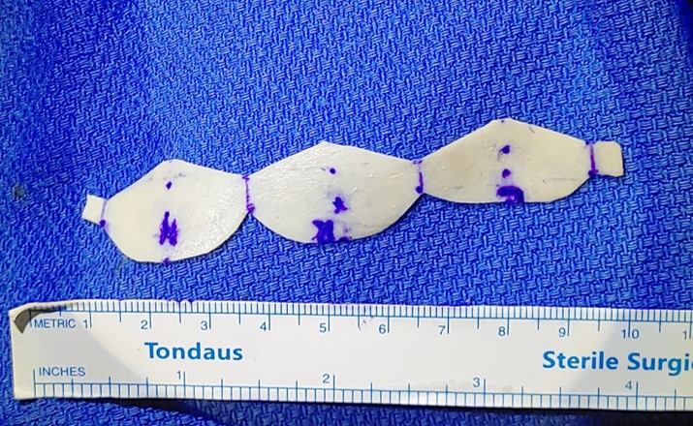
Methods

Slide 5
Results
The median age of the patients was 13 years (33 months to 22 years) and the median follow-up duration was 9 months (1 month to 28 months).
Preoperative aortic regurgitation grade were more than moderate in all patients.
Aortic regurgitation in every patient was less than mild at discharge, however, two patients showed progression of aortic regurgitation to more than moderate at the last follow-up.
In the patients with preoperative aortic stenoinsufficiency, we performed concomitant aortic valvotomy.
In these patients, aortic stenosis was less than mild at discharge and no progression of stenosis was shown at the last follow-up.

Slide 6
Conclusion
Successful repair of aortic valve in young patients with aortic regurgitation is possible.
To avoid or delay aortic valve replacement and prevent ventricular dysfunction, we recommend early surgical intervention before ventricular dysfunction or leaflet deformity is developed.

