Slide 1
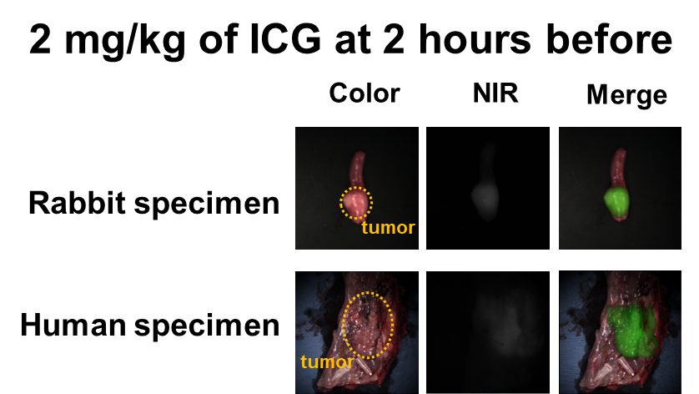
The esophageal cancer was well-detected with 2 mg/kg of ICG at 12 hours pre-operative times,
and this is similar detection patterns in rabbit and human specimens.

