Slide 1
Outcomes of surgical treatment for Non-small cell lung cancer in high-risk patients

Slide 2
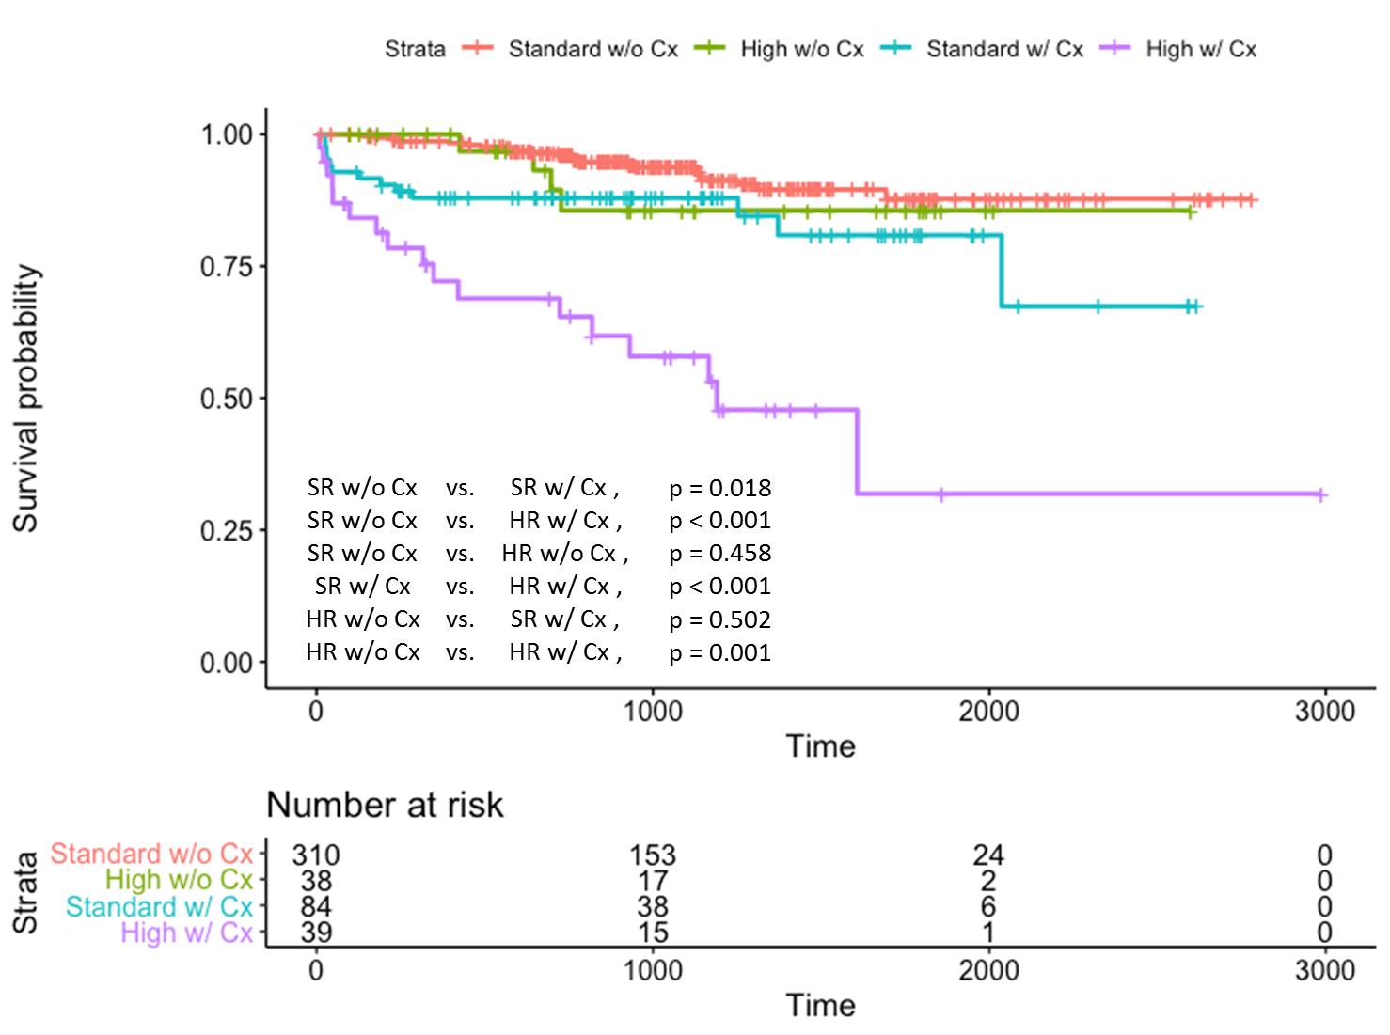
Figure 1. KM for overall survival according to the surgery risk and postoperative complications

Slide 3
Table 1. Multivariate analysis for overall survival
 | OR (95 CI) | P value
Female | 0.571 (0.262 – 1.243) | 0.158
Age | 1.015 (0.983 – 1.049) | 0.346
BMI | 0.973 (0.890 – 1.063) | 0.554
Smoking
Non-smoker | Reference
Ex-smoker | 0.533 (0.274 – 1.038) | 0.064
Current smoker | 0.622 (0.289 – 1.337) | 0.224
VATS (vs. Open) | 0.763 (0.428 – 1.358) | 0.358
Operation extent
Segmentectomy | Reference
Lobectomy | 0.389 (0.151 – 0.998) | 0.049
Extended resection | 0.793 (0.239 – 2.625) | 0.704
Pathology
Squamous cell ca | Reference
Adenocarcinoma | 0.455 (0.229 – 0.903) | 0.024
Other NSCLC | 0.400 (0.087 – 1.832) | 0.238
Stage
Stage I | Reference
Stage II | 1.540 (0.691 – 3.429) | 0.289
Stage III | 6.105 (3.203 – 11.637) | <0.001
Postop complication | 3.116 (1.734 – 5.599) | <0.001
High risk | 1.783 (0.917 – 3.294) | 0.090

