Slide 1
Tricuspid Valve Detachment for Ventricular Septal Defect Closure in Infants Less Than 5kg: Should We Be Hesitant?

Slide 2
Purpose
Over the time, there have been several studies that ventricular septal defect (VSD) can be repaired successfully using the tricuspid valve detachment (TVD)
The impact of TVD on the clinical outcomes of VSD closure in patients with low body weight remains controversial
We reviewed our experience about VSD closure and compared the clinical outcomes of TVD with those of non-TVD (NTVD) in infants less than 5kg

Slide 3
Methods
Retrospective study
TVD indication (performed at the surgeon’s discretion)
  Multiple chordal arrangement obscuring the margins of the defect
  Aneurysmal change that precludes access to the defect
  The defect requiring excessive traction for exposure
Echocardiographic grading of tricuspid regurgitation (TR) severity
  0: none to trivial, 1: mild, 2: mild to moderate, 3: moderate and 4: severe
Propensity score-matching analysis
  TVD group (n=46) and NTVD group (n=416)
  9 variables: age, body weight, sex, preterm, low birth weight, down syndrome, TR grade, TV repair, VSD type
  After matching, Group D (n=44) and Group N (n=44)

Slide 4
Results
Demographic and Perioperative Data
Median age 1.9 months (interquartile range (IQR), 1.4-2.5)
Median body weight 4.2 kg (IQR, 3.7-4.6)
Median follow-up duration: 83.4 months (IQR, 43.3-130.5)
There were no significant differences in demographic and perioperative data between group D and group N, except TV aneurysmal change (p=0.011)
Notes:
There were no significant differences in patient characteristics between matched groups
Significant difference in TV aneurysmal change was observed between the groups

Slide 5
Results
Clinical Outcomes
7 in-hospital mortalities and 2 late mortalities
Postoperative morbidities such as residual VSD, atrioventricular block, and aortic regurgitation were comparable between group D and group N
No significant differences in overall survival rate (p=0.176), freedom from reoperation rate (p=0.166) between group D and group N
The freedom from TR progression rate was significantly higher in group D compared with group N (p=0.018)
TR Progression from Cox Proportional Hazards Model
Variable | HR | 95% CI | P value
Group TVD NTVD (ref.) | 0.121 | 0.019-0.774 | 0.026
Notes:
Propensity score-matching analysis with 9 variables -> 44 pairs
Age, body weight, sex, preterm, low birth weight, down syndrome, TR grade, TV repair, VSD type
There were no significant differences in patient characteristics between matched groups
Significant difference in TV aneurysmal change was observed between the groups

Slide 6
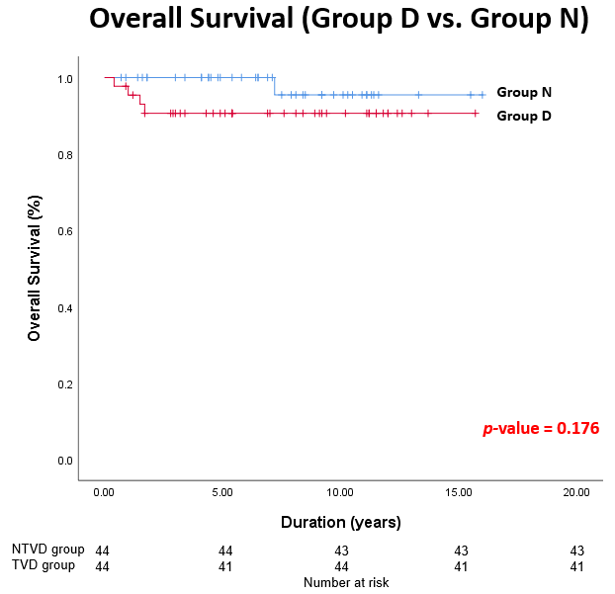
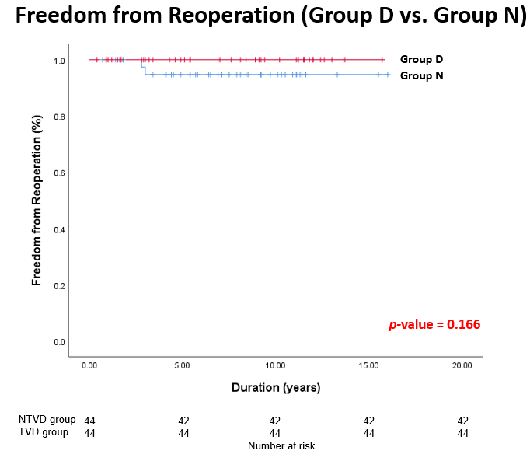
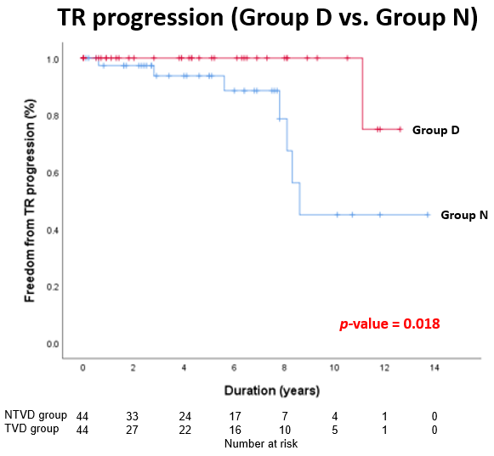
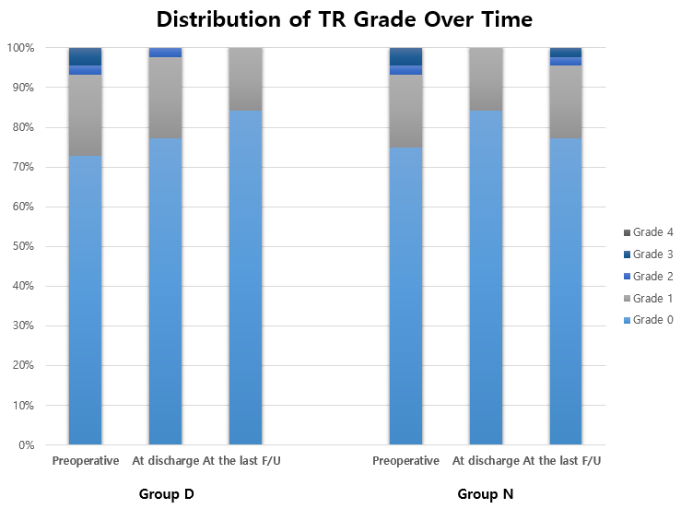
Results

Slide 7
Conclusion
Surgical outcomes of VSD closure in infants less than 5kg were excellent
Surgical outcomes of TVD were comparable to those of NTVD for VSD closure in patients less than 5kg
TR has progressed significantly in the NTVD group than in the TVD group
In infants less than 5kg, TVD can be a reasonable and valid option for successful VSD closure

