Slide 1
Impact of Sarcopenia in minimally invasive cardiac surgery

Slide 2
Background / Study Objective
The sarcopenia
  Aging and disease related syndrome which characterized as loss of skeletal muscle mass and strength
  Regarded as an comprehensive marker of frailty in elderly patients
  Associated with physical disability and mortality after surgery
This study aims to analyse the impact of sarcopenia to the early and late outcomes after minimally invasive cardiac surgery (MICS)

Slide 3
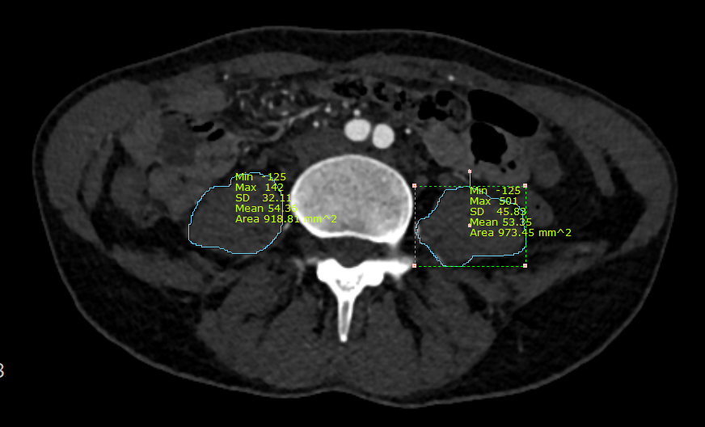
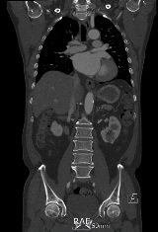
Patients & methods
MICS
Feb. 2009 ~ Apr. 2020
(Total N=1248)
Exclusion: < Age 65
N=401
Lack of preoperative computed tomography (CT) data (n=34)
Included in study cohort
(n=367)
Definition of Sarcopenia
Measured by preoperative CT
Psoas muscle area (PMA) at the top of iliac crests on horizontal plain
The average valve of both psoas muscle area was used
-> lowest sex-specific quartile was defined as sarcopenia
Sarcopenia
(Group S, n=92)
Non-sarcopenia
(Group NS, n=275)

Slide 4
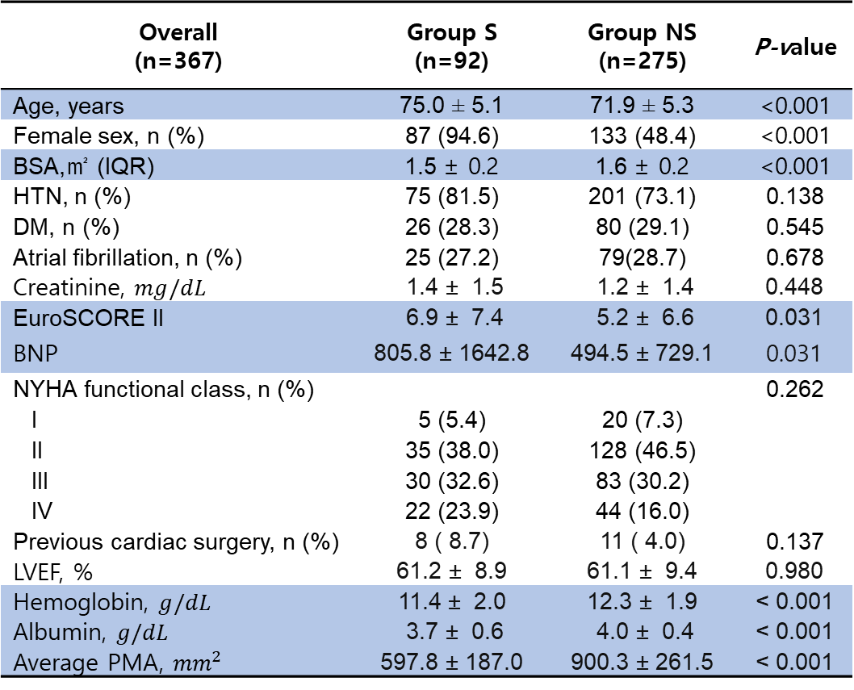
Results 1
Preoperative patient characteristics
Intraoperative data
Overall (n=367) | Group S (n=92) | Group NS (n=275) | P-value
Age, years | 75.0 ± 5.1 | 71.9 ± 5.3 | <0.001
Female sex, n (%) | 87 (94.6) | 133 (48.4) | <0.001
BSA,㎡ (IQR) | 1.5 ± 0.2 | 1.6 ± 0.2 | <0.001
HTN, n (%) | 75 (81.5) | 201 (73.1) | 0.138
DM, n (%) | 26 (28.3) | 80 (29.1) | 0.545
Atrial fibrillation, n (%) | 25 (27.2) | 79(28.7) | 0.678
Creatinine, $mg/dL$ | 1.4 ± 1.5 | 1.2 ± 1.4 | 0.448
EuroSCORE II | 6.9 ± 7.4 | 5.2 ± 6.6 | 0.031
BNP | 805.8 ± 1642.8 | 494.5 ± 729.1 | 0.031
NYHA functional class, n (%) |  |  | 0.262
I | 5 (5.4) | 20 (7.3)
II | 35 (38.0) | 128 (46.5)
III | 30 (32.6) | 83 (30.2)
IV | 22 (23.9) | 44 (16.0)
Previous cardiac surgery, n (%) | 8 ( 8.7) | 11 ( 4.0) | 0.137
LVEF, % | 61.2 ± 8.9 | 61.1 ± 9.4 | 0.980
Hemoglobin, $g/dL$ | 11.4 ± 2.0 | 12.3 ± 1.9 | < 0.001
Albumin, $g/dL$ | 3.7 ± 0.6 | 4.0 ± 0.4 | < 0.001
Average PMA, ${mm}^{2}$ | 597.8 ± 187.0 | 900.3 ± 261.5 | < 0.001
Variable | Group S (n=92) | Group NS (n=275) | P-value
AV, n(%) | 41 (43.5) | 124 (45.5) | 0.652
MV, n(%) | 24 (26.1) | 67 (13.5) | 0.848
TV | 6 (6.5) | 16 (5.8) | 1.000
Combined | 14 (17.4) | 41 (14.2) | 0.678
MV+AV | 0 | 3
MV+TV | 14 | 36
AV+TV | 0 | 2
Maze, n(%) | 16 (17.4) | 80 (29.1) | 0.038
ASD, n(%) | 8 (8.7) | 22 (8.0) | 1.000
Myxoma, n(%) | 2 (2.2) | 13 (4.7) | 0.443
Incision |  |  | 0.945
Thoracotomy | 79 (85.8) | 239 (86.9)
Hemisternotomy | 13 (14.1) | 36 (13.1)
CPB time, min | 103.4 ± 38.4 | 110.1 ± 48.1 | 0.179
Cardiac ischemic time, min | 74.0 ± 28.9 | 77.8 ± 34.5 | 0.367

Slide 5
Results 2
In-hospital outcomes and mortality
Overall (n=367) | Group S (n=92) | Group NS (n=275) | P-value
Early outcomes
Early mortality, n (%) | 5 (5.4) | 4 ( 1.5) | 0.081
Hospital stay (days) | 7.5 ± 6.5 | 7.2 ± 4.3 | 0.655
Intensive care unit stay (hours) | 48.8 ± 91.4 | 38.9 ± 61.4 | 0.334
Major complications
New onset dialysis, n (%) | 4 (4.3) | 6 (2.2) | 0.462
Need for ECMO, n (%) | 20 (21.7) | 59 (21.5) | 1.000
Arrhythmia, n (%) | 32 (34.8) | 89 (32.4) | 0.765
Pulmonary complication, n (%) | 9 (9.8) | 21 (7.6) | 0.667
Prolonged ventilation, n (%) | 8 (8.7) | 10 (3.6) | 0.096
Re-exploration for bleeding, n (%) | 3 ( 3.3) | 6 ( 2.2) | 0.849
Transfusion requirement, n (%) | 56 (60.9) | 130(47.3) | 0.033
Chest tube drain during 12hr, ml | 350.1 ± 264.7 | 346.0 ± 290.3 | 0.903
On-table extubation, n (%) | 41 (44.6) | 147 (53.5) | 0.174
Late outcomes
Follow up duration (months), mean SD | 33.1 ± 30.1 | 35.4 ± 26.7 | 0.481
Late mortality, n (%) | 14 (15.2) | 23 (8.4) | 0.091

Slide 6
Results 3
Group_S
Group_NS
1.00
0.75
p = 0.0068
Survival probability
0.50
0.25
92
66
44
37
27
16
0.00
275
220
157
118
82
45
0
12
24
36
48
60
Time

Slide 7
Conclusion
Sarcopenia did not affect on the early clinical outcomes after MICS, unlike previously reported results of the conventional sternotomy approach
Sternal preserving access may reduce the effect of sarcopenia on the patient’s recovery
The sarcopenia was associated with poorer long-term survival
Thus, preoperative PMA measurements may help assess postoperative risk and requirement for rehabilitation in elderly patients

