Slide 1
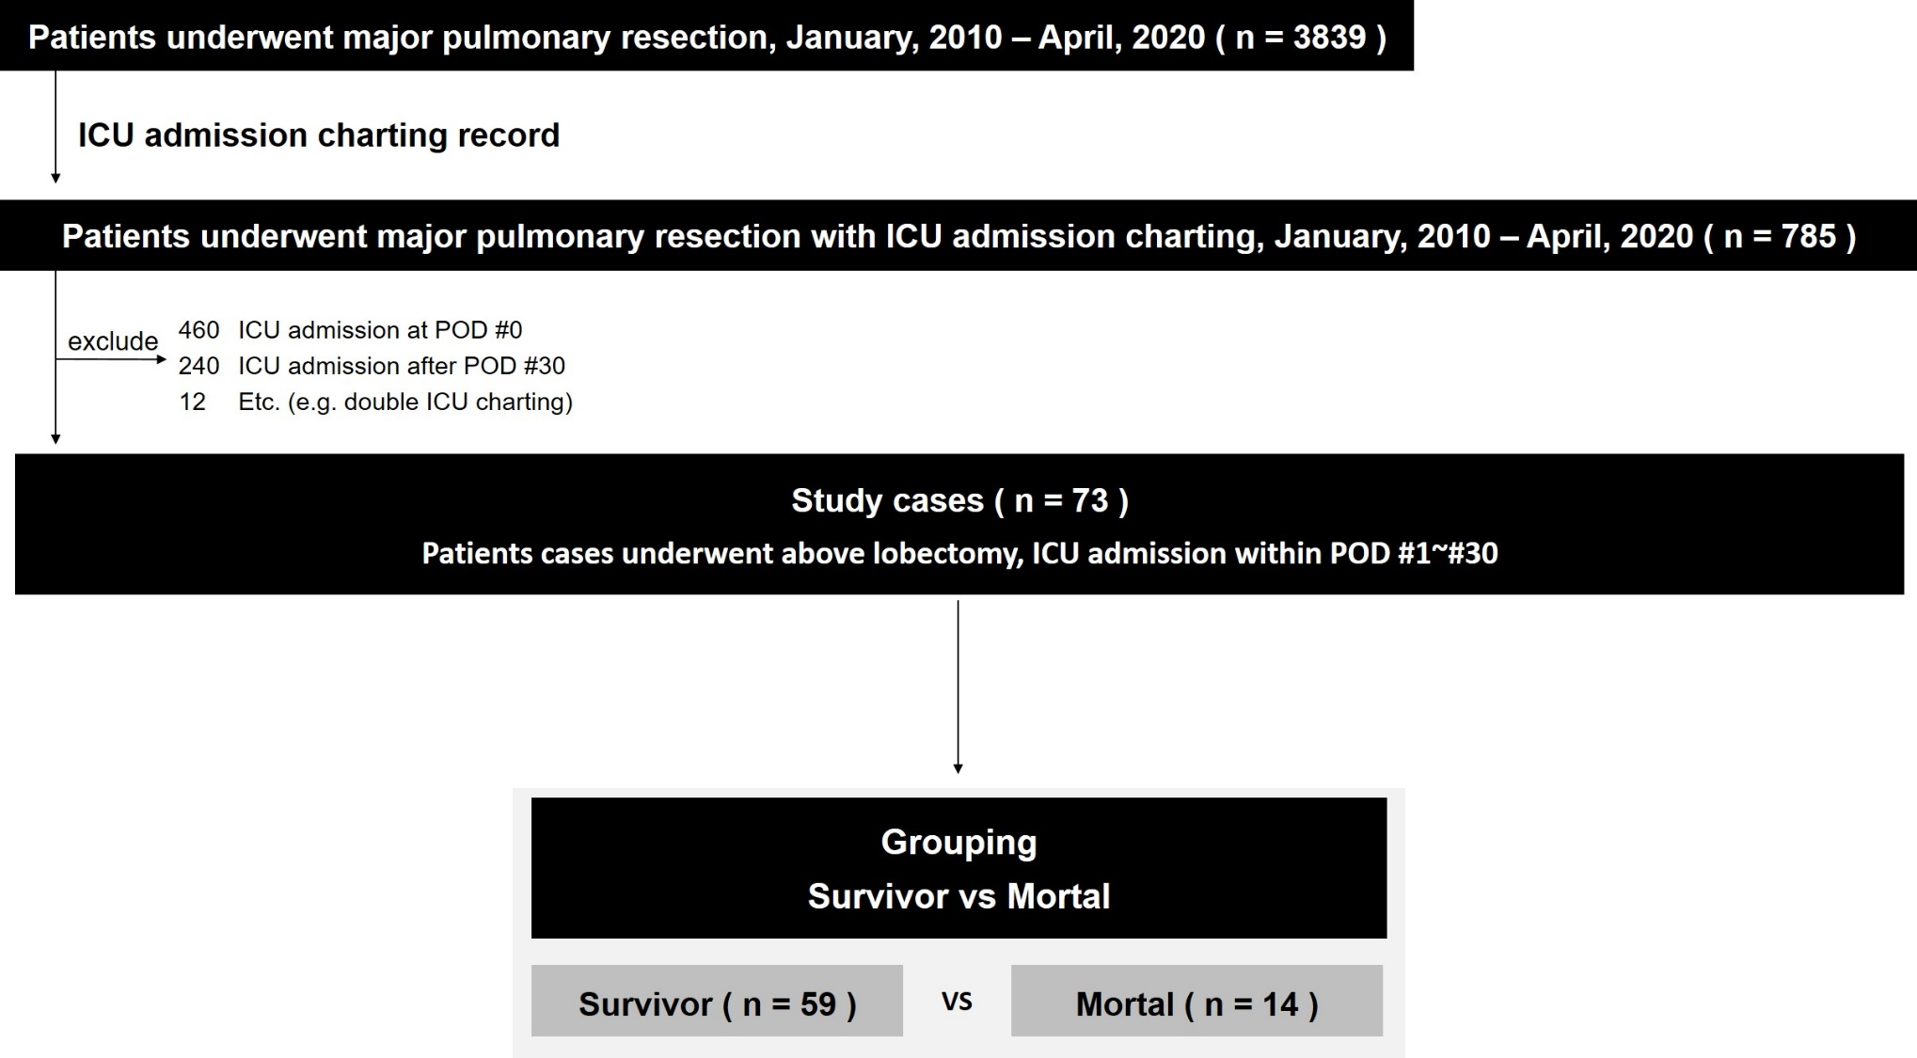

Slide 2
Characteristic | Survivor | Mortal | p Value
Gender (%) |  |  | .121
Male | 50 (84.7) | 14 (100)
Female | 9 (15.3) | 0 (0)
Age (yr, mean) | 65.6±13.0 | 69.2±5.9 | .542
Smoking history (n, %) |  |  | .460
Current | 11 (18.6) | 2 (14.3)
Cessation above one month | 33 (55.9) | 11 (78.6)
Never | 15 (25.4) | 1 (7.1)
Pulmonary function
Preoperative FVC (%, mean) | 94.1±16.1 | 85.5±16.6 | .075
Preoperative FEV1 (%, mean) | 92.6±19.3 | 82.1±23.1 | .094
Preoperative DLco (%, mean) | 89.1±21.1 | 87.0±20.5 | .820
POD of ICU admission (day) | 11.3±11.2 | 19.1±12.1 | .036
APACHE IV Score (mean) | 59.0±20.4 | 80.2±27.1 | .002
Diagnosis |  |  | .660
Malignancy (including metastasis) | 53 (89.8) | 12 (85.7)
Inflammation | 6 (10.2) | 2 (14.3)
Operation
Approach (n, %) |  |  | .322
VATS | 47 (79.7) | 9 (64.3)
Thoractomy | 11 (18.6) | 5 (35.7)
Sternotomy | 1 (1.7) | 0 (0)
Extent (n, %) |  |  | .200
Lobectomy | 53 (59.8) | 11 (78.6)
Bilobectomy | 1 (1.7) | 0 (0)
Pneumonectomy | 5 (8.5) | 3 (21.4)
Characteristic | Survivor | Mortal | p Value
COPD (%) |  |  | .004
No | 46 (78.0) | 5 (35.7)
Yes | 13 (22.0) | 9 (64.3)
IPF (%) |  |  | .022
No | 56 (94.9) | 10 (71.4)
Yes | 3 (5.1) | 4 (28.6)
Cardiovascular history (%) |  |  | .721
No | 45 (76.3) | 12 (85.7)
Yes | 14 (23.7) | 2 (14.3)
Cerebrovascular history (%) |  |  | .192
No | 50 (84.7) | 14 (100)
Yes | 9 (15.3) | 0 (0)
CKD (%) |  |  | .039
No | 55 (93.2) | 10 (71.4)
Yes | 4 (6.8) | 4 (28.6)
Using extracorporeal support (%) |  |  | .012
No | 27 (45.8) | 1 (7.1)
Yes | 32 (54.2) | 13 (92.9)
Anesthesia time (hour, mean) | 4.0±1.7 | 4.1±1.4 | .752
Operation time (hour, mean) | 3.3±1.6 | 3.4±1.3 | .594

Slide 3
 | Univariate analysis Hazard ratio (95% CI) | p Value | Multivariate analysis Hazard ratio (95% CI) | p Value
COPD | 6.369 (1.816-22.334) | .004 | - | -
IPF | 7.467 (1.449-38.539) | .016 | 43.354 (2.443-769.510) | .010
CKD | 5.500 (1.178-25.681) | .030 | 8.015 (0.910-70.613) | 0.061
ICU Admission POD | 1.053 (1.004-1.105) | .033 | 1.109 (1.021-1.203) | .014
APACHE IV Score | 1.039 (1.010-1.068) | .007 | 1.046 (1.007-1.086) | .020
Extracorporeal supports | 10.969 (1.347-89.344) | .025 | 67.256 (1.123-4029.205) | .044

