Slide 1
Clinical Outcome of extracorporeal membrane oxygenation bridged left ventricular assist device implantation

Slide 2
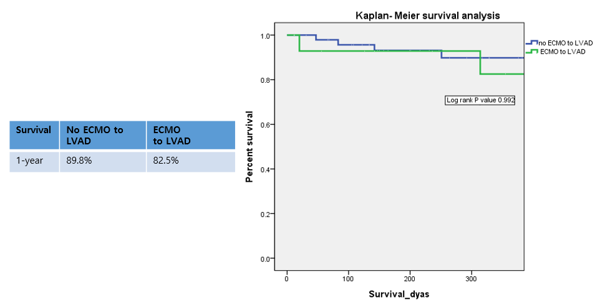
Results
Figure 1

Slide 3
Results

