Slide 1
CT obstruction score
(Qanadli et. al. AJR 2001;176:1415–1420)
Figure 1
CT obstruction score =Σ(n⋅d)
n, value of the proximal thrombus in the pulmonary arterial tree equal to the number of segmental branches arising distally(minimum, 1; maximum, 20)
d, degree of obstruction scored (0:no obstruction, 1:partial obstruction, 2:total obstruction)
The arterial tree of each lung: 10 segmental arteries
Three to the upper lobes
Two to the middle lobe and to the lingual
Five to the lower lobes
Maximal CT obstruction score = 20 + 20 = 40

Slide 2
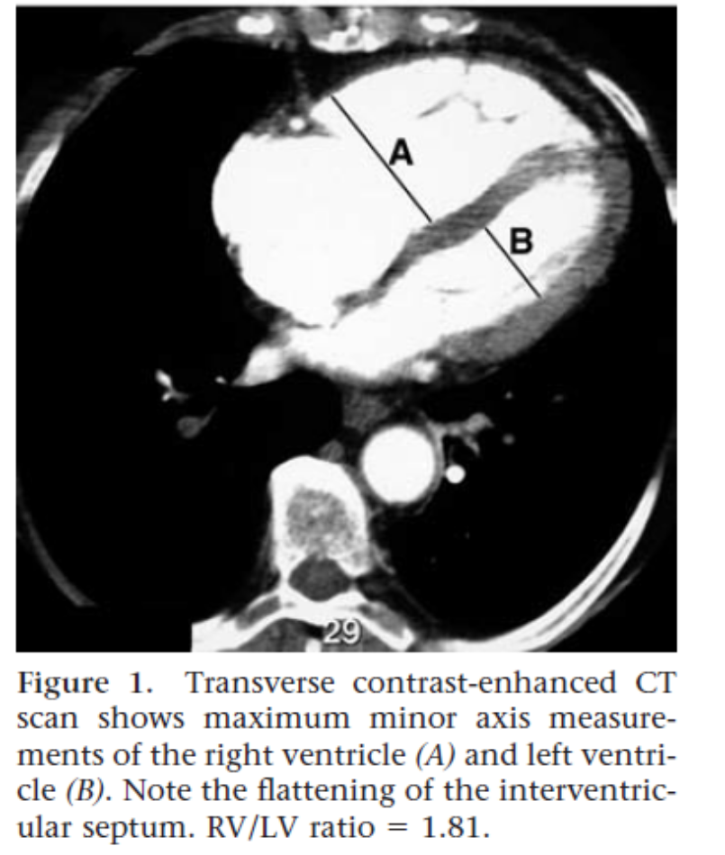
RV/LV ratio
(Radiology 2005; 235:798–803)
Figure 1

Slide 3
Figure 2
Massive PTE
(n=39)
Initial shock(n=16)
(CPR(n=13))
Stable circulation under
Inotropic support (n=23)
Delayed shock(n=5)
(CPR(n=2))
n=13
n=3
n=4
n=2
ECMO(n=15)
Intensive care with mechanical ventilation
(n=7)
Intensive care without mechanical ventilation
(n=18)
9 survivors
3 survivors
18 survivors

