Slide 1
Mitral Valve Myxoma in a Child

Slide 2
Purpose
Cardiac tumors are uncommon relative to other organs of the body. Among them, the most common are myxomas, with 75% arising from the left atrium. Other locations are very rare. We report an unusual case of a young male with a large mxyoma originating from the mitral valve, who presented with fever and multiple embolism.

Slide 3
Method
A 16-year-old male, presented to emergency department with fever, dysuria and multiple digital pain. Abdomen CT revealed bilateral kidney and splenic infarctions. Brain MRI confirmed acute embolic infarctions. However, no neurological signs were observed. Echocardiogram for evaluation of multiple embolism showed approximately 3 X 1.7 cm sized mobile mass attached to the ventricular side of the mitral valve anterior leaflet.

Slide 4
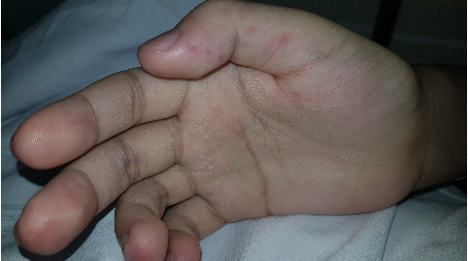
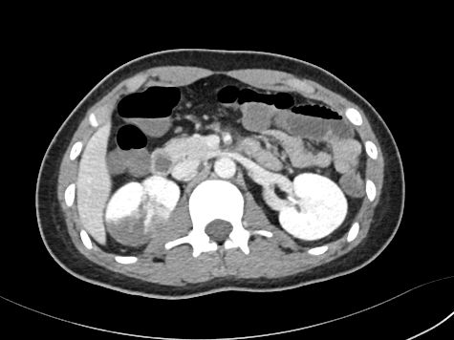
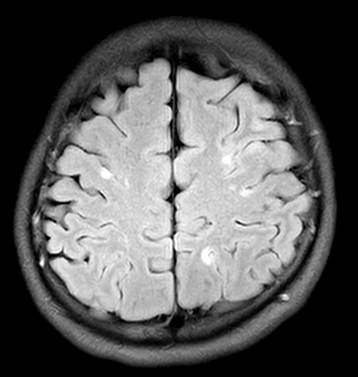
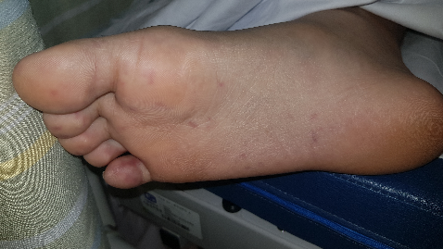
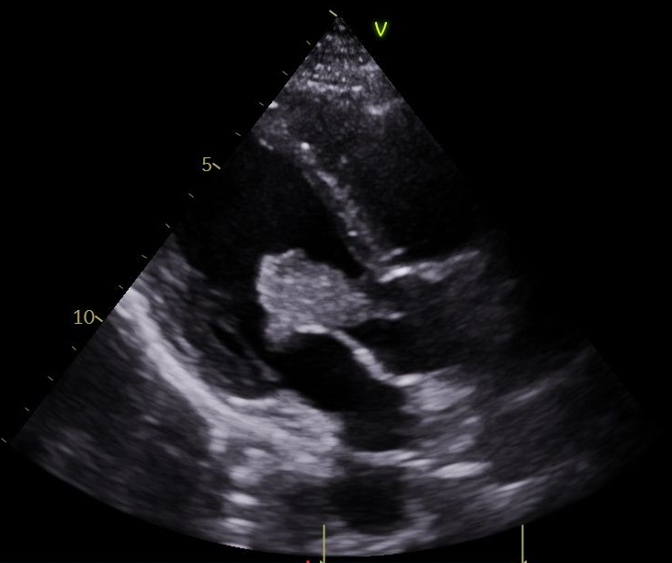
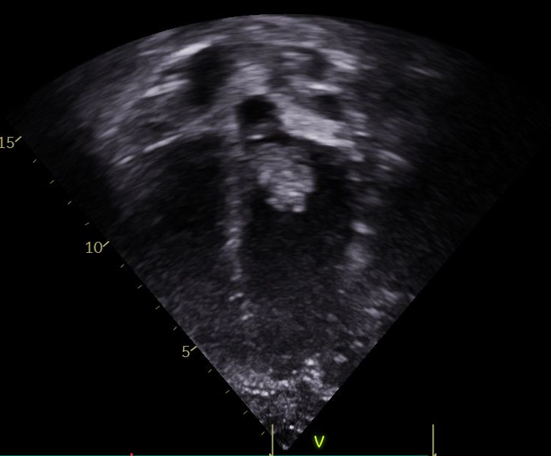
Multiple petechiae of hand and foot
Kidney embolic infarction
Multiple brain embolism
*
*
Mobile mass on anterior leaflet of MV
Mass protruding into LVOT

Slide 5
Results
The patient underwent an operation for tumor resection. A large (3 X 2 cm), friable, pedunculated mass, that was firmly attached to the mitral valve anterior leaflet free margin and primary chordae, was identified and resected. Pre-discharge echocardiography revealed no residual mass and normal mitral valve function. The patient was discharged on postoperative day 8 without complications. Pathologic examination confirmed myxoma.
Notes:
수술 과정도 간략히
CPB cannla : Asc. Ao & bicaval
Approach : trans aortic valve ?
Excision 과정? 방법?
ACC, CPB time: 몇 분 몇분
2X2 table 로
a.수술 필드 영상
b.수술 TEE 영상
c. Excision 된 사진
Bx, H&E stain 사진은 다음 슬라이드 내용 근처에 배치

Slide 6
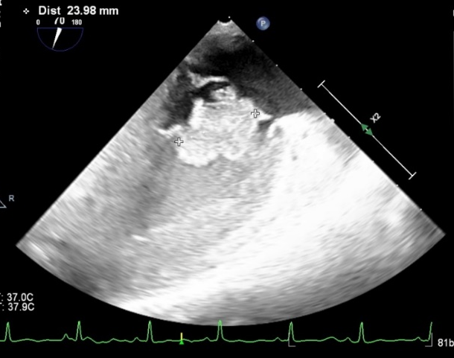
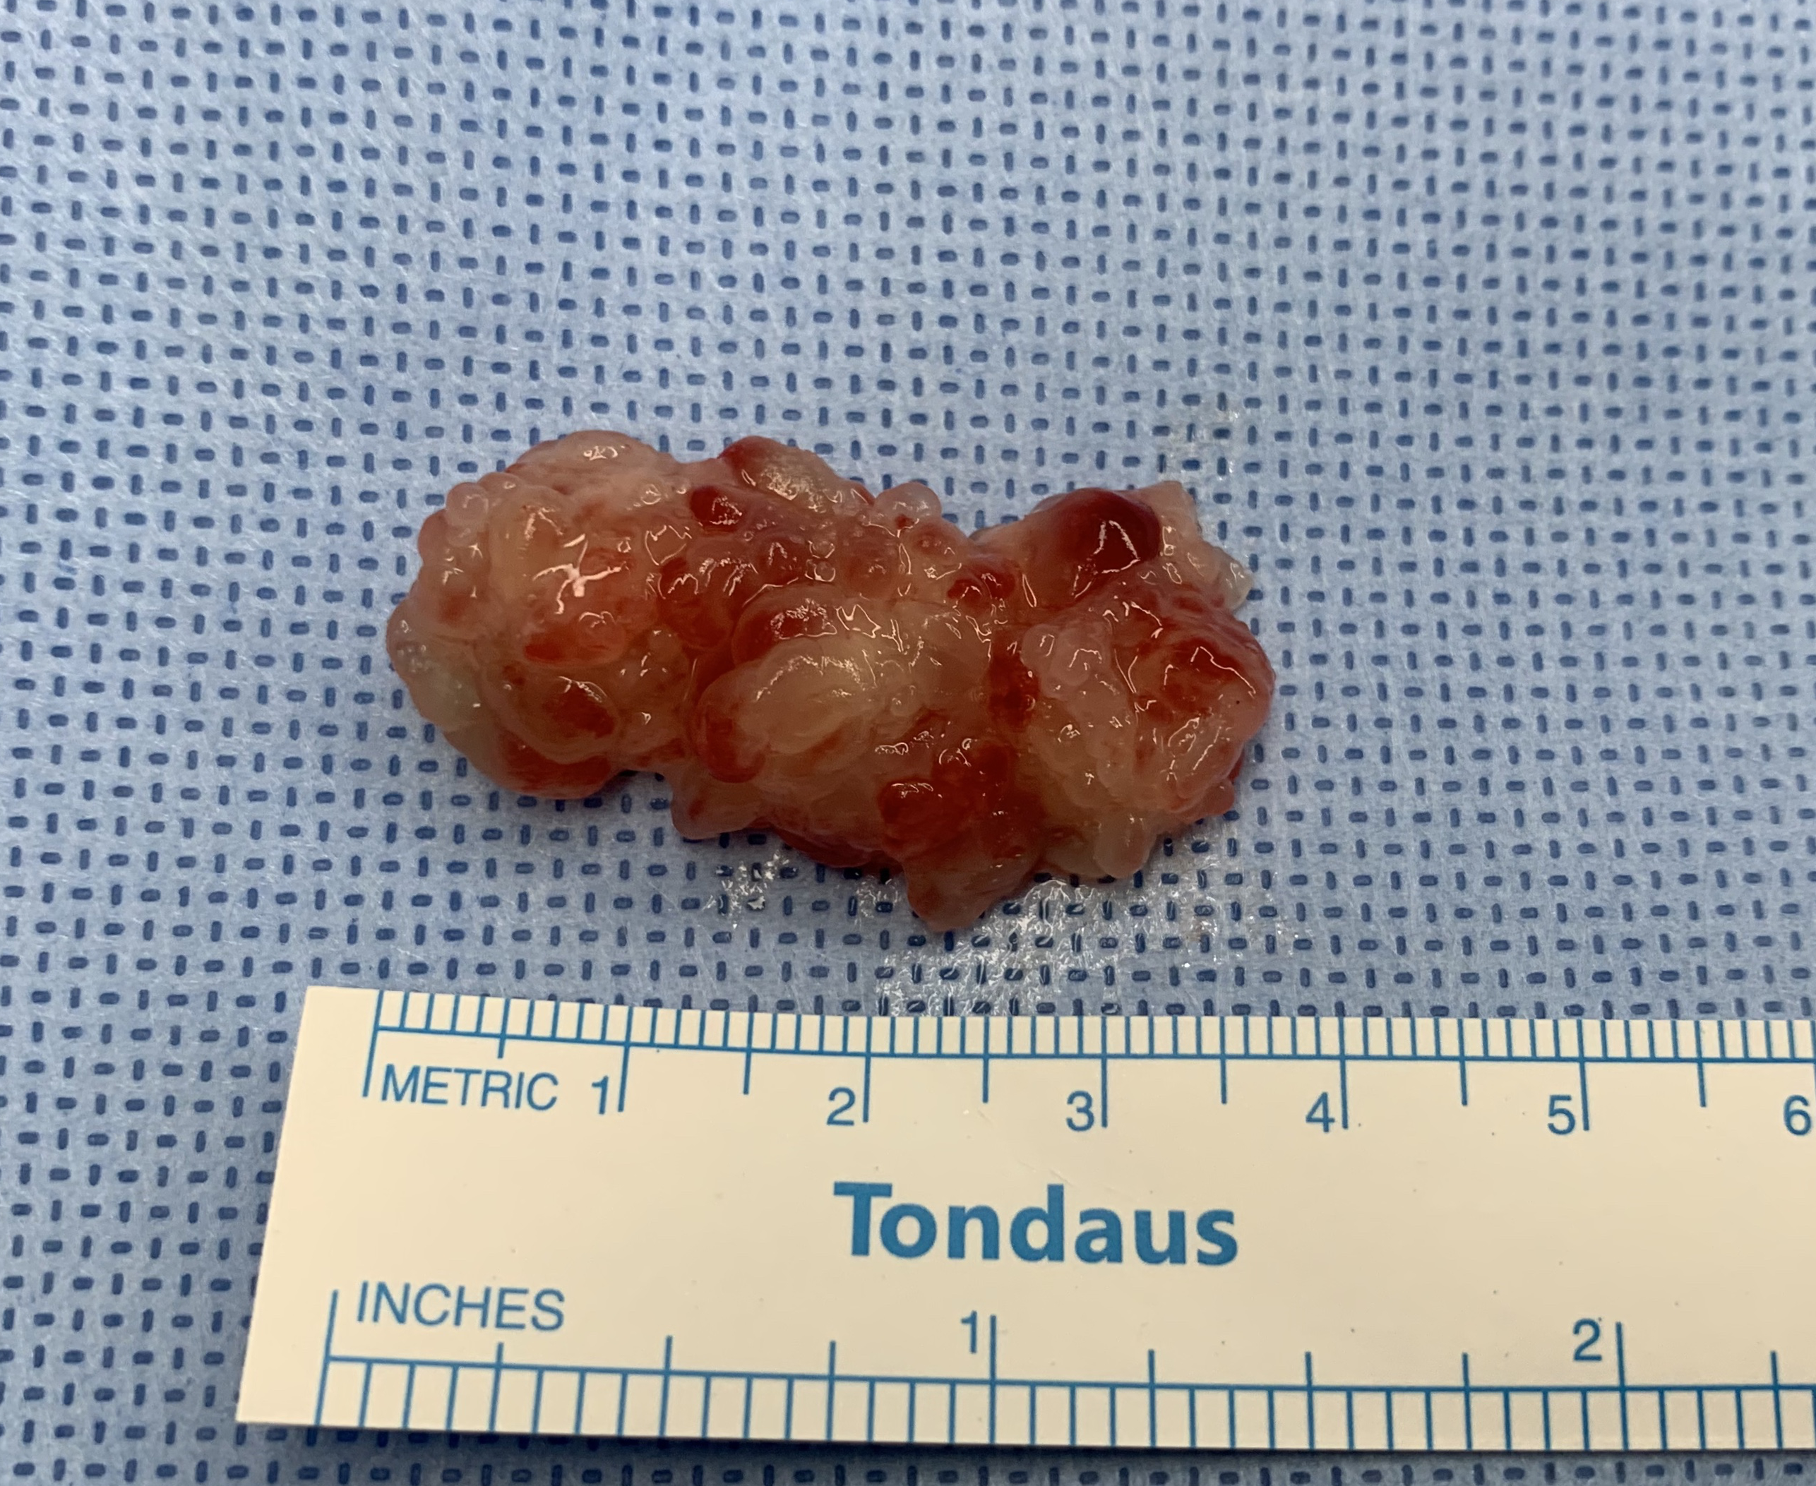
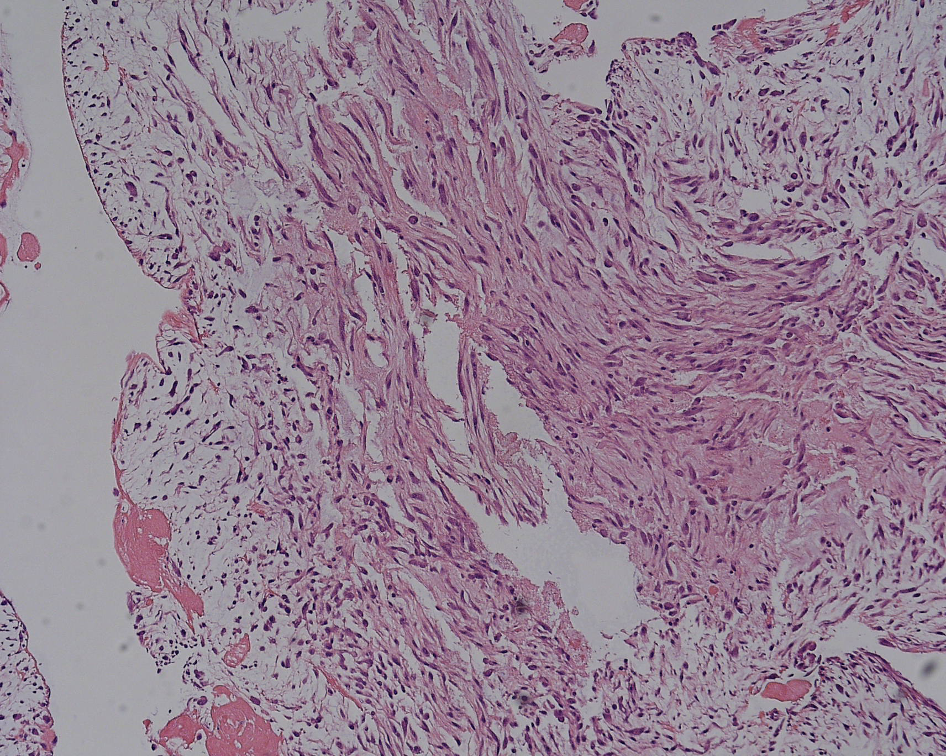
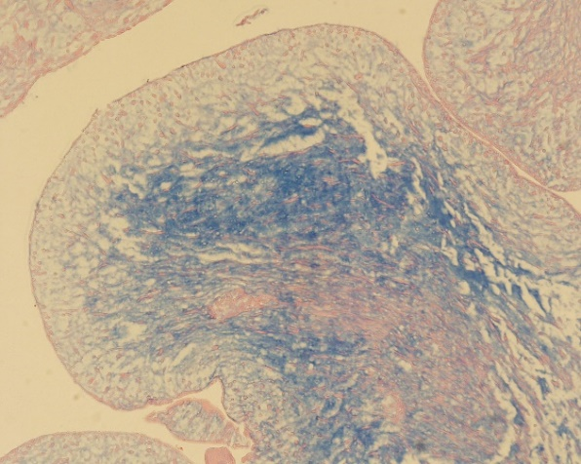
Results
TEE: 2.5cm size mobile mass on AML
H&E stain
Alcian B 2.5: myxoid matrix (+)

Slide 7
Conclusion
We have experienced a very rare case of mitral valve myxoma in a child. Follow-up is mandatory for possible tumor recurrence.

