Slide 1
Figure 1
From 1997 to 2020, surgery for patients with chronic thromboembolic pulmonary hypertension
Exclusion
Reoperative pulmonary endarterectomy (n=1)
Primary pulmonary endarterectomy
in a single center (n=78)
Conventional group :
32 patients
Hybrid group :
46 patients

Slide 2
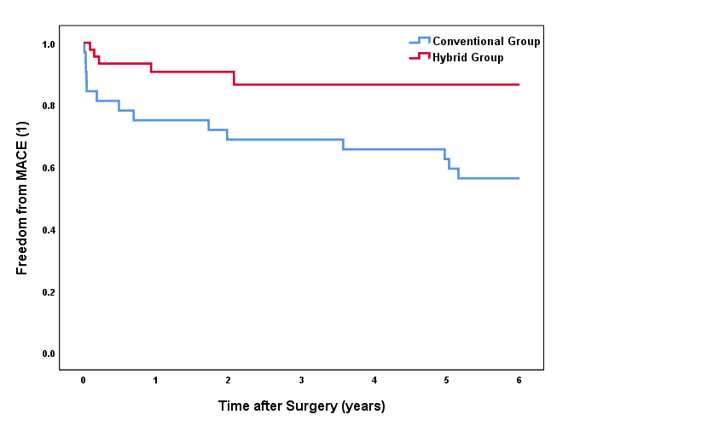
Figure 2-1
Hybrid group:
6 year 86.5%
Conventional group:
6 year 56.3%
Log-rank test
: P=0.023
Notes:
MACE(1) = HF readmission, reoperation (HTPL, redo CTEPH), total death

Slide 3
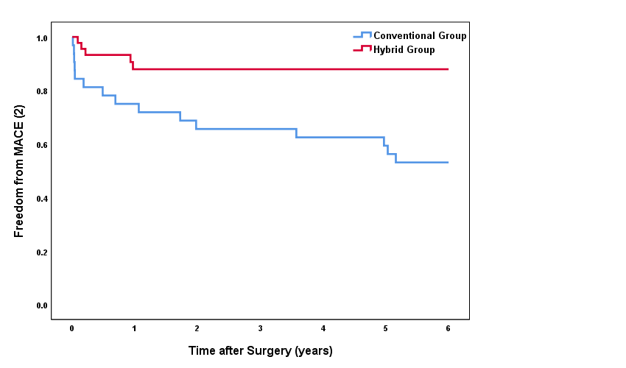
Figure 2-2
Hybrid group:
6 year 88.0%
Conventional group:
6 year 53.1%
Log-rank test
: P=0.011
Notes:
MACE(2) = HF readmission, reoperation (HTPL, redo CTEPH), total death, recurrent PTE/DVT

Slide 4
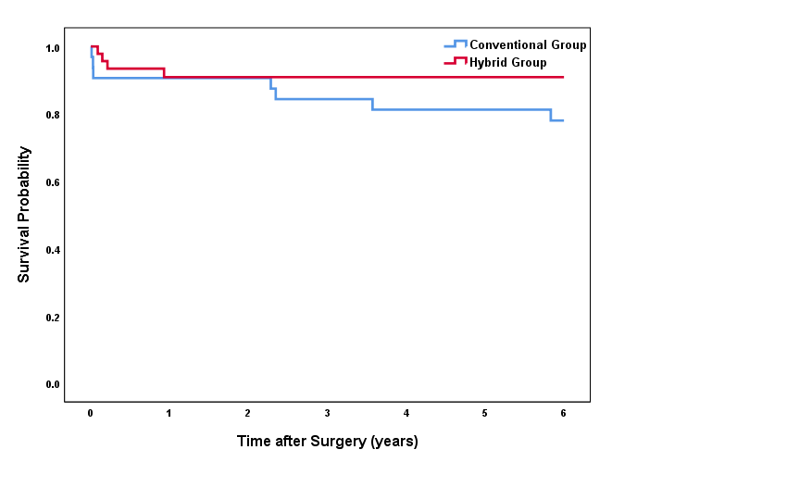
Figure 2-3
Hybrid group:
6 year 90.9%
Conventional group:
6 year 78.0%
Log-rank test
: P=0.365

Slide 5
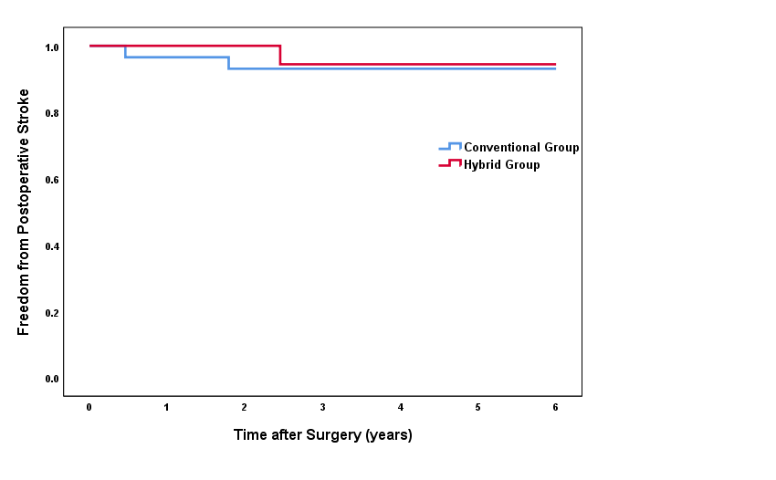
Figure 2-4
Hybrid group:
6 year 94.4%
Conventional group:
6 year 93.1%
Log-rank test
: P=0.598

Slide 6
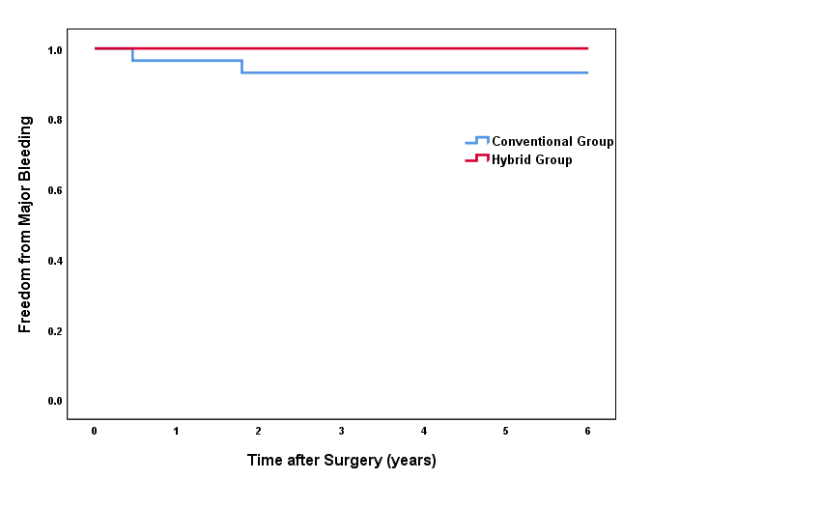
Figure 2-5
Hybrid group:
6 year 100%
Conventional group:
6 year 93.1%
Log-rank test
: P=0.134

Slide 7
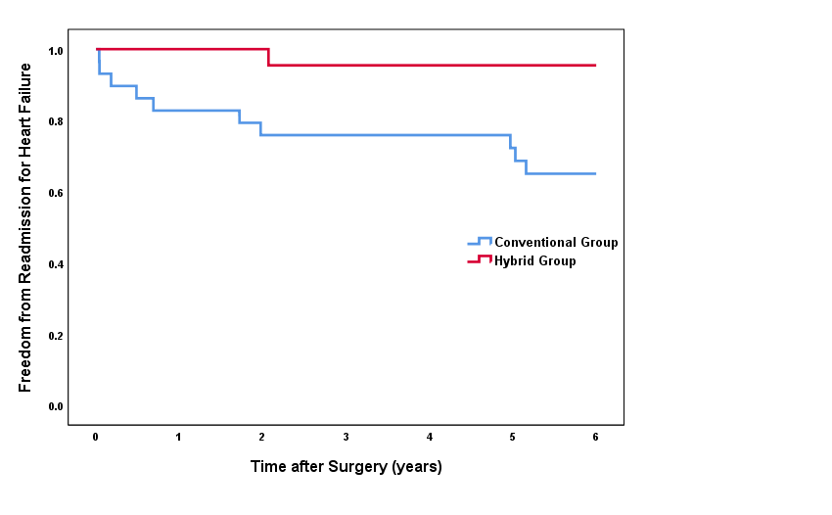
Figure 2-6
Hybrid group:
6 year 95.5%
Conventional group:
6 year 65.0%
Log-rank test
: P=0.008

Slide 8
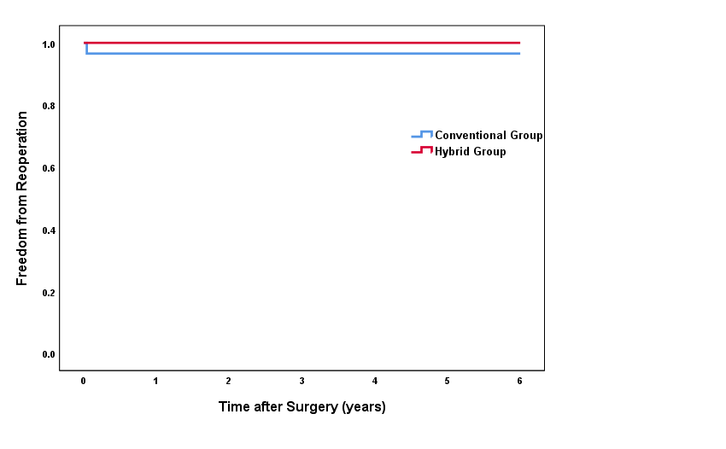
Figure 2-7
Hybrid group:
6 year 100%
Conventional group:
6 year 96.6%
Log-rank test
: P=0.208

Slide 9
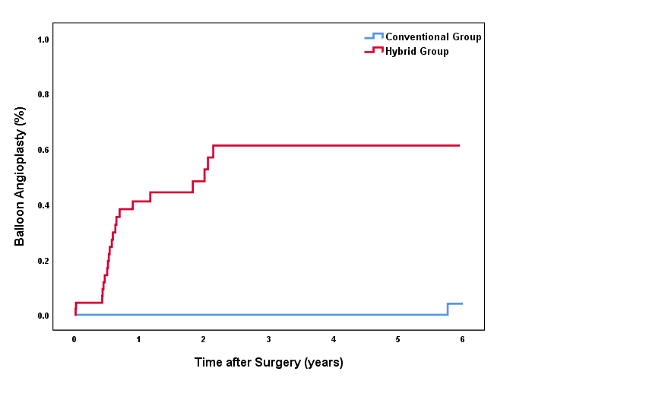
Figure 2-8
Log-rank test
: P<0.001
Hybrid group:
6 year 51.8%
Conventional group:
6 year 96.0%

Slide 10
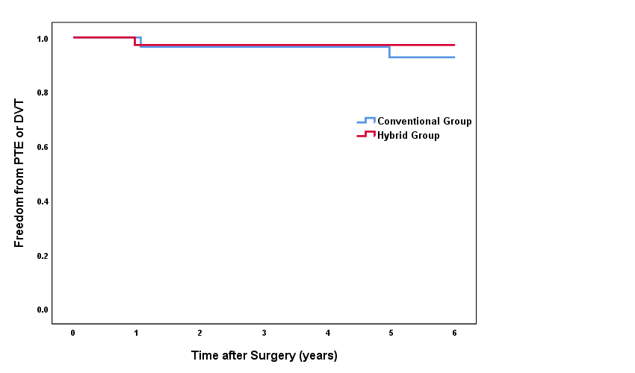
Figure 2-9
Hybrid group:
6 year 97.2%
Conventional group:
6 year 92.7%
Log-rank test
: P=0.715

Slide 11
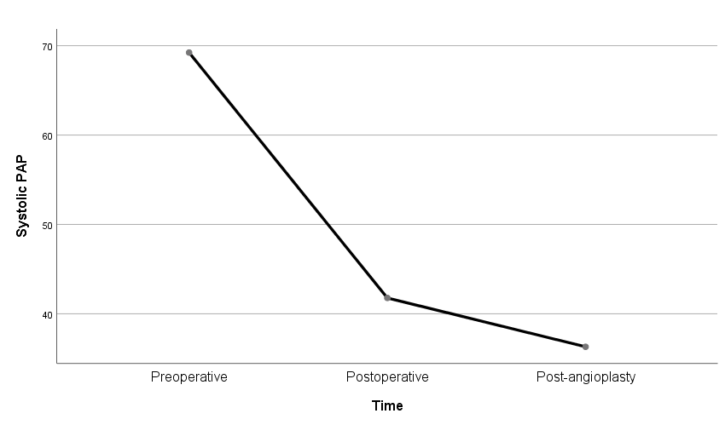
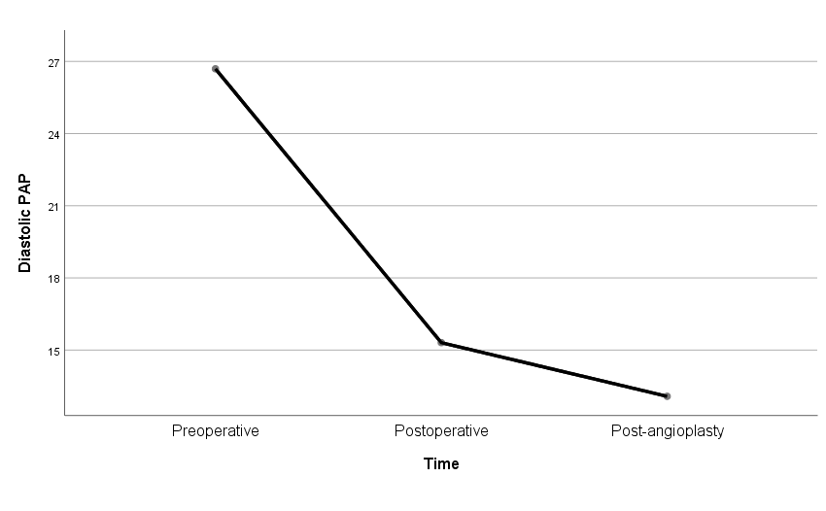
Figure 3. Serial change in the Hybrid group

Slide 12
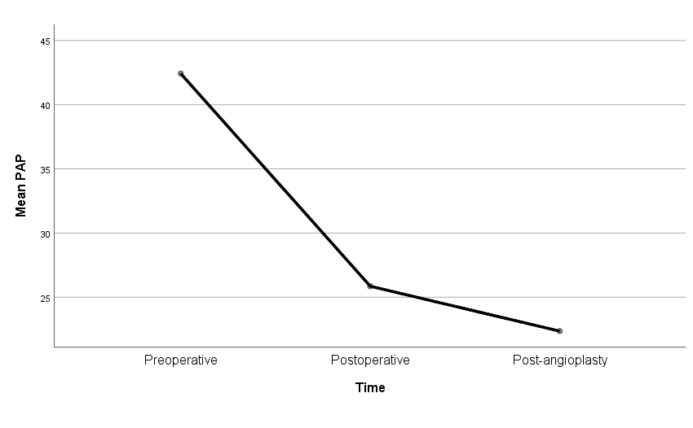
P<0.001
P=0.111

Slide 13
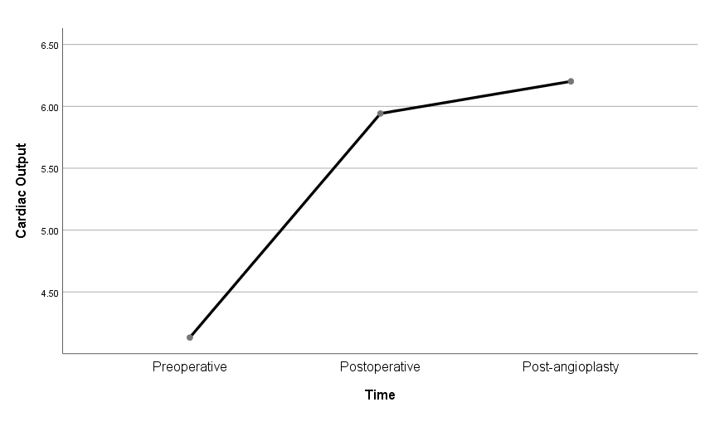
P=0.008
P>0.999

Slide 14
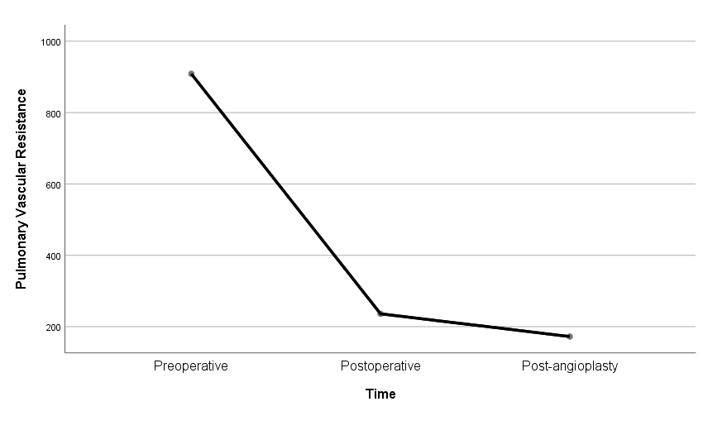
P=0.008
P=0.009

Slide 15
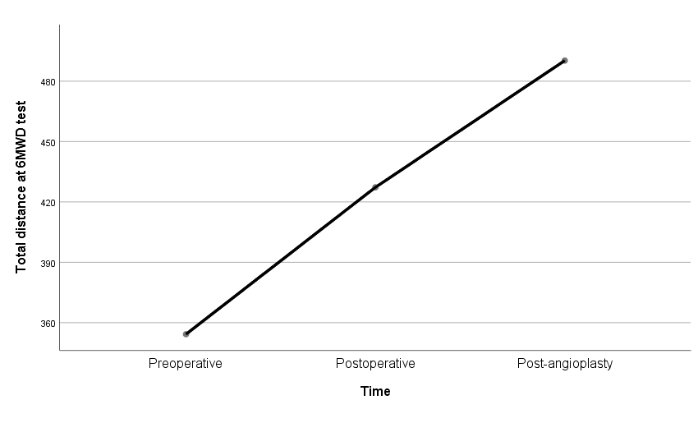
P=0.027
P=0.363

