Slide 1
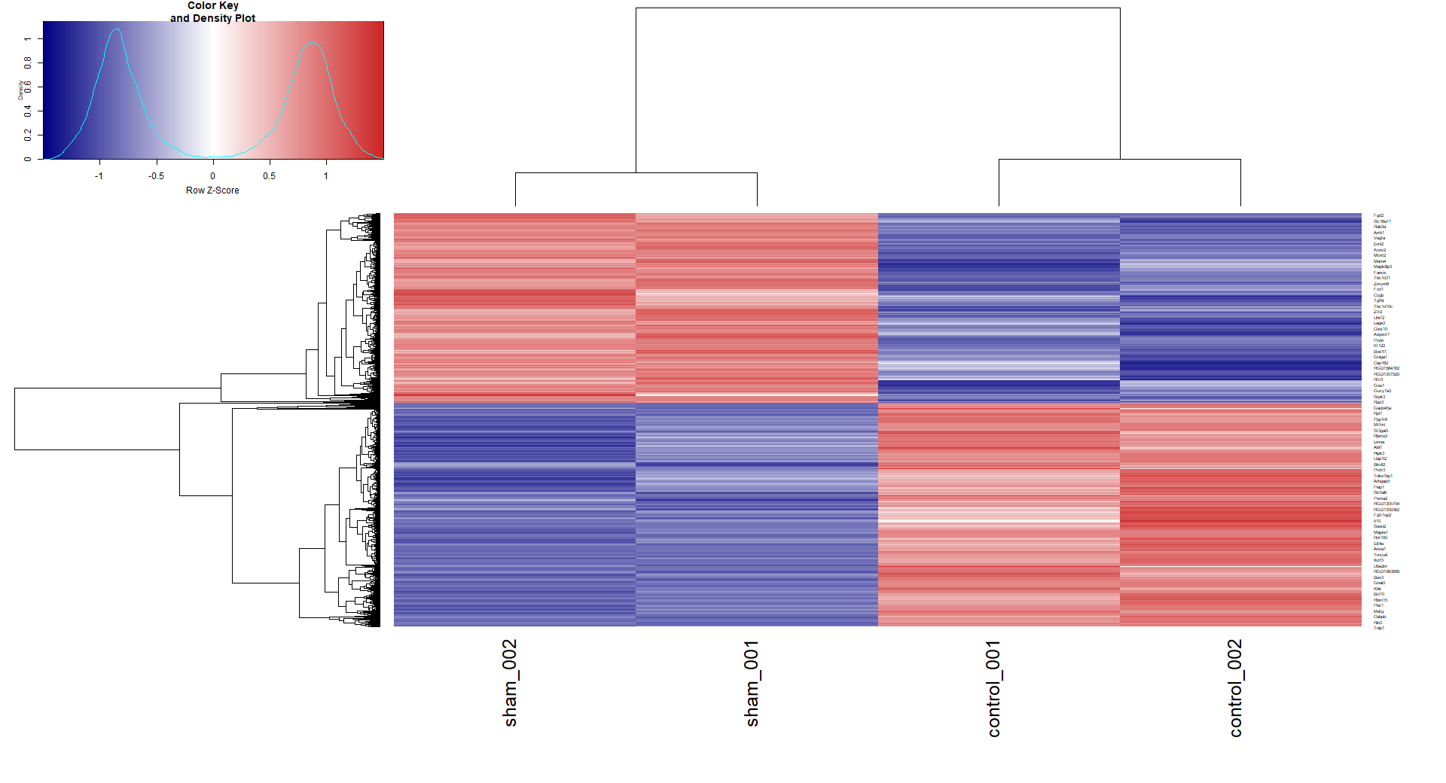
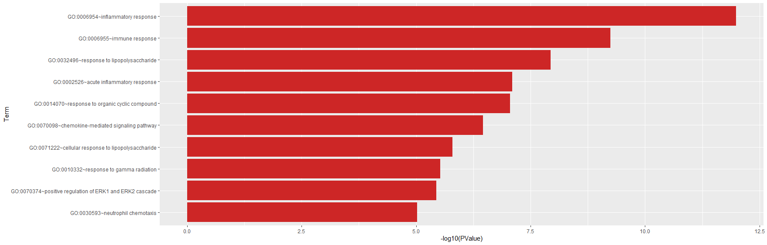
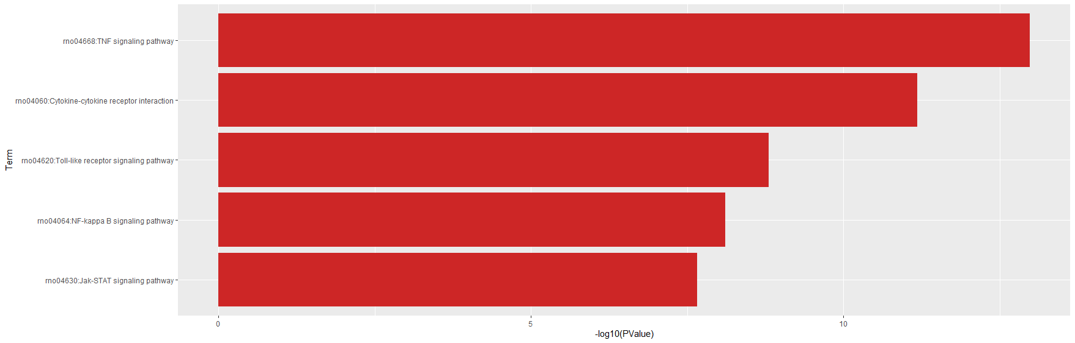
The heatmap of the genes significantly increased or decreased in the control group than in Sham (n=7172, P<0.01).
Top 10 Gene ontology list of the 100 genes that increased most in Control group
Top 5 pathways activated by the top 1000 genes that increase significantly in the control group

Slide 2
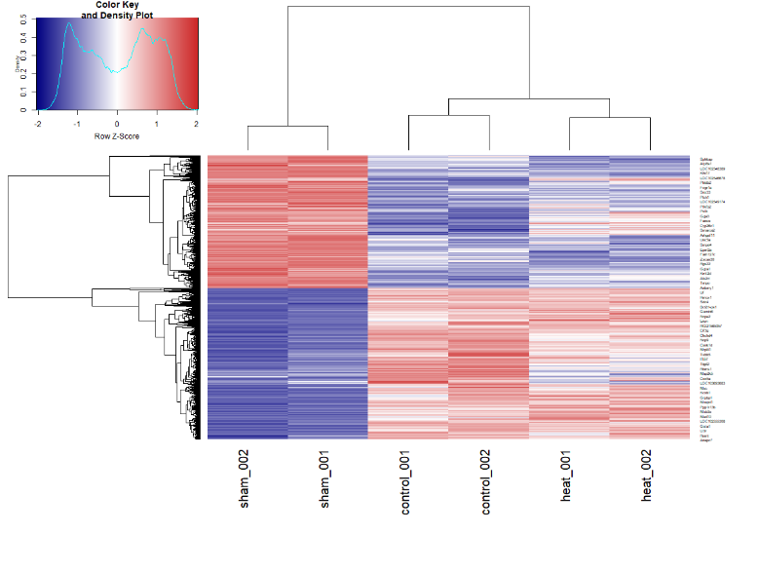
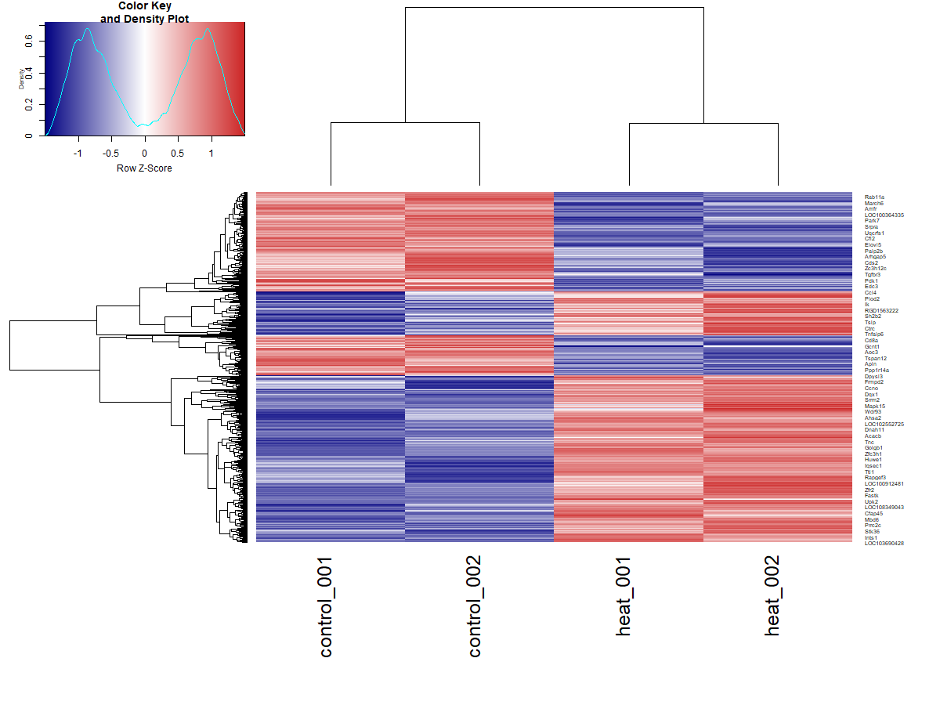
Heatmap of genes that were significantly changed by heat among genes that changed in control compared to Sham (n=1322, P<0.01)

Slide 3
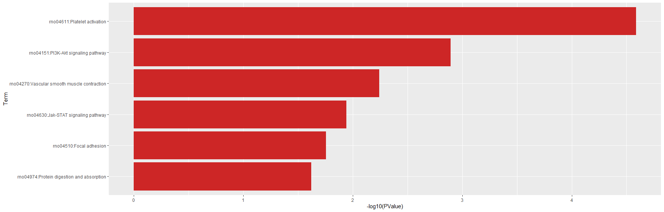
Pathway activated by genes that significantly increased by heat among the genes that changed in control compared to Sham (n=770, P<0.01)

Slide 4
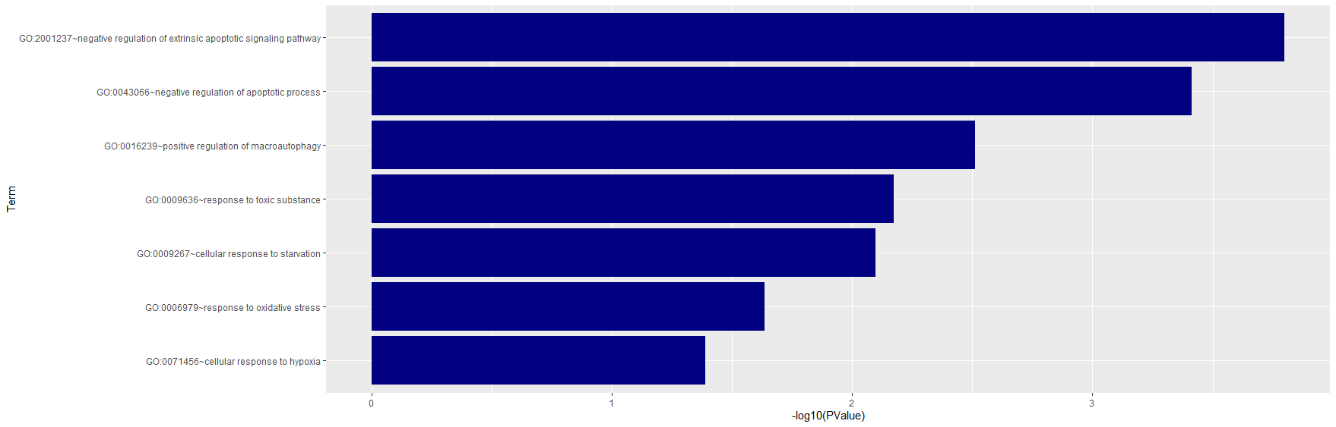
Pathway activated by genes that significantly increased by heat among the genes that changed in control compared to Sham (n=551, P<0.01)

