Slide 1
The impact of prophylactic tricuspid repair in concomitant bioprosthetic aortic valve replacement
Fellow 박일근
Professor 조양현

Slide 2
Introduction
Management of mild to moderate tricuspid regurgitation (TR) in patients with left-sided valve surgery is not clearly defined.
  In mitral valve surgery, concomitant tricuspid annuloplasty had beneficial impact on long-term right sided remodeling (JACC, Joanna Chikwe, et al., 2015)
In aortic valve surgery, the impact of prophylactic tricuspid repair is not defined.

Slide 3
Figure 1
From 1994 to 2019, patients with mild to moderate tricuspid regurgitation and severe aortic stenosis who underwent aortic valve replacement
Exclusion
Concomitant mitral valve repair or replacement
Concomitant mechanical aortic valve replacement
Bioprosthetic AVR (n=120)
Non-TAP group :
89 patients
TAP group :
31 patients

Slide 4
Variable | Total patients
 | Non-TAP group (n=89) | TAP group (n=31) | p-value
Age, years Male sex, n (%) BSA | 73.6±6.4 37 (41.6%) 1.6±0.2 | 73.1±6.3 15 (48.4%) 1.6±0.1 | 0.725 0.534 0.350
Comorbidities Diabetes mellitus Hypertension Previous cerebrovascular accident Chronic kidney disease Previous myocardial infarction Extracardiac arteriopathy Chronic lung disease NYHA functional class 1 2 3 4 Preoperative inotropic support Previous critical status Previous atrial fibrillation EuroSCORE Logistic EuroSCORE | 18 (20.2%) 38 (42.7%) 5 (5.6%) 4 (4.5%) 4 (4.5%) 7 (7.8%) 4 (4.5%) 13 (14.6%) 46 (51.7%) 27 (30.3%) 3 (3.4%) 8 (12.7%) 3 (3.3%) 20 (22.5%) 7.6±2.7 11.1±12.2 | 11 (35.5%) 15 (48.4%) 1 (3.2%) 2 (6.4%) 0 (0%) 0 (0%) 2 (6.4%) 8 (25.8%) 13 (41.9%) 5 (16.1%) 5 (16.1%) 1 (6.2%) 3 (9.7%) 17 (54.8%) 7.2±2.3 9.2±8.0 | 0.143 0.734 0.962 0.733 0.535 0.274 0.733 0.024 0.776 0.099 0.002 0.416 0.339
Preoperative laboratory results Creatinine Estimated glomerular filtration rate | 1.2±1.5 67.0±23.0 | 1.3±1.6 62.3±23.5 | 0.691 0.327

Slide 5
Variable | Total patients
 | Non-TAP group (n=89) | TAP group (n=31) | p-value
Preoperative echo Left ventricular dilation Decreased left ventricular function Left ventricular ejection fraction Right ventricular dilation Decreased right ventricular function Left atrial enlargement Left atrial diameter Left atrial volume index Right atrial enlargement Right atrial diameter Mitral stenosis No Mild Moderate Mitral regurgitation Mild Moderate Right ventricular systolic pressure | 16 (18.0%) 12 (13.5%) 58.4±12.6 5 (10.9%) 4 (8.7%) 75 (85.2%) 45.5±9.2 60.5±29.4 26 (29.5%) 45.8±4.6 81 (93.1%) 5 (5.7%) 1 (1.1%) 39 (44.8%) 12 (13.8%) 44.6±14.3 | 7 (22.6%) 7 (22.6%) 54.5±13.6 5 (22.7%) 5 (22.7%) 30 (96.8%) 50.6±10.1 76.9±32.4 22 (71.0%) 47.2±4.5 27 (87.1%) 3 (9.7%) 1 (3.2%) 20 (64.5%) 5 (16.1%) 49.8 ±14.2 | 0.767 0.363 0.155 0.355 0.224 0.164 0.012 0.022 <0.001 0.311 0.551 0.009 0.093

Slide 6
Variable | Total patients
 | Non-TAP group (n=89) | TAP group (n=31) | p-value
Operative characteristics Type of surgery Elective Urgent Emergent CABG Maze operation Myectomy Ascending aorta replacement CPB time ACC time | 58 (92.1%) 2 (3.2%) 3 (4.8%) 17 (19.1%) 11 (12.4%) 8 (9.8%) 5 (5.6%) 121.7±41.9 89.0±32.0 | 16 (100%) 0 (0%) 0 (0%) 6 (19.4%) 7 (22.6%) 1 (3.2%) 6 (19.4%) 160.3±51.6 121.2±42.7 | 0.508 >0.999 0.280 0.450 0.055 <0.001 <0.001

Slide 7
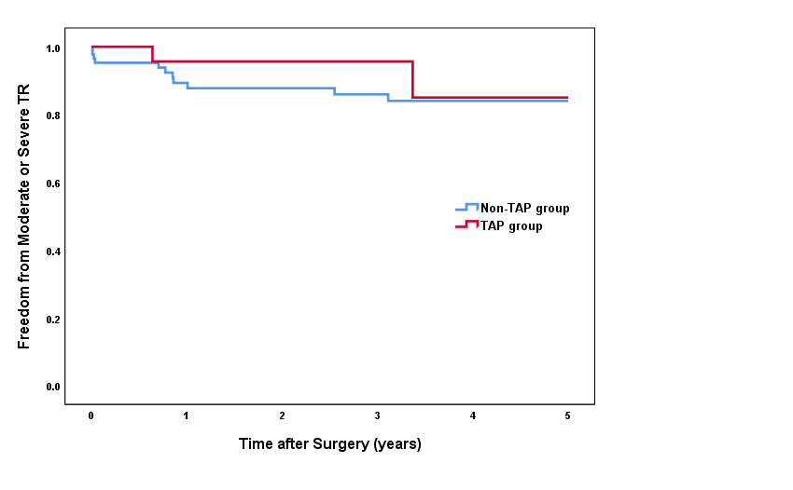
Figure 2
TAP group:
5 year 85.0%
Non-TAP group:
5 year 84.0%
Log-rank test
: P=0.461
Notes:
SR conversion in raw cohort

Slide 8
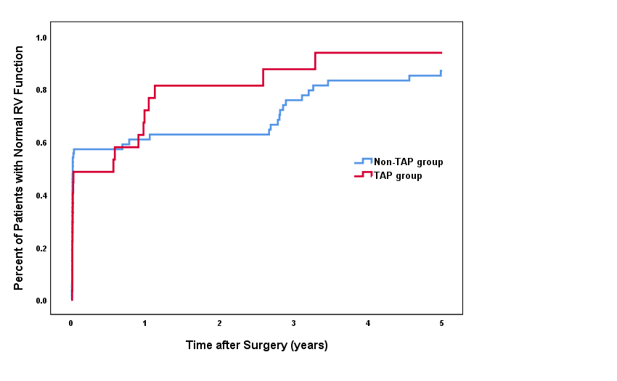
Figure 3
TAP group:
5 year 93.8%
Non-TAP group:
5 year 87.0%
Log-rank test
: P=0.779
Notes:
SR conversion in raw cohort

Slide 9
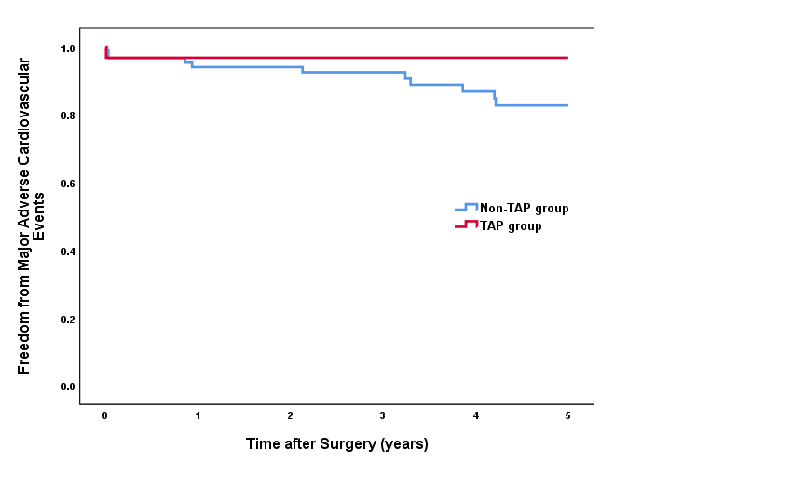
Figure 4
MACE (major adverse cardiovascular event : cardiac death, myocardial infarction, stroke, major bleeding
TAP group:
5 year 96.8%
Non-TAP group:
5 year 82.7%
Log-rank test
: P=0.207
Notes:
SR conversion in raw cohort

Slide 10
Percentage of Patients with RV dilation
Percentage of Patients with RV dysfunction

Slide 11
Univariable and Multivariable analysis for RV dysfunction at last follow-up
Variable | Multivariable analysis
 | Odds Ratio | 95% Confidence Interval | p-value
NYHA Functional Class 1 2 3 4 | 1 0.332 0.181 3.342 | 0.087-1.268 0.043-0.765 0.327-34.143 | 0.064
Preoperative echo Left atrial volume index Right atrial diameter | 1.015 1.111 | 1.003-1.028 1.012-1.219 | 0.015 0.027
Tricuspid annluoplasty | 0.959 | 0.581-1.581 | 0.869

