Slide 1
Contemporay outcome after pulmonary artery banding in complete atrioventricular septal defect: how the band tightness affect the outcome?

Slide 2
Purpose
Pulmonary artery banding (PAB) remains a surgical option for patients with complete atrioventricular septal defect (AVSD) presenting earlier.
This study investigated the outcomes after PAB in patients with complete AVSD.

Slide 3
Methods
From 2000 through 2019, a total of 34 infants (median age, 2.09months) who underwent PAB for complete AVSD were included in this study.
Preoperative and operative characteristics were analyzed as independent variables for identifying factors associated with adverse outcome, which was defined as prolonged stay in the intensive care unit (>10 days) or in-hospital death, using multiple logistic regression model.
ROC analysis indicated 4.69mm in diameter measured by echocardiography during immediate postoperative period as a threshold band tightness for adverse outcome (AUC 0.854, 95% CI 0.705~1.000).

Slide 4
Results
The median age and weight were 43 days (IQR, 22~64 days) and 3.6 kg (IQR, 2.7~4.1kg), respectively.
There were 4 in-hospital deaths.
Median ICU stay and hospital stay were 8 days (6~14 days), and 14 days (9~22 days), respectively.
Twenty six patients (26/30, 87%) underwent corrective surgery at a median of 337 days after PAB.
In multivariable analysis, preoperative use of intravenous inotropes (OR 5.33, CI 1.16~24.47; p=0.031), ventilator care (OR 10, CI 1.59~63.1; p=0.014) and Loose band (<4.69mm) (OR 63.0, CI 5.75~690.37; p=0.001) were identified as significant factors associated with adverse outcome (Table).
The level of B-natriuretic peptide similarly decreased after PAB regardless of band tightness, although the probability of worsening in atrioventricular valve regurgitation was decreasing in patients with tighter band (Figure).

Slide 5
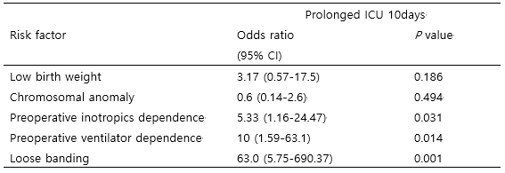
Table

Slide 6
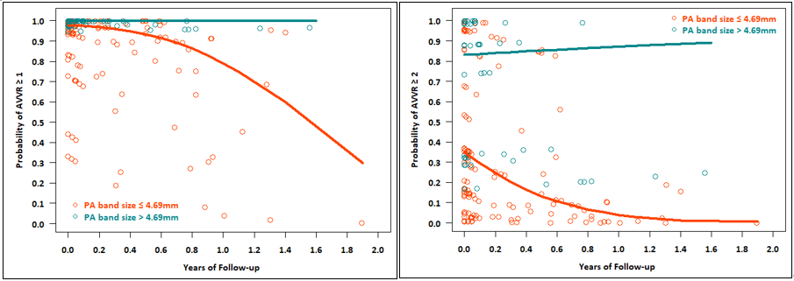
Figure

Slide 7
Conclusion
PAB is a viable option for patients with early presenting complete AVSD. Tighter band might be better in terms of immediate postoperative outcomes and AVV regurgitation.

