Slide 1
Surgical outcome of plication for diaphragmatic eventration in infants after congenital heart surgery
공지사항
  소속기관이나 저자명이 드러나지 않도록 해주세요.
  제목 슬라이드 제외 최대 6장, Font size 20 이상
  사진/illustration등으로 인해 용량이 큰 경우 PDF로 전환해서 접수

Slide 2
Introduction
Plication
- An effective treatment for diaphragm paralysis
- Congenital heart surgery as follows
(weaning failure from ventilator, respiratory distress, lung infection)

Slide 3
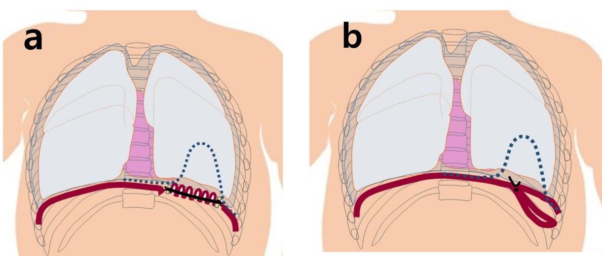
Introduction
Indentify effect of plication
- Short term and long term
- For diaphragm paralysis after congenital heart surgery
a. Thoracotomy – pleating technique
b. VATS – invaginating technique

Slide 4
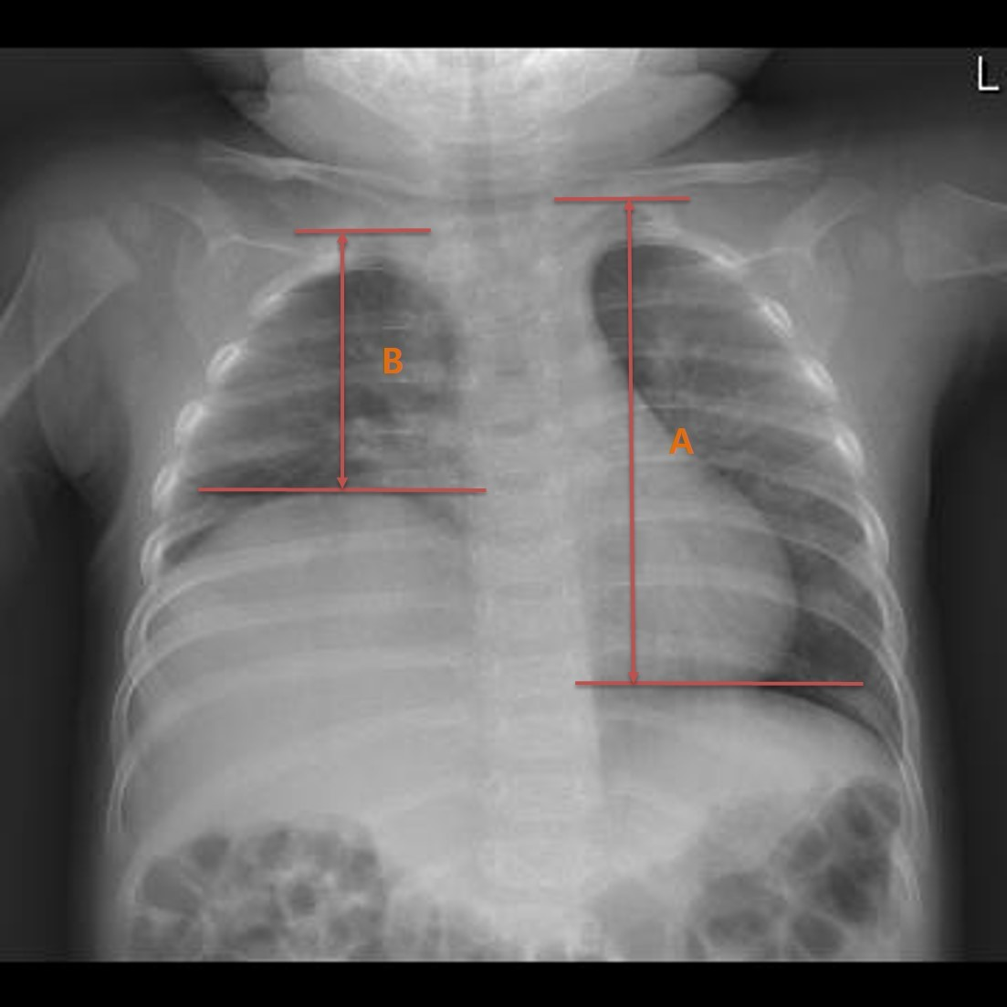
Methods
From March 2007 to May 2019
14 patients
(phrenic nerve palsy after congenital
cardiac surgery)
Eventration level calculated as a percentage by using the B/A ratio
Calculation fomula
: 100 − (100 × B/A)
A: from the peaks of the normal hemidiaphragm to apex
B: from the peaks of the eventrated hemidiaphragm to apex
Ozkan S, et al. Is surgical plication necessary in diaphragm eventration?
Asian J Surg. 2016;39:59-65.

Slide 5
Results (Short-term)
 | Total (14)
Male: Female | 10 : 4
Ages (months) | 5.1 ± 5.5
Laterality (Right. : Left.) | 4 : 10
Thoracotomy : Thoracoscopy | 12 : 2
Ventilator care before plication (days) | 5.8 ± 14.1
Ventilator care after plication (days) | 5.4 ± 5.0
Operation time (mins) | 107.9 ± 33.4
Hospital stay (days) | 40.2 ± 30.9
Post-operative stay (days) | 22.3 ± 18.9
Reoperation due to plication failure | 2 (14.3%)
Follow up duration (months) | 69.0 ± 56.8
Reoperation due to plication failure (e.g. stitch rupture)
: 2 patients (e.g. stitch rupture)
Supported mechanical ventilator care before plication : 6 patients (Duration of postoperative ventilator care: 5.4 ± 5.0days)
Mean ventilator care duration
- Before : 5.8 ± 14.1 days
- After : 5.4 ± 5.0 days

Slide 6
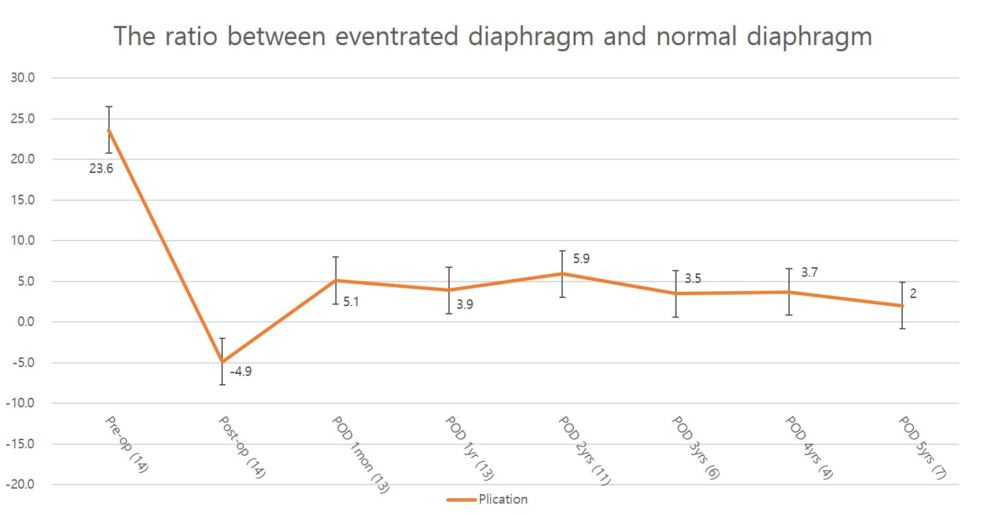
Results (Long-term)
Mean follow-up duration : 69.0 ± 56.8 months
Mean eventration rate
- before operation : 23.6 ± 8.0%,
- first postoperative month : 5.1% ± 8.7%,
- 12th postoperative month : 3.9% ± 5.7%
Degree of diaphragm elevation : maintained well (1yr-5yrs)
No recurrence of diaphragmatic eventration

Slide 7
Conclusion
Plication
- effective treatment option
for diaphragm paralysis after congenital heart surgery
- helpful in the growth of thoracic cages and lung volume

