Slide 1
Right Mini-thoracotomy Approach for Infective Endocarditis
공지사항
  소속기관이나 저자명이 드러나지 않도록 해주세요.
  제목 슬라이드 제외 최대 6장, Font size 20 이상
  사진/illustration등으로 인해 용량이 큰 경우 PDF로 전환해서 접수

Slide 2
Purpose
A mini-thoracotomy (MT) approach has been widely adopted in cardiac surgery, but some concerns are remained in infection control for endocarditis with this approach
Aims of the study was to report:
  Early clinical outcomes of IE with MT approach
  Mid-term follow up data for infection control

Slide 3
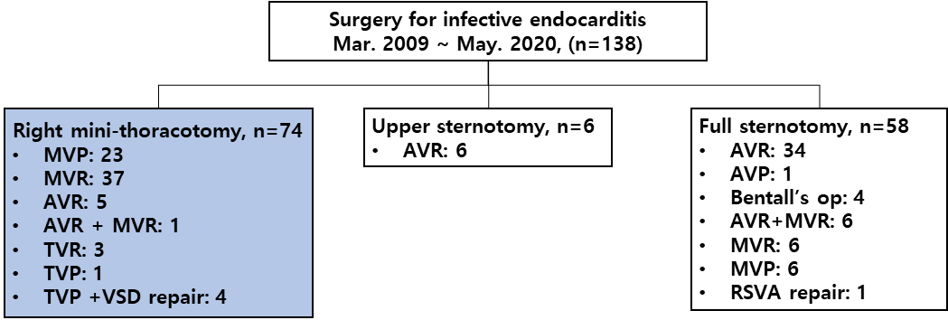
Methods
Retrospective study of prospectively collected database in tertiary, referral, academic center
MT approach was primary approach and applied whenever possible in our program
All patients had undergone MT approach for IE was reviewed

Slide 4
Results 1
Preoperative data | Overall (n=74)
Age, years | 49.9 ± 17.0
Female gender | 21 (28.4%)
BSA,㎡ | 1.7 ± 0.2
HTN | 21 (28.4%)
DM | 12 (17.2%)
Atrial fibrillation | 12 (16.2%)
Stroke | 41 (55.4%)
CRF on dialysis | 4 (5.4%)
Chronic obstructive pulmonary disease | 8 (10.8%)
LV ejection fraction, (%) | 62.8 ± 6.5
NYHA functional class, n (%)
I | 18 (24.3%)
II | 26 (35.1%)
III | 14 (18.9%)
IV | 16 (21.6%)
Urgency | 28 (37.8%)
Emergency, n (%) | 34 (45.9%)
Previous cardiac surgery | 5 (6.8%)
CRP | 8.9 ± 8.0
EuroSCORE II | 18.3 ± 11.6
Critical preoperative state | 16 (21.6%)
Operative data | Overall (n=74)
Days diagnosis to surgery | 0.5 [0.0;3.0]
Days symptom onset to surgery | 12.0 [7.0;30.0]
Location of infection
Mitral valve | 61 (82.4%)
Aortic valve | 5 (6.8%)
Tricuspid valve | 4 (5.4%)
Ventricular septal defect | 4 (5.4%)
Active endocarditis | 62 (83.8%)
Vegetation | 65 (87.8%)
Vegetation size, mm | 12.5 ± 11.6
Annular abscess | 15 (20.3%)
Microbiology
Culture negative endocarditis | 30 (40.5%)
Staphylococcus spp. | 10 (13.5%)
Streptococcus spp. | 24 (32.4%)
Enterococcus spp. | 5 (6.8%)
Klebsiella spp. | 2 (2.7%)
Hemophilus spp. | 2 (2.7%)
Abiotrophia spp. | 1 (%)
Replacement of infected valve | 45 (60.8%)
Repair of infected valve | 29 (39.2%)
Cardiopulmonary bypass time, minutes | 120.7 ± 44.3
Aortic cross-clamp time, minutes | 82.4 ± 33.3

Slide 5
Results 2
Postoperative outcomes | Overall (n=74)
Early mortality, n (%) | 5 (6.8%)
Major complications
Acute renal failure | 0
Stroke, n (%) | 3 (4.1%)
New dialysis | 3 (4.1%)
Low cardiac output syndrome | 13 (17.6%)
Mechanical support | 0
Arrhythmia | 14 (18.9%)
Permanent pacemaker | 0
Pulmonary complications, | 10 (13.5%)
Prolonged ventilation over 24 hours | 8 (10.8%)
Reoperation for bleeding | 1 (1.4%)
Transfusion incidence | 49 (66.2%)
Chest tube drain within 12 h, ml | 257.4 ± 216.1
ICU stay, hours | 25.0 [21.0;47.0]
Surgery department stay, days | 5.5 [3.0;8.0]
Follow up duration, month | 47.4 ± 39.7
Recurrent endocarditis | 2 (2.7%)
Late mortality, n (%) | 11 (14.9%)
Last echocardiographic data | Overall (n=70)
Echocardiographic follow up, months | 27.0 ± 33.0
LV ejection fraction, (%) | 59.7 ± 9.2
Mitral regurgitation > +1 | 1 (1.4%)
Aortic regurgitation > +1 | 0
Tricuspid regurgitation > +1 | 2 (2.8%)
Paravalvular regurgitation after replacement | 3/43 (7.0%)
Residual regurgitation after mitral repair > +1 | 1/27 (3.7%)

Slide 6
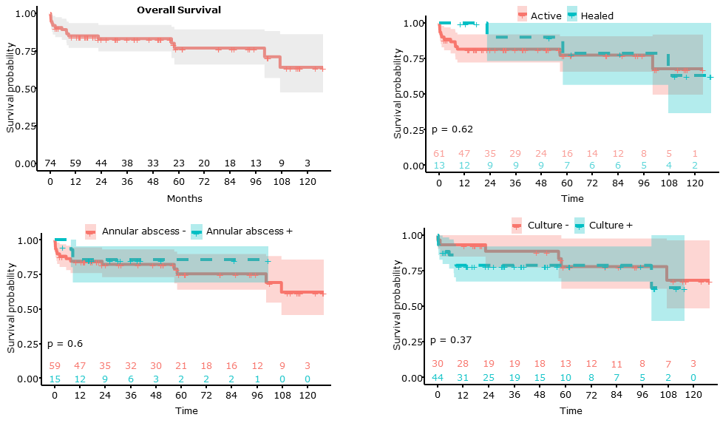
Results 3

Slide 7
Conclusion
MT approach for IE showed
  Excellent early postoperative results
  Durable mid-term echocardiographic outcomes
  Acceptable overall survival in mid-term follow-up
  Comparable mid-term survival in complicated cases: active, culture positive, and annular abscess formation
The mini-thoracotomy approach is plausible option to treat patients with infective endocarditis

