Slide 1

Unexpected N2 LN metastasis in early lung adenocarcinoma without hilar/interlobar LN metastasis

Slide 2
Purpose
It has not been widely reported that how N2 LN metastasis (N2M), especially non-lobe specific LN metastasis (non-LSN2M), manifested in patients with early lung adenocarcinoma (ADC) not accompanying hilar/interlobar LN metastasis.
The purpose of our study was to investigate the variables affecting N2M and non-LSN2M in early ADC without hilar/interlobar LN metastasis.

Slide 3
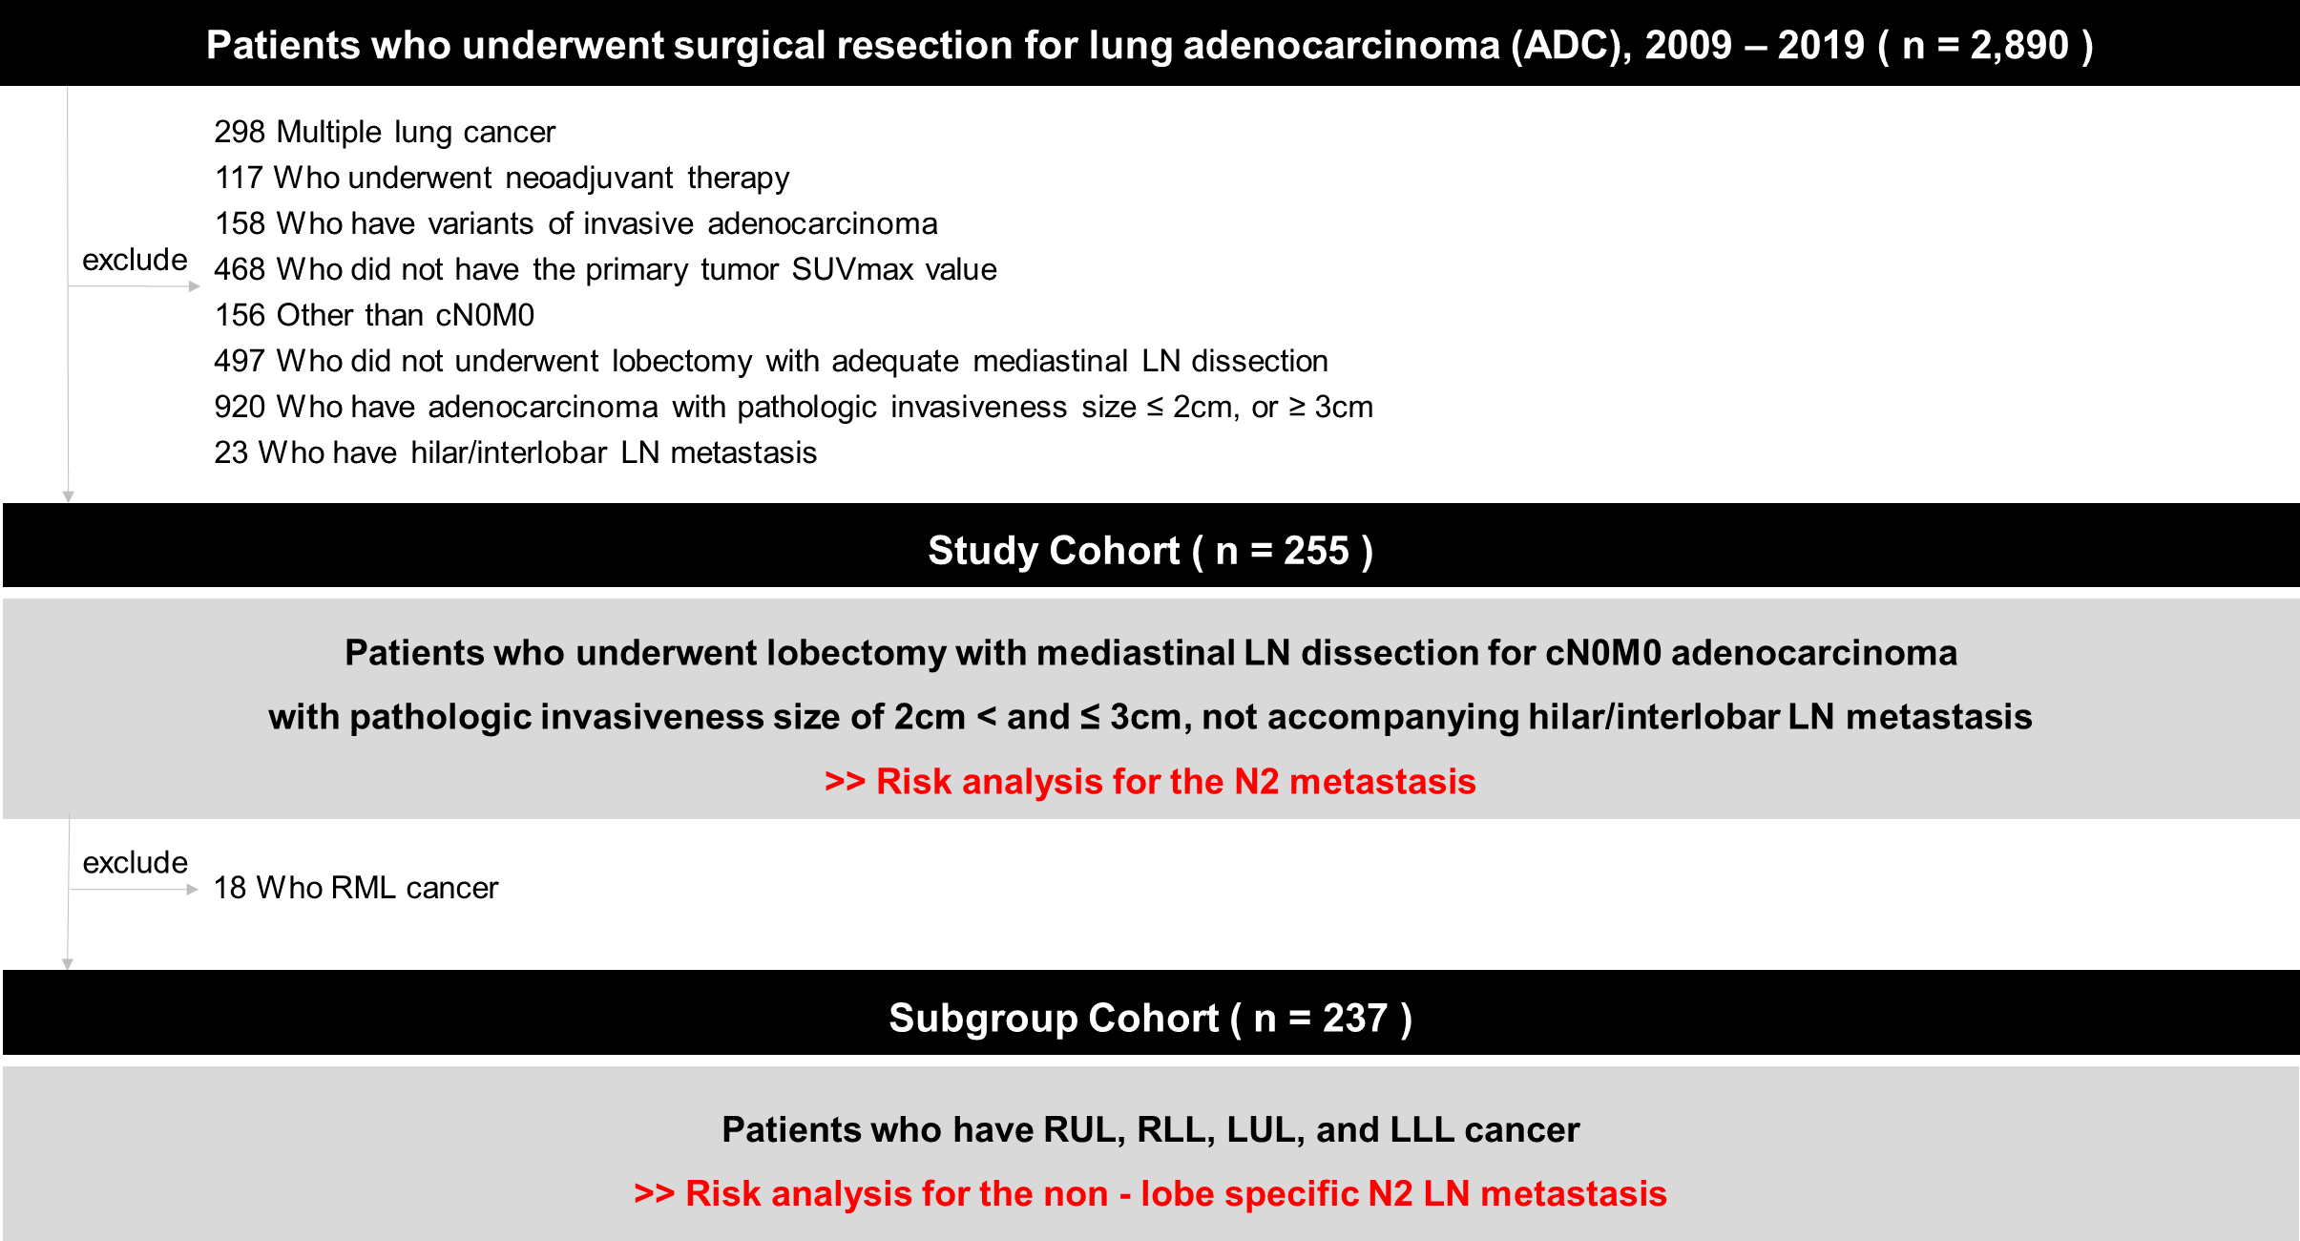
Methods
Figure 1. Study flow diagram.

Slide 4
Results
Table 1. Risk analysis for the N2 metastasis in study group.
 | Pre-OP variables |  |  | All variables
 | Adjusted OR (95% CI) | P |  | Adjusted OR (95% CI) | P
SUVmax, high | 7.144 (1.491-34.231) | 0.014 |  | 10.576 (1.398-80.008) | 0.022
CT features, indentation | 7.061 (0.862-57.861) | 0.069 |  | 5.743 (0.6-54.943) | 0.129
CT features, attachment | 7.541 (0.847-67.165) | 0.070 |  | 4.513 (0.407-50.064) | 0.220
Lymphatic invasion |  |  |  | 7.406 (1.708-32.104) | 0.007
Visceral pleural invasion |  |  |  | 3.388 (1.037-11.076) | 0.043
1. Adjusted ORs were calculated using the Firth penalized logistic regression model, which was adjusted for preoperative variables, i.e., age, se, smoking status, DM, HTN, GGO to solid tumor ratio, CEA, and both preoperative and postoperative variables, i.e., vascular invasion, STAS, MP pattern, histologic grade, respectively. 2. High SUVmax, primary tumor maximum standardized uptake value ≥ 2.9mg/ml, which was determined by the Receiver operating characteristic curve analysis for occult N2 metastasis in study cohort.

Slide 5
Results
Table 2. Risk analysis for the non-lobe specific N2 metastasis in subgroup cohort.
 | Pre-OP variables |  |  | All variables
 | Adjusted OR (95% CI) | P |  | Adjusted OR (95% CI) | P
SUVmax, high | 8.513 (1.01-1080.119) | 0.049 |  | 15.985 (0.862-12651.33) | 0.073
CT features, indentation | 2.936 (0.269-396.858) | 0.425 |  | 0.993 (0.041-195.377) | 0.067
CT features, attachment | 7.526 (0.729-1009.169) | 0.098 |  | 2.969 (0.153-684.463) | 0.997
Lymphatic invasion |  |  |  | 8.914 (0.691-975.201) | 0.102
Visceral pleural invasion |  |  |  | 10.77 (1.579-447.941) | 0.012
1. Adjusted ORs were calculated using the Firth penalized logistic regression model, which was adjusted for preoperative variables, i.e., age, se, smoking status, DM, HTN, GGO to solid tumor ratio, CEA, and both preoperative and postoperative variables, i.e., vascular invasion, STAS, MP pattern, histologic grade, respectively. 2. High SUVmax, primary tumor maximum standardized uptake value ≥ 2.9mg/ml, which was determined by the Receiver operating characteristic curve analysis for occult N2 metastasis in study cohort.

Slide 6
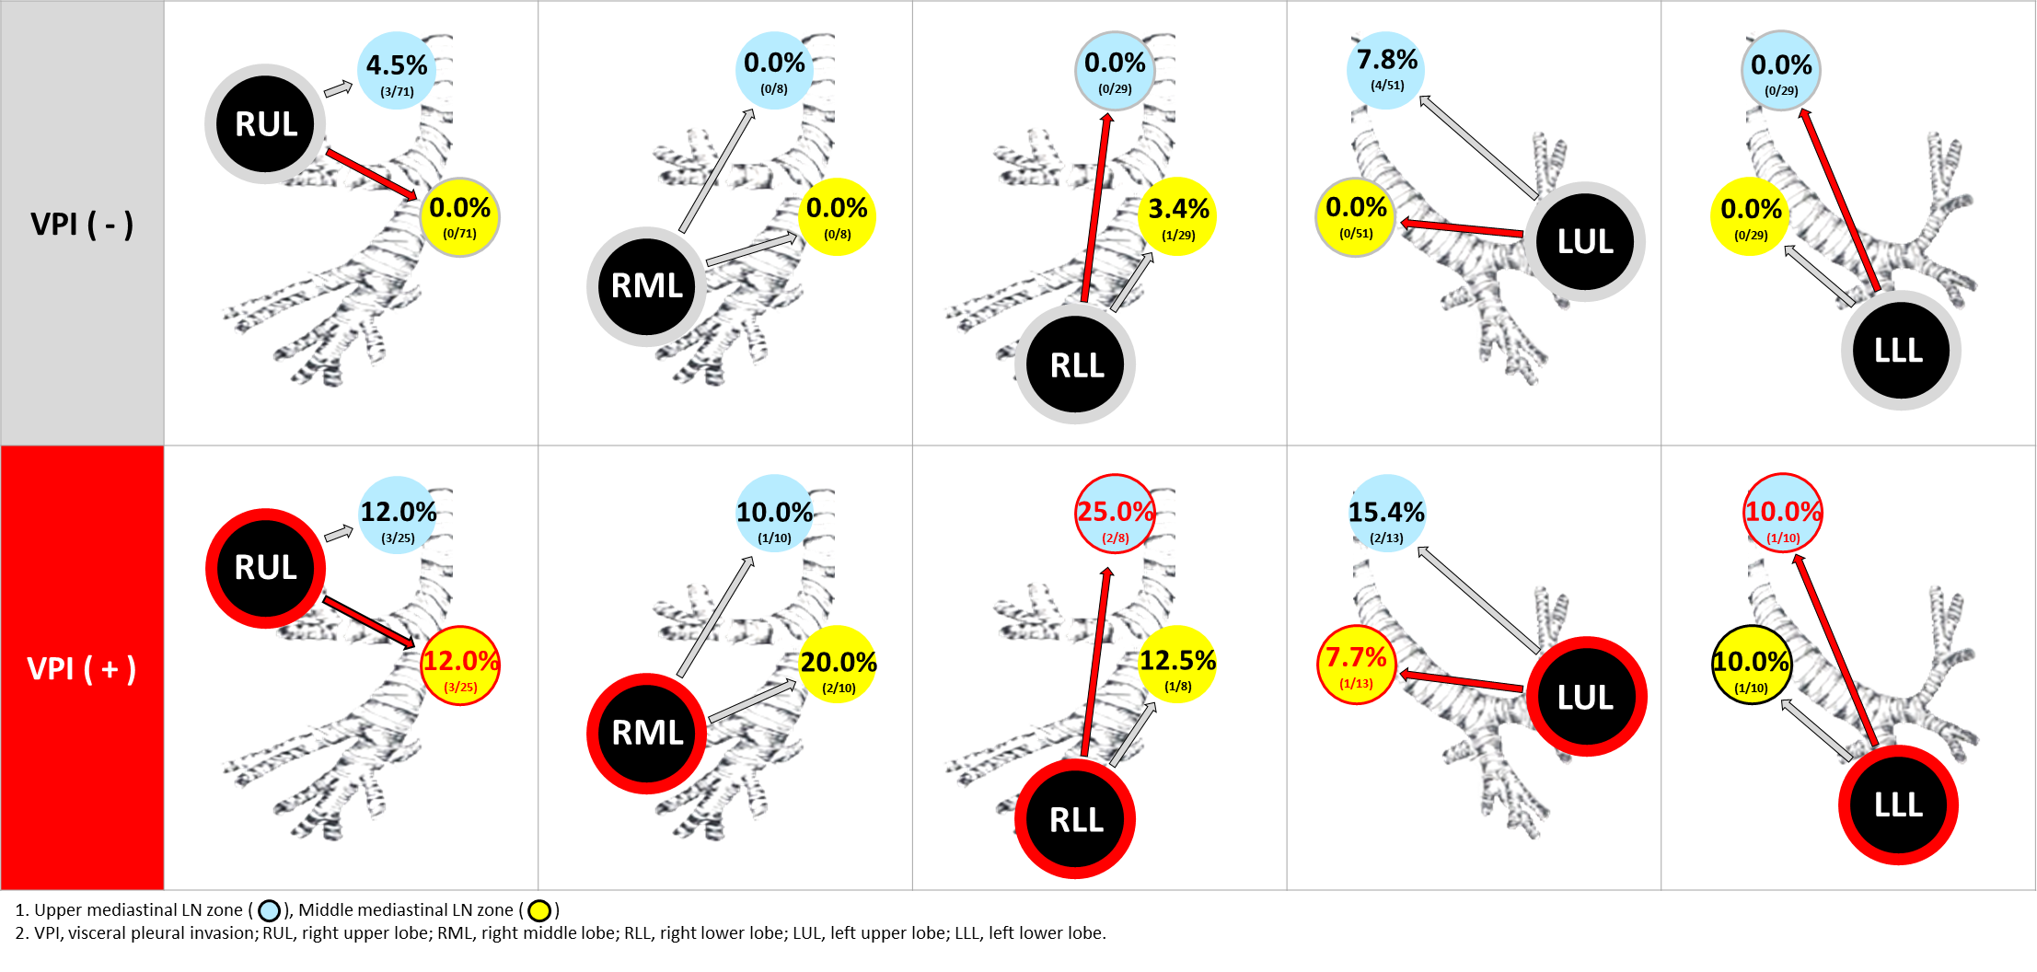
Results
Figure 2. Rate of N2 LN metastasis at each LN zone according to the tumor location and the visceral pleural invasion status (VPI) among the subgroup cohort B.

Slide 7
Conclusion
In patients with early ADC not accompanying hilar/interlobar LN metastasis, high SUVmax, lymphatic invasion, and visceral pleural invasion predicted N2M well.
The visceral pleural invasion also predicted non-LSN2M well.
Our results could help to define the adequate LN dissection strategy for early ADC.

