Slide 1
How to make surgical scar less visible after congenital heart surgery from the surgeon`s point of view?
: A 13-year experience in single center

Slide 2
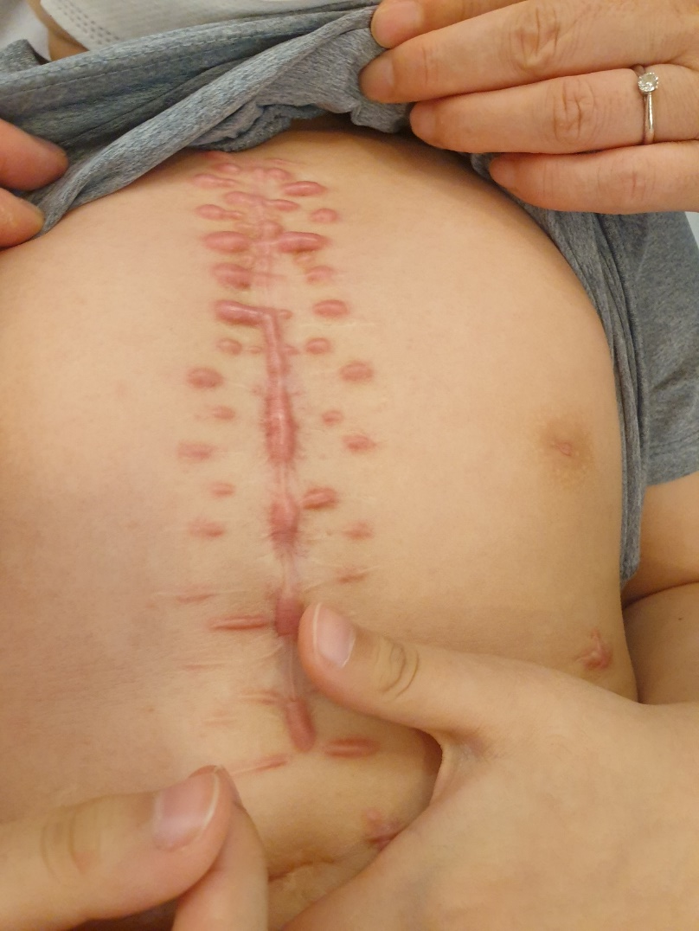
Purpose
Chest scarring remains troublesome issue aspect clinical or cosmetic significance especially babies or young patients.
However, there has been not established satisfactory treatment modalities or protocol even the chest is one the keloid-prone area especially in Asians.
We report our experience of scar management to help establish the comprehensive strategies.

Slide 3
Methods
We open “Scar clinic” base on laser or steroid injection therapy for patient with cardiac surgery since 2007.
Of the 4,588 patients who underwent congenital cardiac surgery,
637 patients visited the scar clinic up to 2019. (637/4588,13.8%)
Scar clinic in our institution
637 patients (April 1, 2007~December 31, 2019)
6 patients who are under the therapy during the study period were excluded
Only used ointment or silicone sheets
(N=76)
Pulsed-dye laser therapy
(N=315)
Pulsed-dye laser + Triamcinolone injection
(N=210)
Triamcinolone injection
(N=30)

Slide 4
Methods
Assessment of wound at 1st visit out-patient clinic after discharge
Dehiscence or discharge at wound
Remain suture or knot
Abscess or infection sign
Apply the silicone gel sheeting
Clear scar
(White)
Mild scar
(Reddish, flat and pliable scar)
Hypertrophic scar or Keloid
(Elevated, firm or symptomatic scar)
Keep silicone gel sheeting
(2months)
595nm pulsed-dye laser
Every 3 or 4 weeks
Intralesional injection of steroid
(Triamcinolone acetonide)
Every 3 or 4 weeks
Silicone gel sheeting or scar ointment for prevention
(6-12months)
<Scar management protocol>

Slide 5
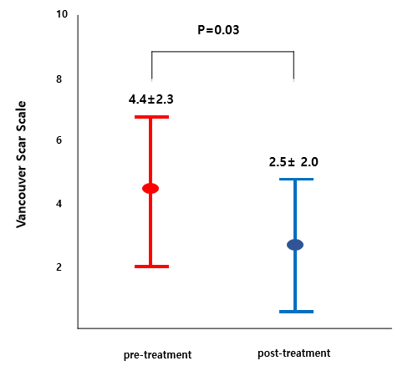
Results
469 patients who under 18-year (84.1%)
402 patients underwent clinic within 3months after discharge (74.5%)
Median f/u duration : 47.2 months (1-146)
Recurrence rate: 11 patients(2.3%)
< Scar state at last treatment >
< VSS points before and after treatment >
462 (83.3%)
75 (13.5%)
18 (3.2%)

Slide 6
Conclusion
For the better scar on a patient, more attention is needed from operating room to out-patient clinic from the surgeon.
If a cardiac surgeon performs scar management, it has the advantage of being able to detect and treat the wound infection quickly.
Chest scar can be managed successfully even by a surgeon with well-established protocol including laser and steroid therapy .

