Slide 1

Does position of prosthetic valve affect a long-term durability of prosthetic valve in pulmonary position?
: Focusing on the angle between prosthetic valve and main pulmonary artery

Slide 2
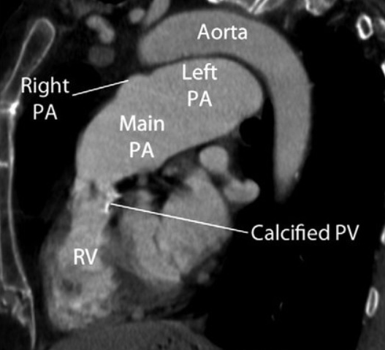
Purpose
The objectives of this study were to evaluate the long-term durability of prosthetic valve, focusing on the angle (a) between prosthetic valve and main pulmonary artery.
a

Slide 3
Methods
January 2001 and May 2020
58 patients with Tetralogy of Fallot having a prosthetic valve in the pulmonary position, with CTs, MRIs or angiographic studies
  Reviewed 36 patients (excluded those who did not have good images to measuring angle)
Prosthetic valve failure
  PS 3.5m/s or PR ≥ moderate grade
“Angle of implantation”
  The angle between an imaginary axial line from the center of the prosthetic valve and an imaginary parallel line (parallel to horizontal plane) from the point that above line pulmonary valve meets the anterior wall of MPA
  Measured the angle by CT, MRI, or angiography

Slide 4
Results
Median age at total repair : 14.2 months [IQR, 8.7 – 22.5]
Median age at PVR : 10.1 years [IQR, 8.3 – 12.4]
The follow-up completeness : 94.4%
mean follow-up duration after first PVR : 15.6±2.5 years (8.5 ~ 18.7 years)
(median, 16.1 years / IQR, 13.6 – 17.7)
  2 overall operative mortalities
  5 major complications: low cardiac output, bleeding, and respiratory problem.
mean interval from first PVR to redo PVR : 10.0±3.6 years (2.6 ~ 17.0 years)
(median, 10.6 / IQR, 6.9 – 13.1)
Mean size of prosthetic valve at first PVR : 24.0±2.1 mm (median, 25 mm / IQR, 23 - 25)

Slide 5
Results
The overall survival rates at 10 and 20 years were 97.1% and 93.8%, respectively.
Follow-up echocardiographic examination demonstrated significant improvement in both TR (p=0.03) and PR (p<0.01) after PVR.
Right ventricular end diastolic volume index decreased from an average 155.3±45.4 to 120.3±21.9 ml/m² (p<0.01) after redo PVR on MRI data.
RVEF and LVEF were improved after PVR on echocardiography, MRI

Slide 6
Results
Regarding the relationship between the angle and prosthetic valve failure, the duration taken until the occurrence of valve insufficiency is significantly shortened when implanted at an angle of 45 degrees or more (p=0.04).
On univariate analysis, age at first PVR, valve size, and angle of implantation were significant (p<0.01, p=0.04, and p<0.01).
In the multivariate analysis, angle of valve implantation was the significant risk factors for early prosthetic valve failure (p=0.009).

Slide 7
Conclusion
PVR after TOF patients results in significant improvement in ventricular size and function and it lasts well
However, the wider the implantation angle, the faster the prosthetic valvular failure occurred
We should be careful to implant a prosthetic valve with an adequate angle to keep a laminar flow in the pulmonary position for better durability

