Slide 1

Clinical Outcome of Leaflet Patch Augmentation for Left Atrioventricular Valve Reoperation Following Repair of Complete Atrioventricular Septal Defect

Slide 2
Purpose
Outcomes of repair of complete atrioventricular septal defects (cAVSDs) have improved over the last decades.
However, the need for reoperation following correction of cAVSD remains a major concern caused by left-sided atrioventricular valve regurgitation (LAVVR).
We evaluated surgical outcome of reoperation for LAVVR repaired by leaflet patch augmentation

Slide 3
Methods
Between April 2010 and April 2020, 28 consecutive patients with cAVSD underwent reoperation for LAVVR after repair of cAVSD. Of them, 10 patients underwent leaflet patch augmentation.
Mean age at repair of cAVSD was 5.7±5.2 months (range, 14 days to 16 months)
Mean age at reoperation for LAVVR was 22.2±16.3 months (range, 4 to 60 months).
Rastelli type A of cAVSD : 10
Double orifice of LAAV : 2
Palliative surgery (pulmonary artery banding) : 3

Slide 4
Results
The mean follow-up duration was 3.0±2.2 years after LAAV repair (range, 3.8 months to 7.6 years).
All patients survived. There was no operative and late mortality.
4 patients underwent LAAV leaflet patch augmentation for severe LAVVR, 5 for moderate LAVVR, and 1 patient for mild LAVVR.
Patients also had LAVV stenosis for mild in 6, moderate stenosis in 3, and severe stenosis in one patient.
Left ventricular end diastolic dimension decreased from an average 30.0±4.7 mm preoperatively to 27.1±5.8 mm postoperatively (p < 0.01).
Two patients finally underwent valve replacement or additional cleft closure for LAAV after leaflet patch augmentation caused by progression of LAVV regurgitation to severe grade and mean pressure gradient more than 10 mmHg. The rest was well maintained with less than moderate regurgitation and asymptomatic state at the last follow-up.

Slide 5
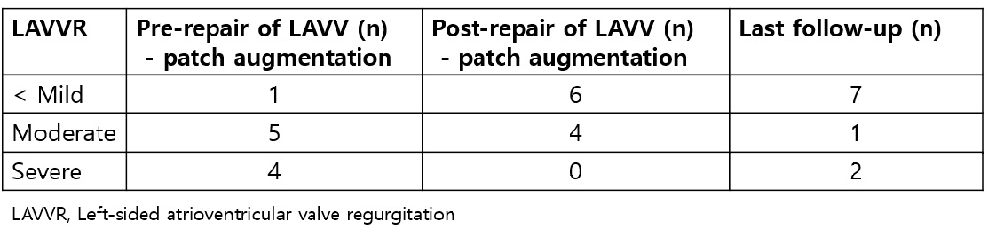
Follow-up echocardiographic examination demonstrated significant improvement in LAVVR (p < 0.01).

Slide 6
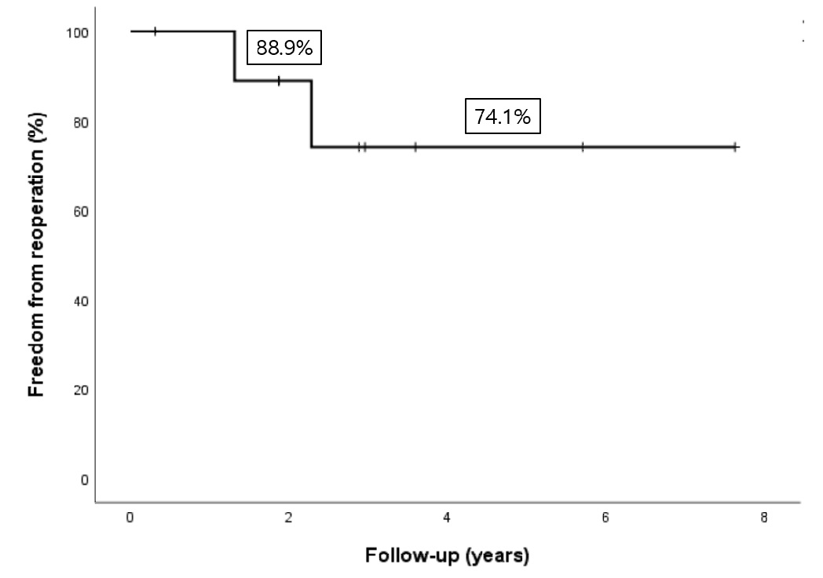

Slide 7
Conclusion
LAAV repair by leaflet patch augmentation results in significant clinical improvement and lasting recovery in ventricular size and function.
Especially in complex LAVV pathology with both regurgitation and stenosis, LAAV leaflet patch augmentation might be considered surgical option in young children before valve replacement associated with considerable valve-related morbidity.

