Slide 1
Observation of Aortic Dilatation in Congenital Conotruncal Anomalies
- Tetralogy of Fallot, Double Outlet Right Ventricle and Truncus Arteriosus
대한흉부심장혈관외과학회
제52차 추계학술대회
공지사항
  소속기관이나 저자명이 드러나지 않도록 해주세요.
  제목 슬라이드 제외 최대 6장, Font size 20 이상
  사진/illustration등으로 인해 용량이 큰 경우 PDF로 전환해서 접수

Slide 2
Purpose
대한흉부심장혈관외과학회
제52차 추계학술대회
Background
  Ascending aorta or aortic root dilatation is commonly seen in the patients with conotruncal anomalies.
  Rate of dilatation of aorta or aortic root in these diseases entity in long-term is not well-known
Objective
  To evaluate rate of dilatation of aorta or aortic root structures
    comparison of computed tomography findings in conotruncal anomaly patients (tetralogy of fallot (TOF), double outlet right ventricle (DORV) and truncus arteriosus (TA))
  To determine an adequate timing and interval of follow-up studies for aortic structures in these diseases

Slide 3
Methods
대한흉부심장혈관외과학회
제52차 추계학술대회
Patients
From 2004 to 2018
Conotruncal anomaly patients (total: 825 patients)
  Underwent biventricular correction for TOF, DORV and truncus arteriosus
  had follow-up CT studies at least 5 years after initial CT
  → 99 patients were enrolled in this study

Slide 4
Methods
대한흉부심장혈관외과학회
제52차 추계학술대회
Follow-up duration (median [IQR])
  from initial CT after total repair to most recent CT
  Clinical : 16.12 years [IQR: 11.77~26.24]
  Interval of chest CT : 9.37 years [IQR: 7.12~11.45]
Outcomes
  Comparison of z-score of the diameter of ascending aorta and aortic root structures
Variables | TOF (n=60) | DORV (n=25) | TA (n=14)
Female, n (%) | 15 (25) | 13 (52) | 7 (50)
Initial age (years) | 5.95 [0.49~12.97] | 6.39 [0.16~16.26] | 0.21 [0.11~3.95]
Follow-up age (months) | 15.94 [9.39~23.33] | 15.63 [8.36~26.19] | 11.73 [6.96~12.77]
Initial body surface area (m²) | 0.80 [0.37~1.35] | 0.65 [0.25~1.49] | 0.29 [0.25~0.59]
Follow-up body surface area (m²) | 1.53 [0.02~1.81] | 1.34 [0.95~1.75] | 1.19 [0.87~1.41]
Performed cardiac surgery (n) | 2.8 ± 1.3 | 3.0 ± 1.5 | 2.7 ± 1.1
Median value [IQR]

Slide 5
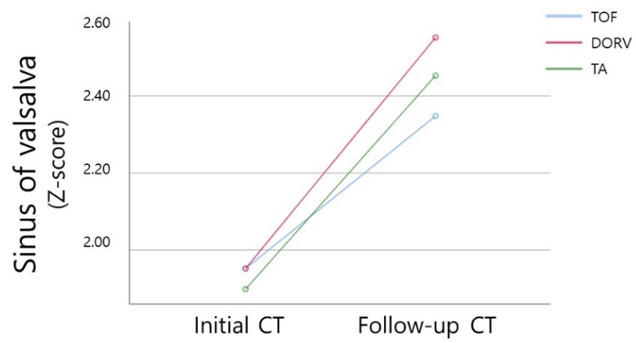
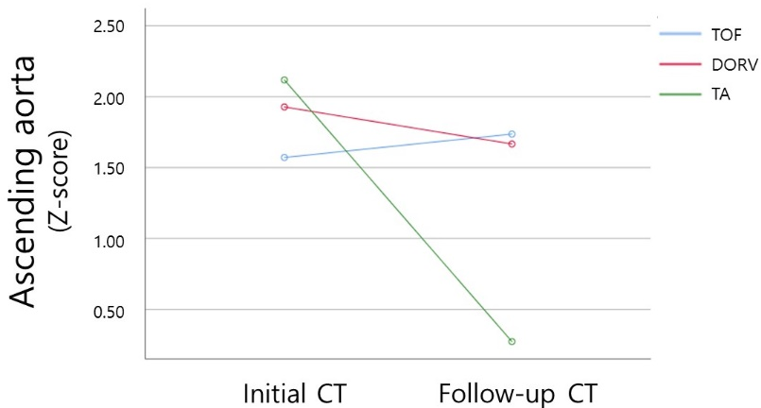
Results
대한흉부심장혈관외과학회
제52차 추계학술대회
Comparison of aorta diameter
Variables | Initial CT | Follow-up CT | P
Age (months) | 4.29 [0.33~12.25] | 14.43 [9.19~22.85] | <0.001
Body mass index (kg/m²) | 15.75 [14.17~17.47] | 20.04 [15.74~23.09] | <0.001
Body surface area (m²) | 0.61 [0.33~1.29] | 1.42 [0.97~1.72] | <0.001
Z-score
Aortic annulus | 2.36 [0.86~3.43] | 2.30 [0.81~3.25] | 0.21
Sinus of Valsalva | 2.01 [0.79~3.26] | 2.42 [1.38~3.34] | 0.006
Sinotubular junction | 1.28 [-0.20~2.55] | 2.18 [0.44~3.29] | <0.001
Ascending aorta | 1.58 [0.43~2.89] | 0.03 [1.64~2.55] | 0.27
Ratio of ascending aorta with sinus of Valsalva | 0.81 [0.73~0.92] | 0.76 [0.67~0.85] | <0.001
P = 0.006
P = 0.27

Slide 6
Results
대한흉부심장혈관외과학회
제52차 추계학술대회
Median increasing rate of maximum diameter
  Aortic annulus (AA): 0.7 mm/year
  Sinus of Valsalva (SV): 0.9 mm/year
  Sinotubular junction (STJ): 0.8 mm/year
  Ascending aorta (AAo): 0.5 mm/year
Significant difference
  Ascending aorta (0.69 in TOF vs. 0.99 in TA, p=0.04)
  Sinus of valsalva (0.81 in TOF vs. 1.53 in TA, p=0.008)
Progression of aortic regurgitation more than moderate degree
  None during the follow-up
Surgeries for dilated aortic structures
  None during the follow-up

Slide 7
Conclusion
대한흉부심장혈관외과학회
제52차 추계학술대회
In TOF, DORV and TA for 9 years of follow-up
  SV and STJ → significantly dilated
  AAo and AA → not significantly dilated
It might be necessary to observe closely aortic valvular function associated with structural deterioration of SV or STJ.

