Slide 1

One and Half Repair of Ebstein’s Anomaly with End Stage Heart Failure and Liver Cirrhosis
Hyun Ah Lim, Hyung Tae Sim
Min Seop Jo, Yong Jin Chang, Deog Gon Cho, Kyu Do Cho
Department of Thoracic and Cardiovascular Surgery, St. Vincent’s Hospital

Slide 2
Brief Patient Profile
F/57
C.C: Dyspnea (NYHA IV)
PI: 1997년 Ebstein anomaly 진단, 이후 c/sec delivery 두차례. Follow-up
loss 되었다가 Dyspnea 심해져 ER visit.
Severe both leg pitting edema(+), Jaundice
Lab> Platelet: 66,000, T. bilirubin:25, D. bilirubin:16.5, PT(INR)=1.35

Slide 3
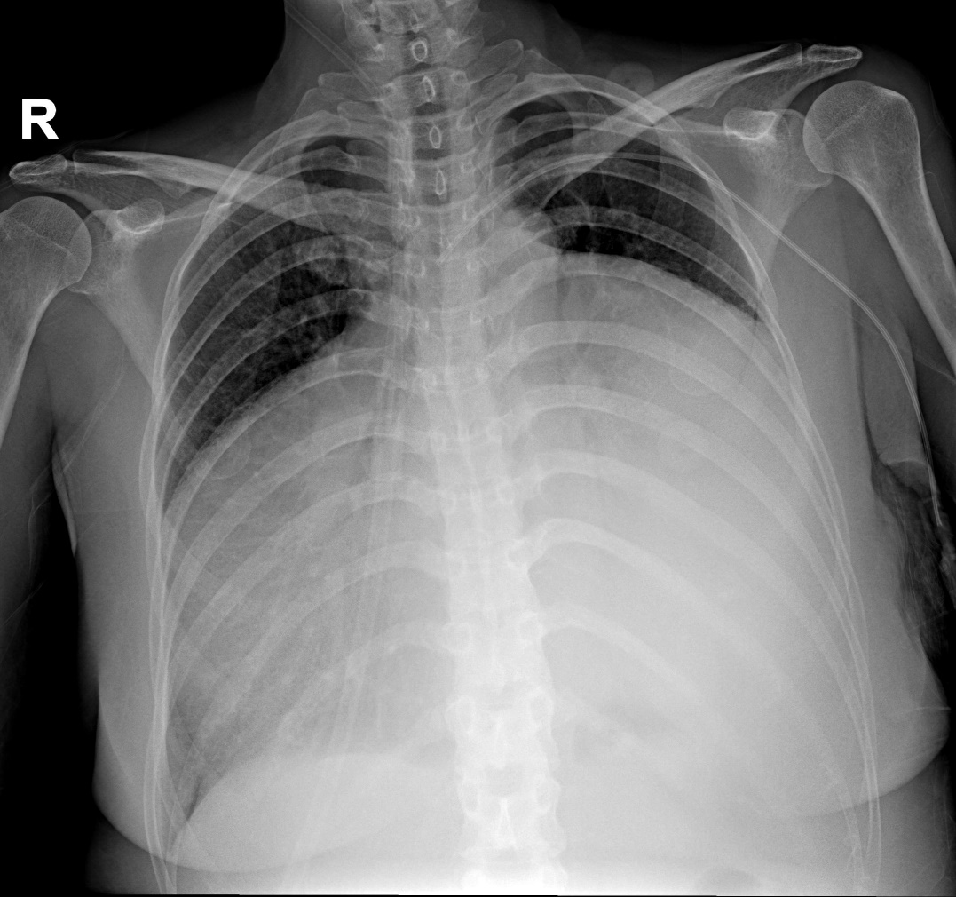
Preoperative Chest X-ray

Slide 4
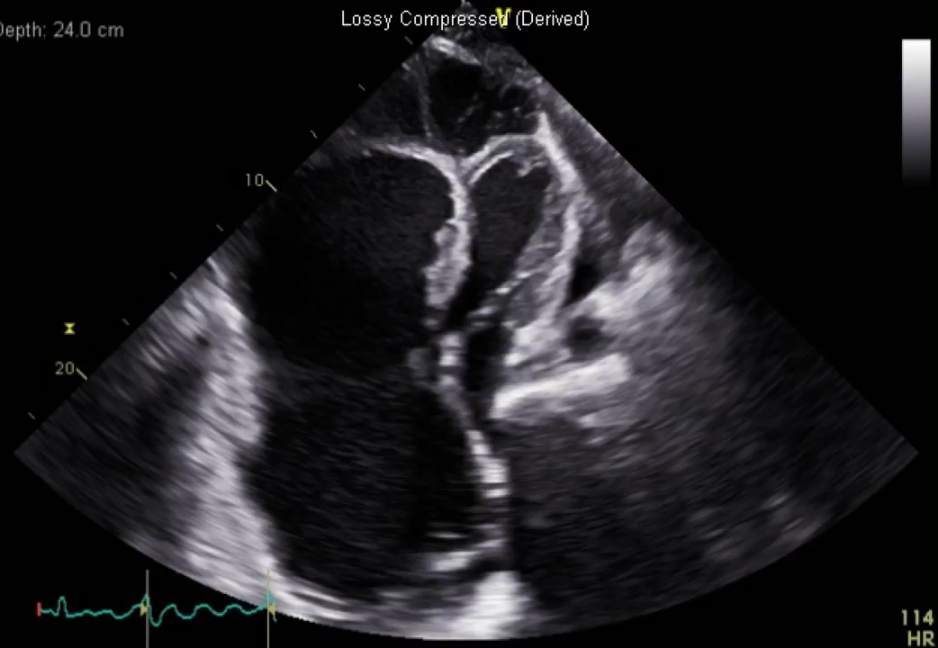
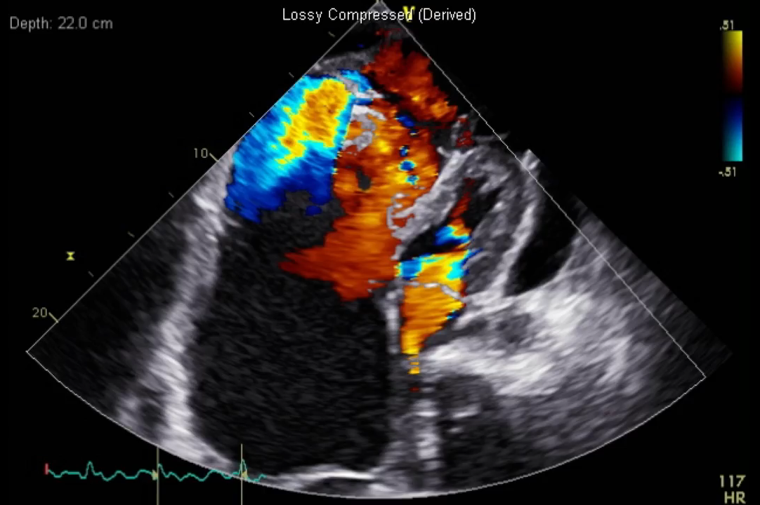
Preoperative Echocardiographpy
Echocardiography:
EF=40%, RVSP=28.8 mmHg
Ebstein’s anomaly, severe TR , marked dilated RA cavity
Moderate amount of pericardial effusion

Slide 5
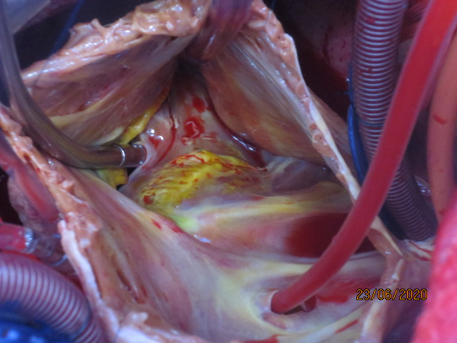
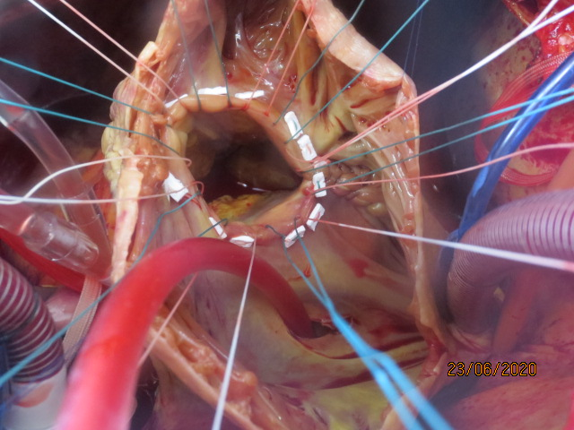
One and half repair (TVR(Epic 33), aRV plication, BCPS(azygous v. ligation)), ECMO(VA, PA vent), opened sternum

Slide 6
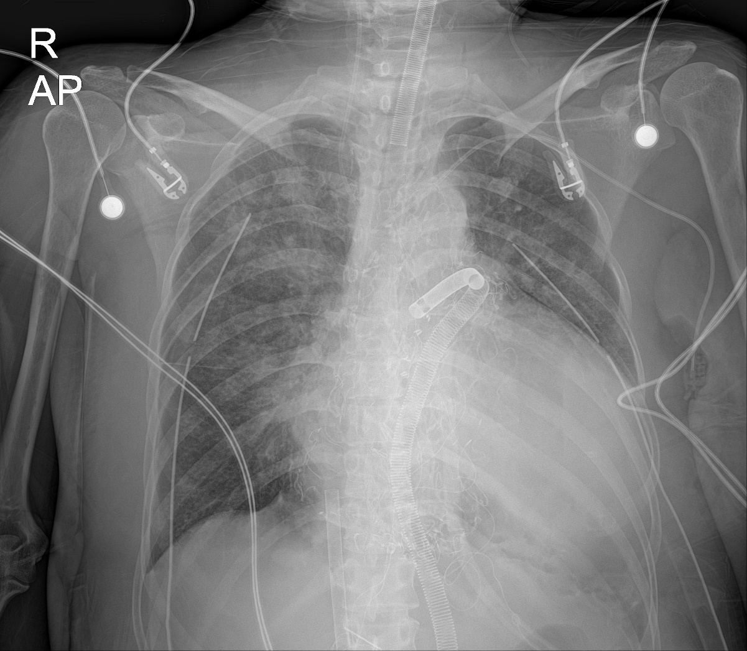
Postop. Course (POD#0~ POD#5)
Stable ECMO flow
OR wound irrigation (x1)
Mx.: NO gas, Iloprost, Viagra

Slide 7
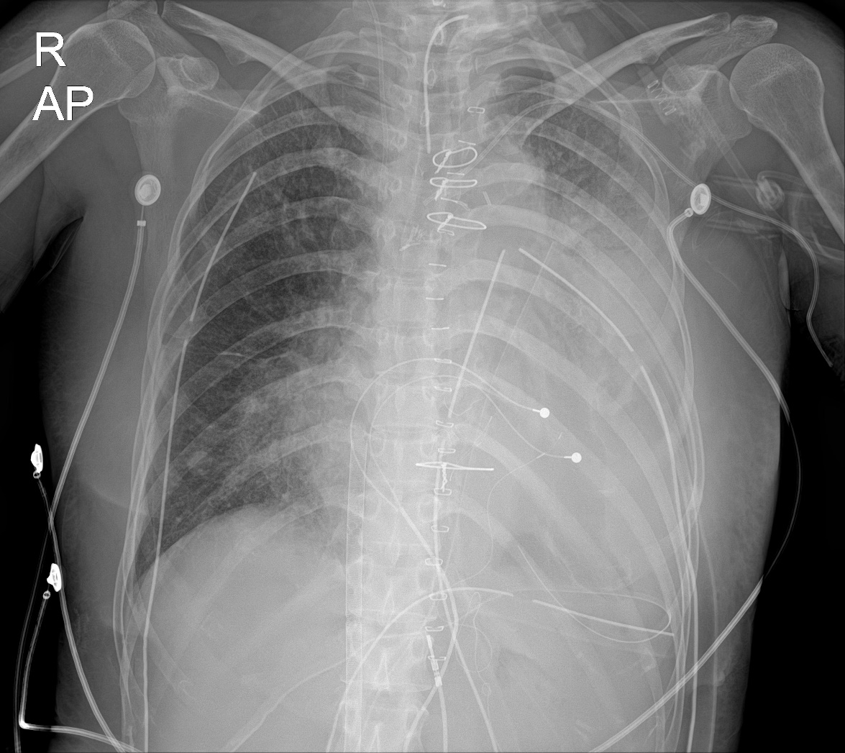
Postop. Course (POD #6)
Delayed sternal closure
PA vent removal
PPM lead insertion(VV)
Tracheostomy
Maintain ECMO(VA)

Slide 8
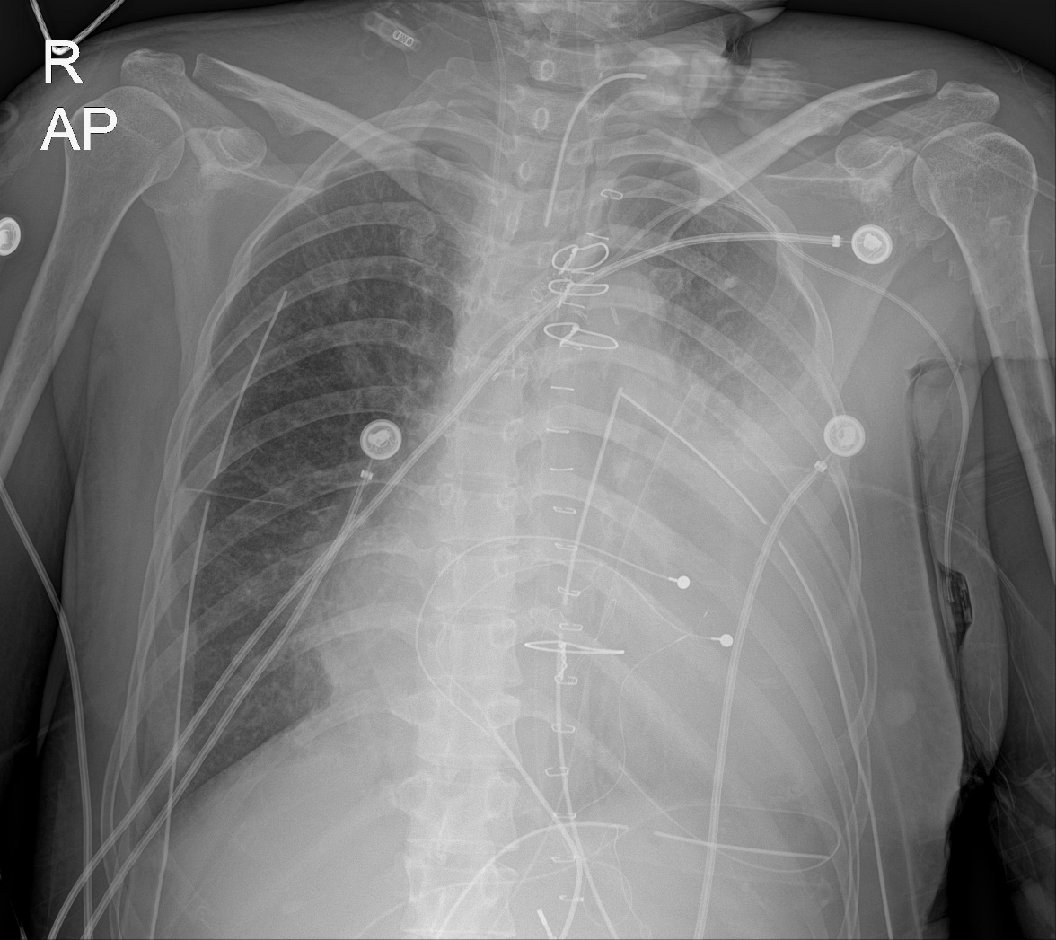
Postop. Course(POD #9)
Successful ECMO weaning

Slide 9
Postop. Course(POD #9)
Successful ECMO weaning

Slide 10
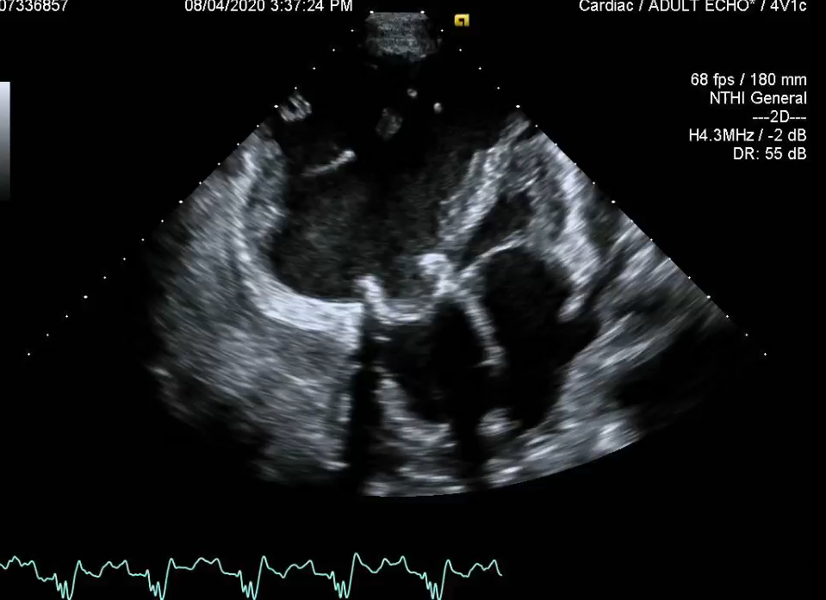
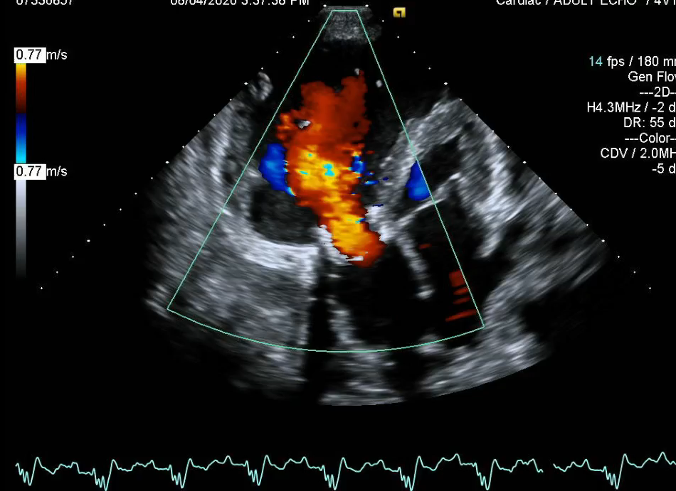
Postoperative Echocardiographpy

Slide 11
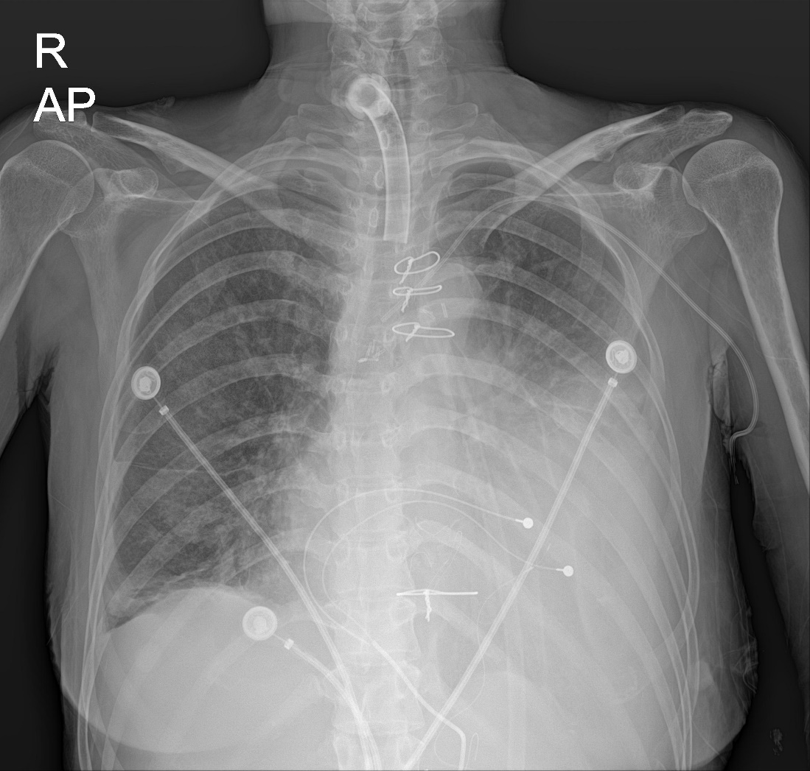
Postop. Course(POD #28)
Transfer to General ward
T-tube plugging

Slide 12
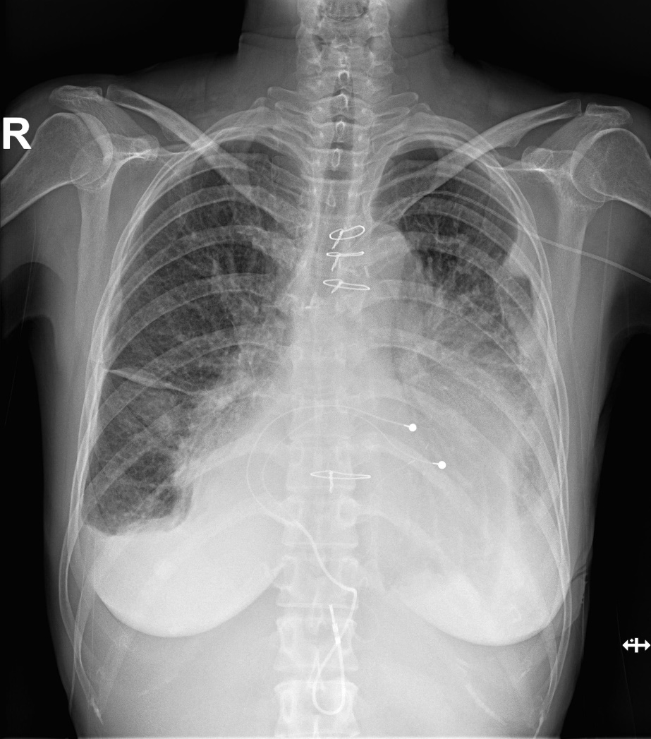
Postop. Course(POD #45)
Discharge to home
NYHA I~II
Lab> T. bilirubin=3.01
Platelet= 180,000

Slide 13
Summary
One and half repair is an effective surgical option for Ebstein’s anomaly with severe RV dysfunction.
LV function and pulmonary vascular bed should be preserved for successful one and half repair.
Venting cannular (pulmonary artery or vein) should be considered if performing ECMO for postoperative low cardiac output after repair.
Aggressive treatment of pulmonary hypertension is necessary during postoperative period.

