Slide 1
Myocardial injury following fibrillatory arrest for minimally invasive cardiac surgery on atrial septal defect

Slide 2
Purpose
Fibrillatory arrest has been used as a method of myocardial protection in cardiac surgery
Recently, the use of Fibrillatory arrest in Minimally invasive cardiac surgery (MICS) has been frequently reported
There is a lack of research showing the quantitative correlation between fibrillatory arrest time and myocardial injury
In surgery requiring ventricular procedures, CABG or Maze surgery, the nature of the surgery makes it difficult to measure myocardial injury due to myocardial protection strategies
We conducted this study to examine the outcomes of ASD repair with fibrillary arrest and to investigate the quantitative correlation of myocardial injury according to fibrillatory arrest time

Slide 3
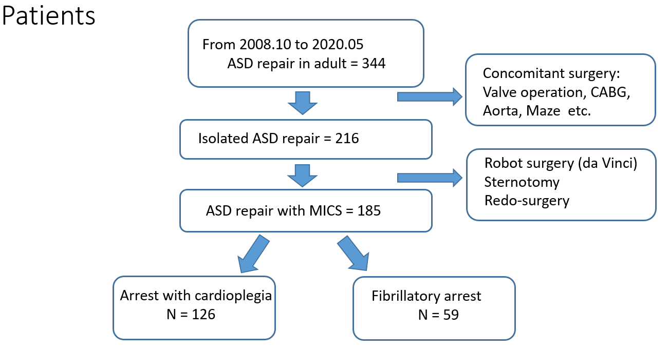
Methods

Slide 4
Methods
Right mini-thoracotomy via 4th intercostal space: 6cm incision
Femoral cannulation, Single lumen intubation
CPS or fibrillatory arrest: Surgeon`s decision
Preoperative AF → all patients underwent Maze operation, exclusion
More than moderate TR → TVP was performed and exclusion
Follow up: 55.5 month [IQR: 25-92]
Compared postoperative clinical outcomes, cardiac enzyme and vasoactive inotropic scores during ICU
Examined changes in cardiac enzyme according to ACC time or fibrillatory arrest time

Slide 5
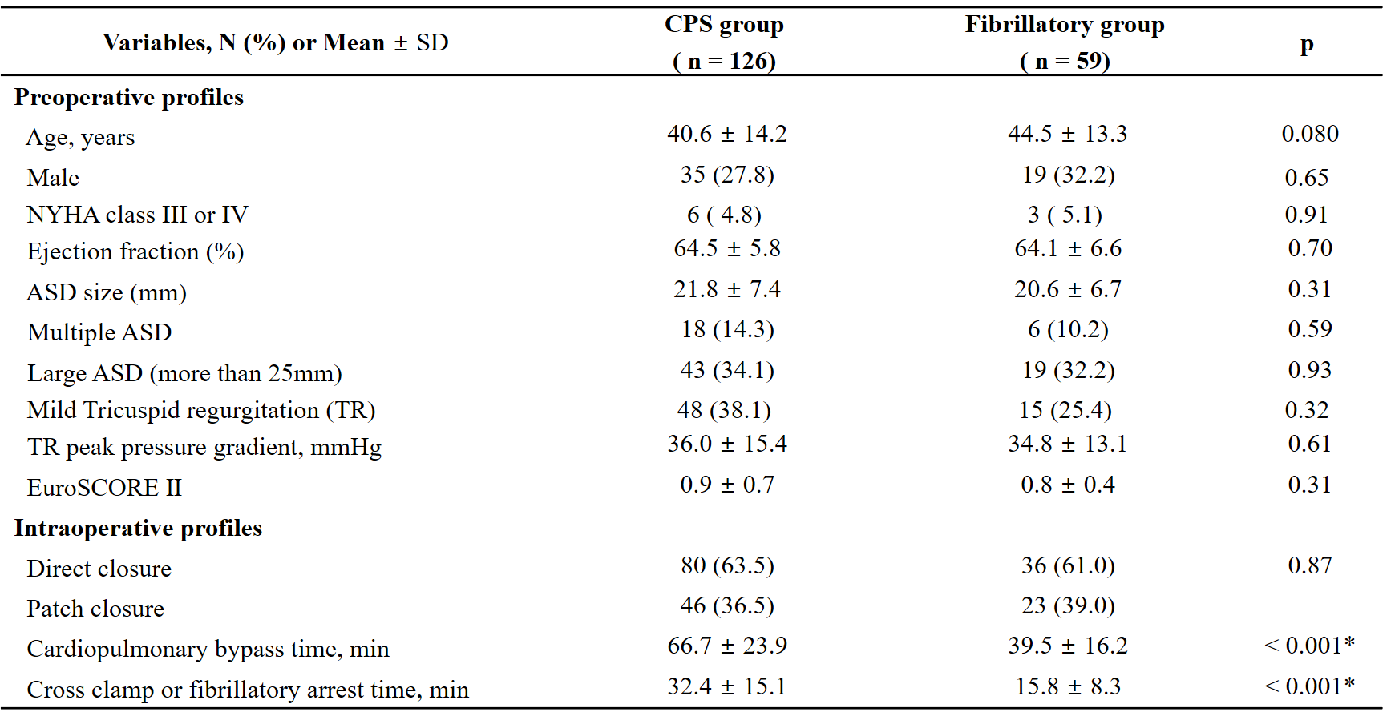
Results 1. Clinical characteristics

Slide 6
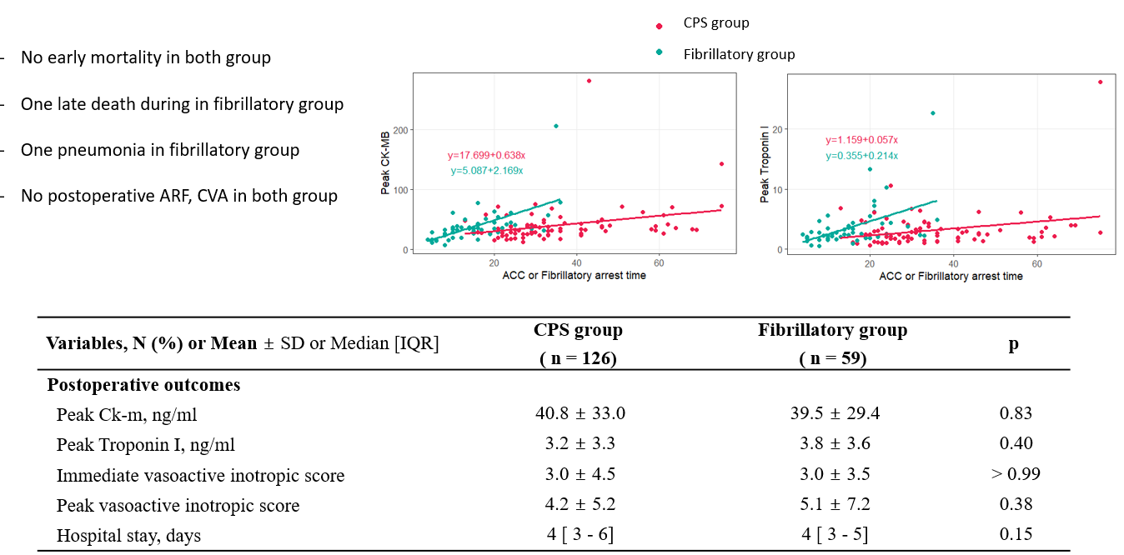
Result 2

Slide 7
Conclusion
Minimally invasive ASD repair using fibrillatory arrest showed comparable clinical outcomes compared to the CPS group.
The fibrillatory group showed significantly shorter cardiopulmonary bypass time
When the fibrillatory arrest time was less than 30 minutes, no significant increase in cardiac enzyme or postoperative inotropic agent was observed
However, in the fibrillatory group, increased cardiac arrest time and cardiac enzyme showed a stronger positive correlation
For cardiac surgery that requires a relatively long cardiac arrest time, further studies are needed to ensure the safety of the fibrillatory arrest

