Slide 1
Surgical outcomes of primary supravalvar aortic stenosis repair
공지사항
  소속기관이나 저자명이 드러나지 않도록 해주세요.
  제목 슬라이드 제외 최대 6장, Font size 20 이상
  사진/illustration등으로 인해 용량이 큰 경우 PDF로 전환해서 접수

Slide 2
Purpose
Supravalvar aortic stenosis (SVAS) is a rare congenital anomaly.
The aim of the study was to review outcomes of patients who underwent repair of SVAS at a single institution.

Slide 3
Methods
Between 1999 and 2018
39 patients underwent surgical repair of primary SVAS.
26 patients had Williams syndrome.
Median age at operation was 4.3 years (range, 0.3 to 25.6)
Median weight at operation was 16.9 kg (range, 5.9 to 55.0)

Slide 4
Methods
Modified simple sliding aortoplasty in 35 (89.7%) patients.
Pulmonary artery stenosis was repaired concomitantly in 13 (33.3%) patients.
The median follow-up time: 8.9 years (range 1.7 – 20.7)
Medical records were reviewed retrospectively.

Slide 5
Results
Survival rates at 5, 10 years were 96.8%.
Freedom from left ventricular outflow tract reoperation at 5, 10, 16 years were 91.7%, 91.7%, and 68.8%, respectively.
Freedom from all-cause reoperation at 5, 11, 16 years were 86.3%, 79.1%, and 59.3%, respectively.
Age younger than 2 years (HR, 6.99. 95% CI, 1.20-40.69, p = 0.031) was a risk factor for all-cause reoperation in Cox regression analysis.

Slide 6
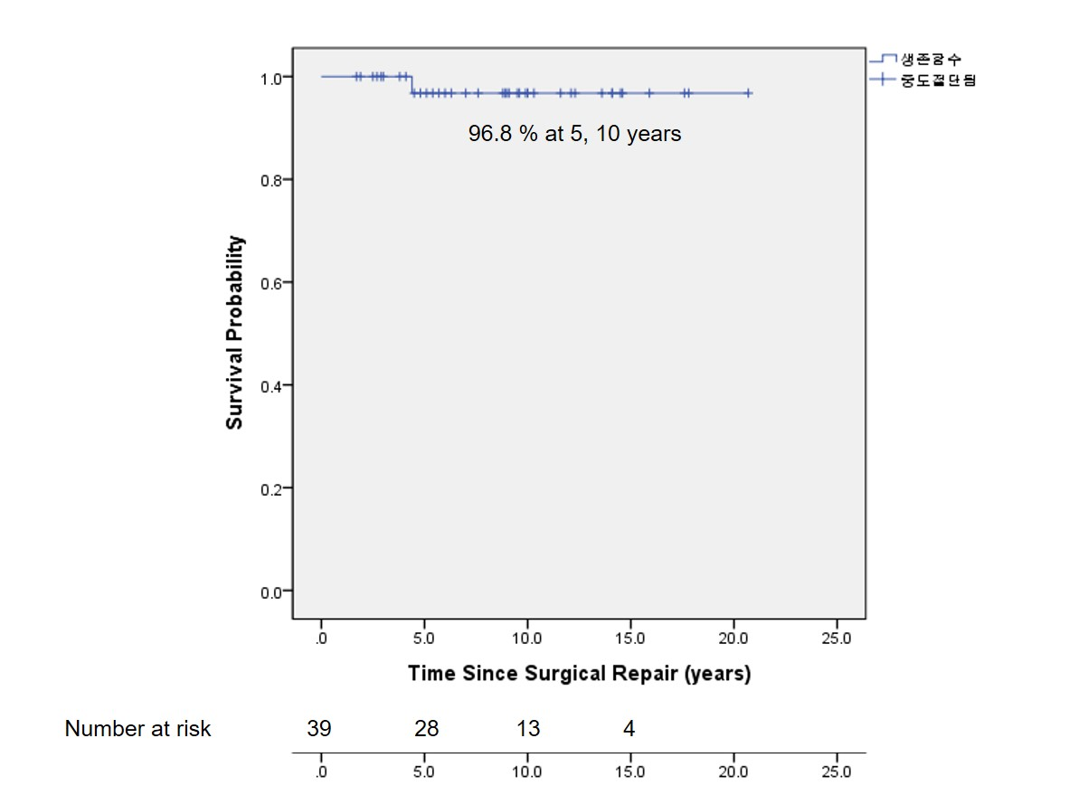
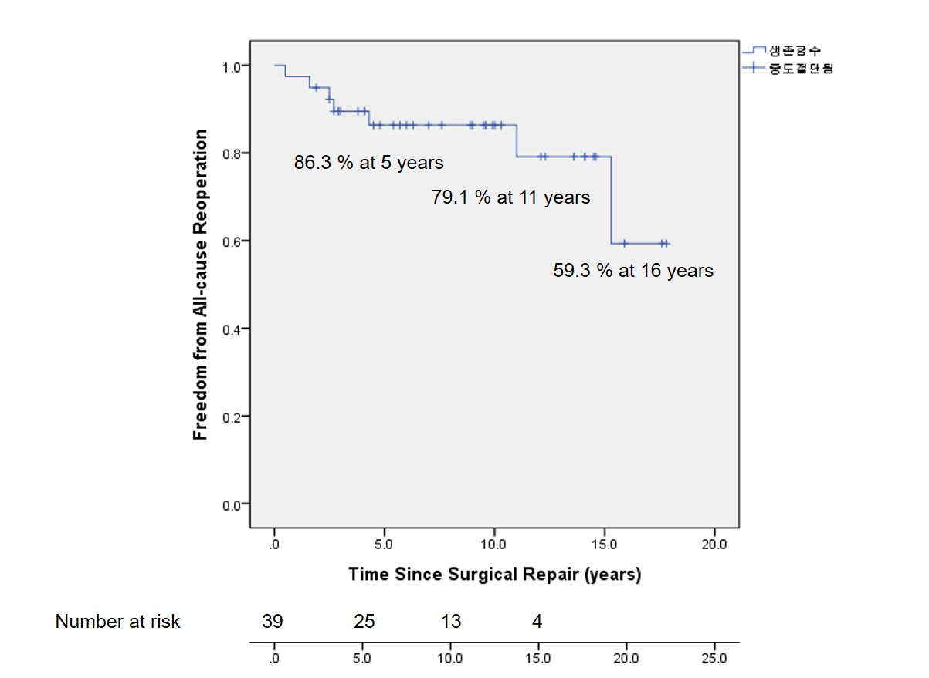
Results

Slide 7
Conclusion
Long term survival was excellent in patients with surgical repair of SVAS.
But all-cause reoperation rate was high.
Age younger than 2 years was a predictor of all-cause reoperation.

