Slide 1
Results after mitral valve replacement with mechanical prostheses in children under three years of age
공지사항
  소속기관이나 저자명이 드러나지 않도록 해주세요.
  제목 슬라이드 제외 최대 6장, Font size 20 이상
  사진/illustration등으로 인해 용량이 큰 경우 PDF로 전환해서 접수

Slide 2
Purpose
We examined outcomes after mitral valve replacement (MVR) with mechanical prostheses in children younger than 3 years.

Slide 3
Methods
between January 1996 and April 2019
Medical records were reviewed of all patients under 3 years of who underwent mechanical MVR (n = 24).
Median valve size: 19 mm (range 16 – 29)
Median age and body weight at operation: 16.5 months (range 1.5 – 31.7) and 7.6 kg (range 3.7 – 12.2)
Median follow-up duration: 6.2 years (range 0 – 20.4)

Slide 4
Results
Two early deaths
One late non-cardiac death.
Overall survival was 87.3% at 5 years.
Five patients required redo-MVR during follow-up period.
Redo-MVR resulted from somatic outgrowth in 3 patients, limited disc mobility in 2 patients.
Median time interval between original operation and redo MVR was 7.3 years (range 1.8 – 15.4 years).
Freedom from redo-MVR was 68.3% at 11 years.
Freedom from the mean gradients across the valves more than 10 mmHg was 83.3% at 5 years and 39.8% at 11 years.

Slide 5
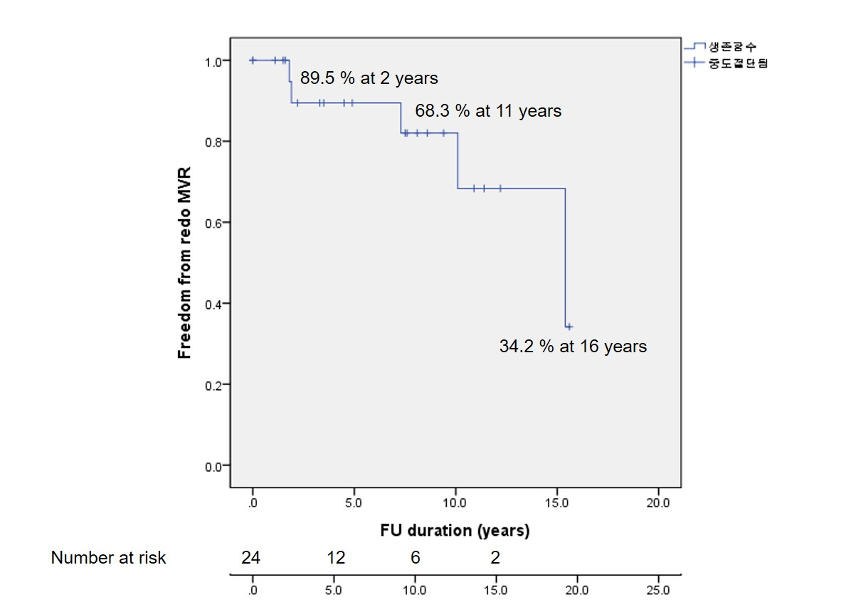
Results

Slide 6
Conclusion
MVR with mechanical prostheses in children under 3 years carries a significant early mortality.
But implanted mechanical prostheses perform well with durable hemodynamics in young children.
MVR with mechanical prostheses can be a salvage option even in small children with mitral valve disease in which repair was failed.

