Slide 1
Surgical Repair of Ventricular Septal Defect in Adult
: The Fate of Aortic Valve

Slide 2
Purpose
Outcome data of VSD (ventricular septal defect) closure in adults on which to base recommendations are limited.
We sought to review our experience with surgical VSD closure in adults.

Slide 3
Methods
From January 1996 to April 2020.
Total 152 patients who underwent VSD repair at adult age.
Median age : 30.5 years (IQR : 23.1- 42.7 years).
95 patients were male (62.5%).
Median follow up duration : 10.9 years (IQR : 4.8 – 16.1 years).

Slide 4
Methods
We retrospective reviewed, Significant AR defined moderate or more AR
VSDs were classified according to the Society of Thoracic Surgeons as type 2(n=66, 43.4%), type 1(n=59, 38.8%), and type 4(n=27, 17.8%).
Coronary cusp deformity (n=88, 57.9%), Aortic cusp prolapse (n=86, 56.6%), aortic regurgitation (AR) (n=51, 33.6%), Qp/Qs ratio ≥2 (n=25, 16.4%), pulmonary hypertension (n=15, 9.9%), left ventricular volume overload (n=19, 12.5%), sinus of Valsalva rupture (n=12, 7.9%), and infective endocarditis (n=10, 6.6%) LV dysfunction 1 (0.7%) were indications for closure.

Slide 5
Results
Concomitant Aortic valve (AV) repair in 21 and AV replacement in 5
We have two in hospital mortality cases
At 10 years, freedom from reoperation was 96.6±0.02%
Total 5 patients underwent late reoperation
  2 AV replacement, 1 AV repair, 1 Residual VSD closure, and 1 mitral valve replacement d/t infective endocarditis
Late moderate or more AR in 10 at median 6.7 years (IQR 0.2 – 11.5)

Slide 6
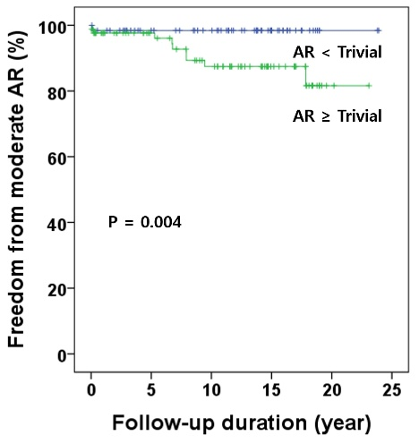
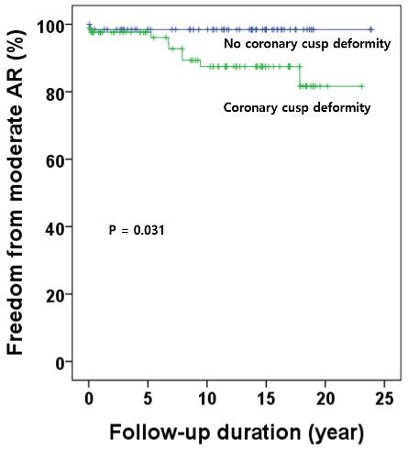
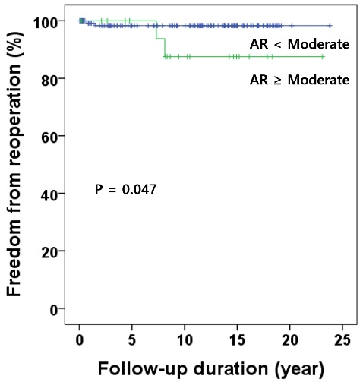
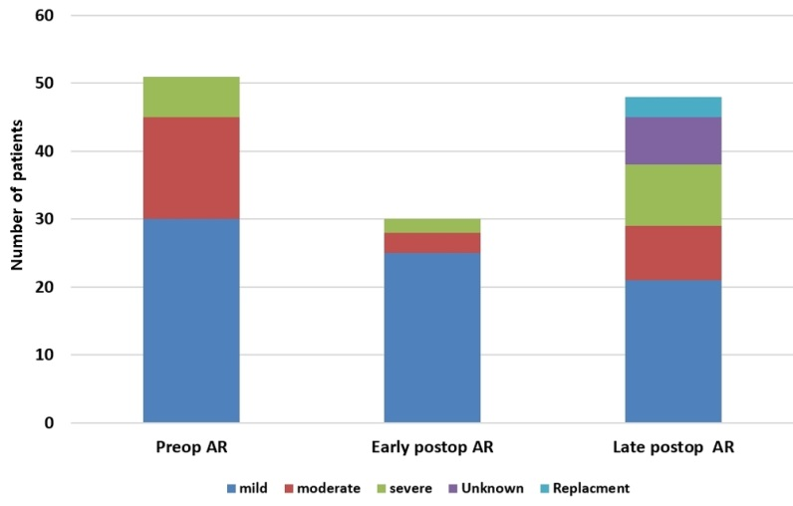
Results
Late moderate or more AR developed in 10 patients at median 6.7 years (IQR 0.2 – 11.5 years). Preoperative more than trivial AR and coronary cusp prolapse or deformity were risk factors for late moderate or more AR in univariate analysis (p=0.004, p=0.031). Preoperative moderate AR or more was the risk factor of reoperation (p=0.047).

Slide 7
Conclusion
VSD closure in adults can be performed with low mortality and morbidity and has excellent long-term outcomes.
AR can be progressed to moderate or more degree even though preoperative AR degree was mild or less. We consider that VSD with aortic valve deformity or AR should be treated aggressively before progressing.

