Slide 1
A case of Infected Left Atrial myxoma presenting no growth bacteria on blood cultures.

Slide 2
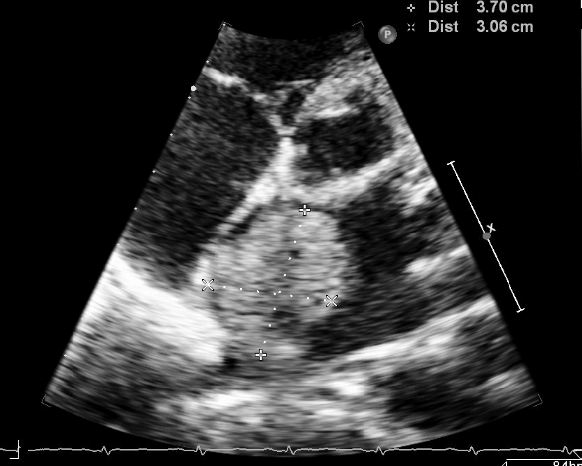
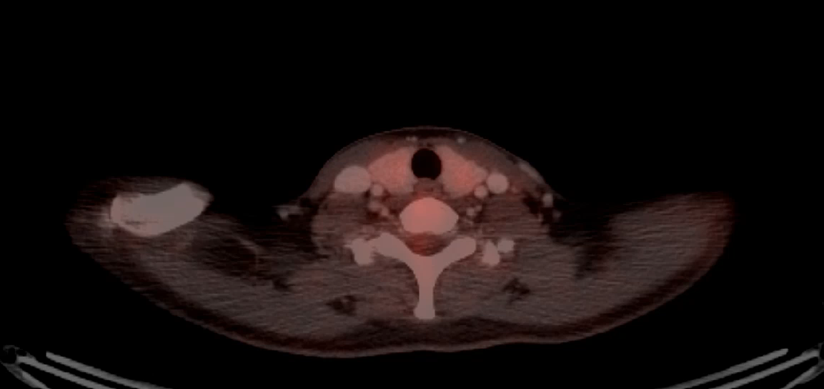
Preoperative Image Examination
TTE (2019.08.28)
  Huge LA mass, R/O LA myxoma
    huge echogenic mass with stalk
    3.7x3.1mm
    Mass irregular surface & hypermobile
PET-CT(타병원/2019.07.12)
  3.2 cm hypermetabolic LA mass
  r/o Cardiac myxoma

Slide 3
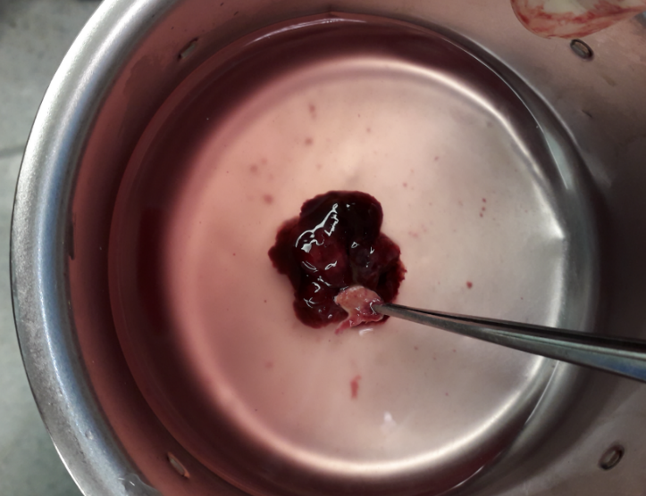
Operative record
Mass
- 3x4cm sized oval mass with broad stalk (1cm)
- abutting to the interatrial septum
- very fragile
->Operation: LA mass excision

Slide 4
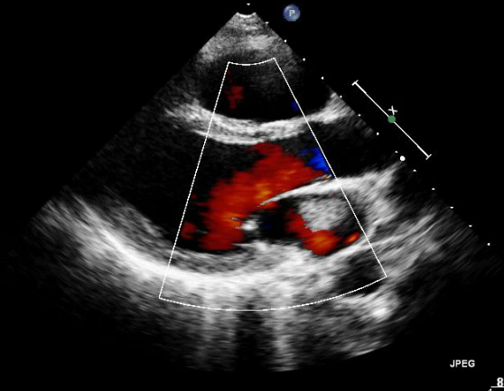
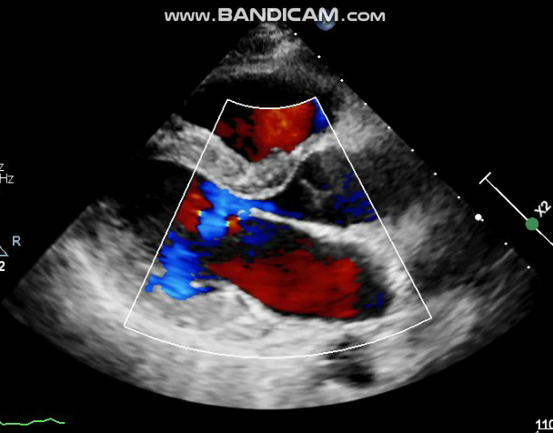
Post operative Image Examination
TTE (2019.09.03)
  No remnant mass
  Normal LV size and systolic function
Pre-op
Post-op

Slide 5
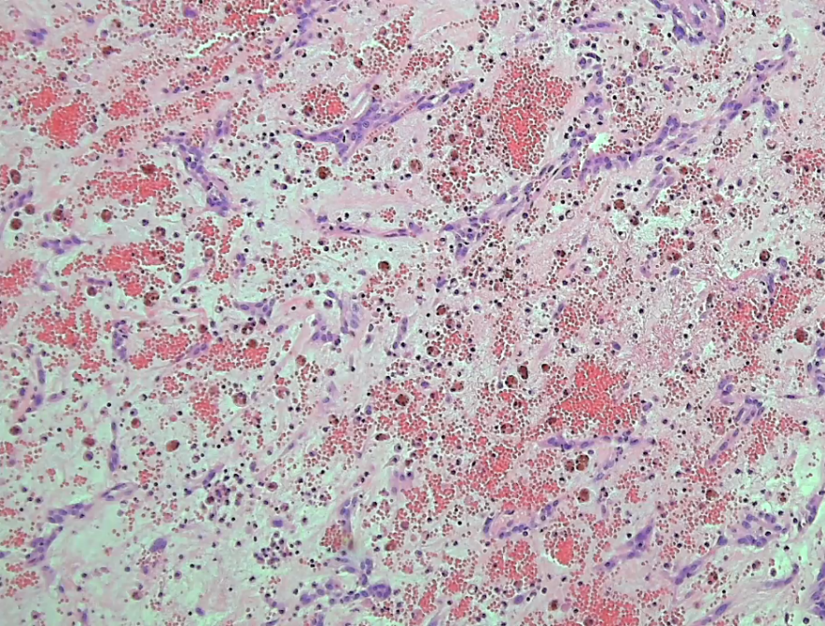
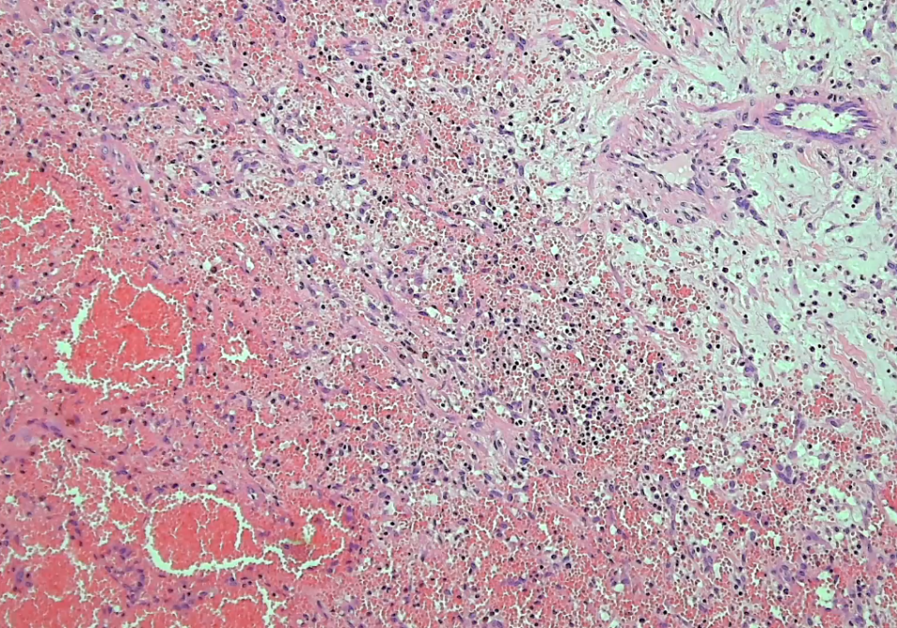
Pathology
Diagnosis > Cardiac myxoma
> Pan-bacterial PCR result :
Haemophilus parainfluenzae 99.87% (796/797)

