Slide 1
Extending the indication for application of home-monitoring program: tetralogy of Fallot or its variants

Slide 2
Purpose
Home monitoring program (HMP) is useful for screening of clinical deterioration in the patient with congenital heart disease.
Since spell events in Tetralogy of Fallot (ToF) can be rapidly occurred and may require emergent treatment, application of HMP would be convincing.
We sought to evaluate incidence of desaturation events in carefully screened ToF patients with HMP, and to elucidate the risk factor for desaturation events.

Slide 3
Methods
Single center retrospective review
From Sep 2017 to May 2019
Inclusion
  Patients who were included in HMP
  HMP was applied to the patients who were deemed at higher risks of developing hypoxic spell

Slide 4
Results
53 patients were enrolled
1 mortality at 75 days after HMP enrollment
Unplanned surgical intervention for desaturation : 17 patients (32.1%)
  Detection in scheduled outpatient follow up : 3 patients
  Detection by HMP : 14 patients
Duration from desaturation detection to surgical management
  Median 13 days (IQR, 7 to 26 days)
6 patients underwent SPS insertion
  4 patients underwent subsequent repair
  2 patients are awaiting repair
11 patients underwent early repair

Slide 5
Results
Results of cox proportional hazard ratio for desaturation event
 | Univariable |  |  |  | Multivariable
 | HR | 95% CI | P |  | HR | 95% CI | P
Sex | 1.24 | 0.44 to 3.53 | 0.69 |  | 1.06 | 0.33 to 3.37 | 0.92
Birth Weight (kg) | 0.46 | 0.16 to 1.34 | 0.15 |  | 0.78 | 0.19 to 3.26 | 0.78
Prematurity | 1.69 | 0.39 to 7.38 | 0.49
PVA (Z) | 0.89 | 0.55 to 1.45 | 0.64
Infundibular volume index (mm³/m²) | 0.996 | 0.994 to 0.998 | <0.001 |  | 0.996 | 0.994 to 0.998 | <0.001

Slide 6
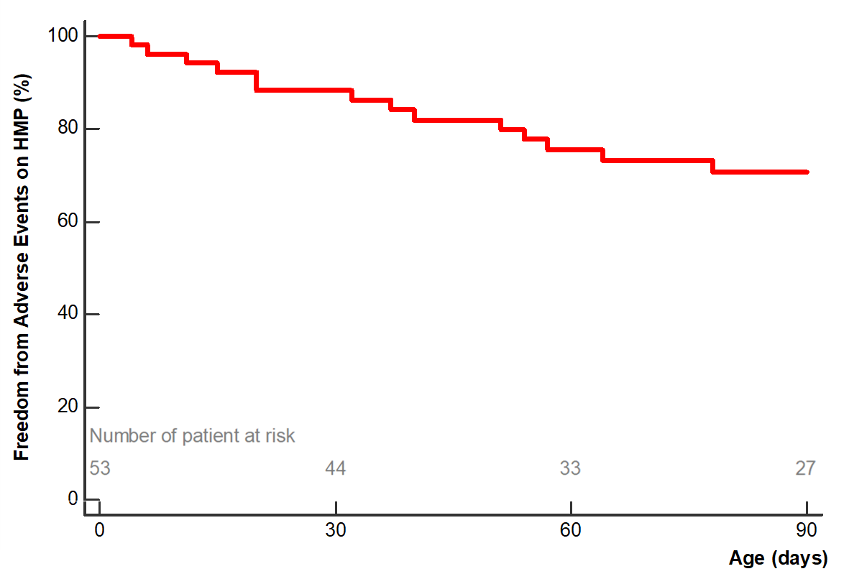
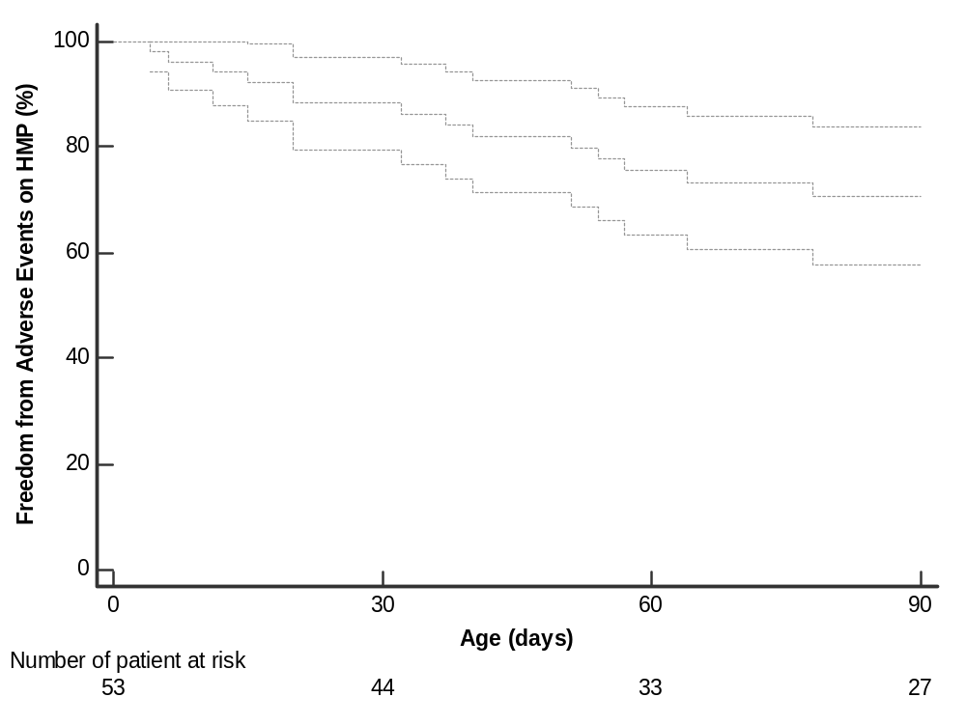
Results
Freedom from desaturation event
  Freedom from adverse events on HMP at 1, 2, and 3 months were 88±4.5%, 75±6.2%, and 70±6.7%

Slide 7
Conclusion
One-third of the preoperative patients with ToF shows unexpected
cyanosis at home necessitating urgent surgical intervention.
Patients with smaller infundibular volume on initial echocardiography are at higher risks.
HMP may be helpful for early detection and timely management of
preoperative desaturation

