Slide 1
Clinical outcomes of various surgical strategies for pulmonary atresia / ventricular septal defect with diminutive native pulmonary artery and major aortopulmonary collateral arteries

Slide 2
Purpose
Treatment of pulmonary atresia / ventricular septal defect with diminutive native pulmonary artery (NPA) is still challenging.
Aggressive unifocalization of major aortopulmonary collateral arteries (MAPCAs) with prosthetic central PA reconstruction requires a substantial learning curve.
NPA rehabilitation strategy which promote the growth of NPA by additional blood flow has been introduced as an alternative strategy.
Utilization of cardiopulmonary bypass (CPB) may prevent severe desaturation upon NPA rehabilitation surgery, however, use of CPB without controlling MAPCAs may lead to systemic hypoperfusion and worse outcomes.
We sought to evaluate the clinical outcomes with respect to the different surgical strategies on the NPA and utilization of CPB.

Slide 3
Methods
Single center retrospective review
From March 2001 to Ja2018
Inclusion
  Patients with pulmonary atresia (or stenosis) / ventricular septal defect, MAPCAs and diminutive NPA (mean z-score of right and left pulmonary artery < -2 at initial presentation)
Exclusion
  Patients with single ventricular physiology
Patients classification
  Group 1 : NPA rehabilitation without CPB
  Group 2 : NPA rehabilitation with CPB
  Group 3 : Primary MAPCAs unifocalization

Slide 4
Results
36 patients were included for analysis
  Group 1 : 17 patients
    Central shunt : 10 patients
    Modified Blalock-Taussig shunt : 5 patients
    Balloon pulmonary valvuloplasty : 1 patient
    Patent ductus arteriosus stent : 1 patient
  Group 2 : 15 patients
    Right ventricle to pulmonary artery shunt : 13 patients
    Right ventricular outflow tract obstruction relief : 2 patients
  Group 3 : 4 patients

Slide 5
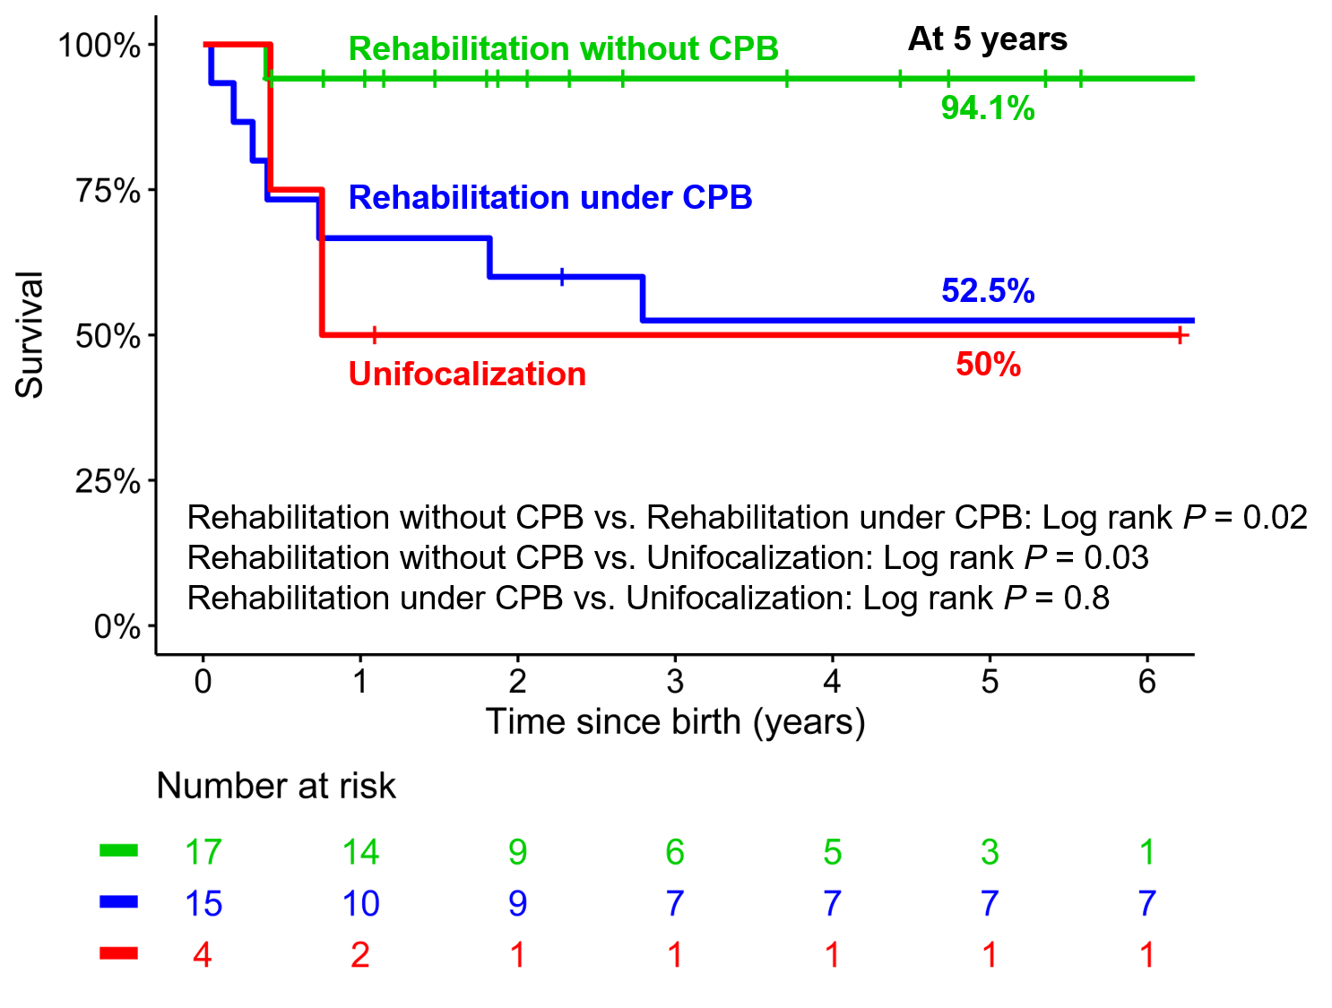
Results
Survival

Slide 6
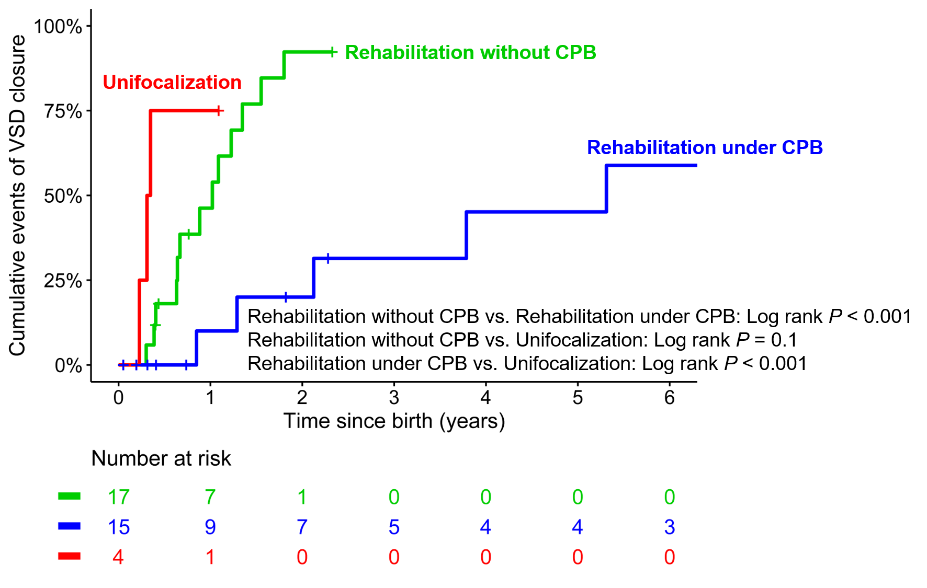
Results
Ventricular septal defect closure

Slide 7
Conclusion
Promising clinical outcome could be achieved with NPA rehabilitation in patients with pulmonary atresia / ventricular septal defect,
MAPCAs and diminutive NPA.
Utilization of CPB should be reserved until the complete MAPCA
control is achieved.

