Slide 1
ECMO Support as a Bridge to Lung Transplantation;
Comparison of results before and after the introduction of Oxy RVAD
공지사항
  소속기관이나 저자명이 드러나지 않도록 해주세요.
  제목 슬라이드 제외 최대 6장, Font size 20 이상
  사진/illustration등으로 인해 용량이 큰 경우 PDF로 전환해서 접수

Slide 2
Purpose
Patients with acutely exacerbated idiopathic pulmonary fibrosis require extracorporeal membrane oxygenation (ECMO) for bridge to transplant (BTT)
If secondary right heart failure (RHF) has developed, it is difficult to maintain survival via conventional peripheral ECMO alone.
We changed BTT strategy as Oxy-RVAD and report result of Oxy-RVAD delivery for BTT in end-stage IPF patients with RHF.

Slide 3
Methods
From March 2012 to June 2019.
patients listed for lung transplantations.
patients underwent ECMO support for lung transplantation
Oxy RVAD was introduced since Oct 2018 for secondary pulmonary hypertension (RHF)
We retrospectively compared the clinical result before and after Oxy RVAD.
ECMO Support for LT (40)
Before Oxy RVAD (22)
After Oxy RVAD (18)
Delisting (4)
LT (18)
LT (14)
Delisting (4)

Slide 4
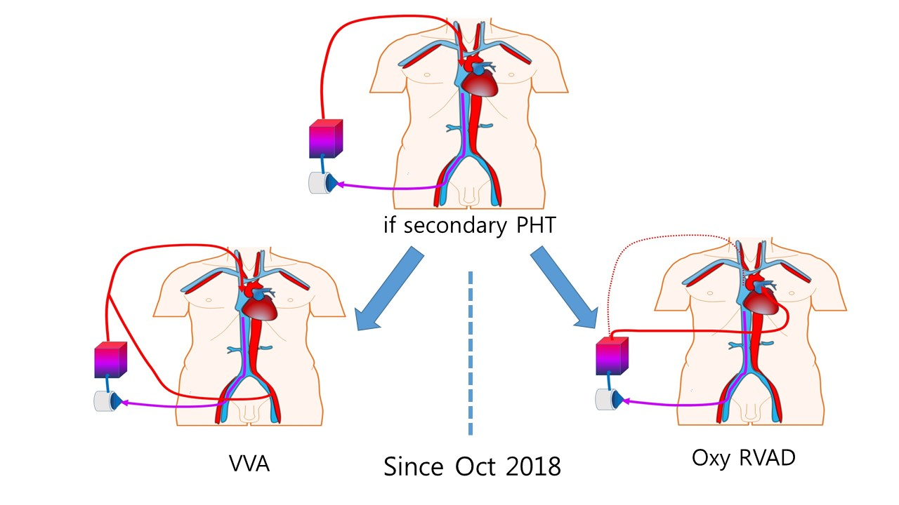
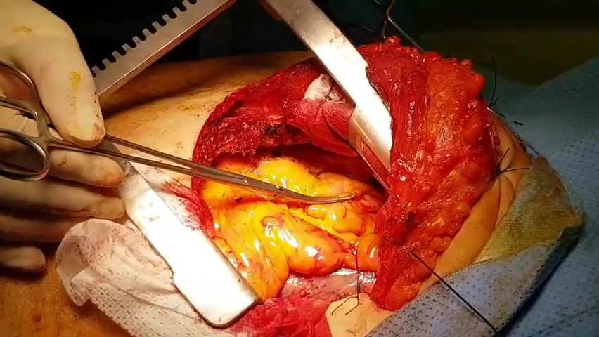
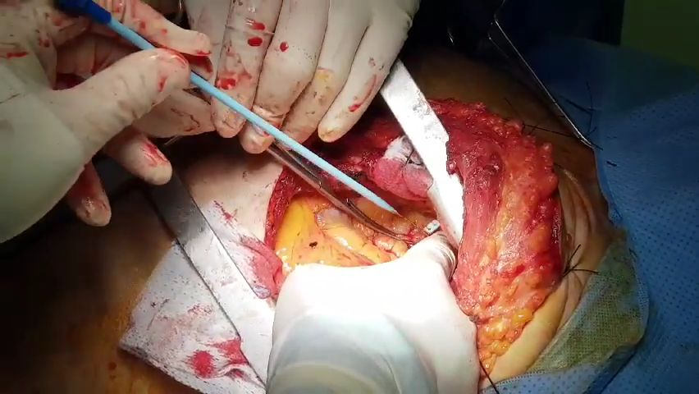
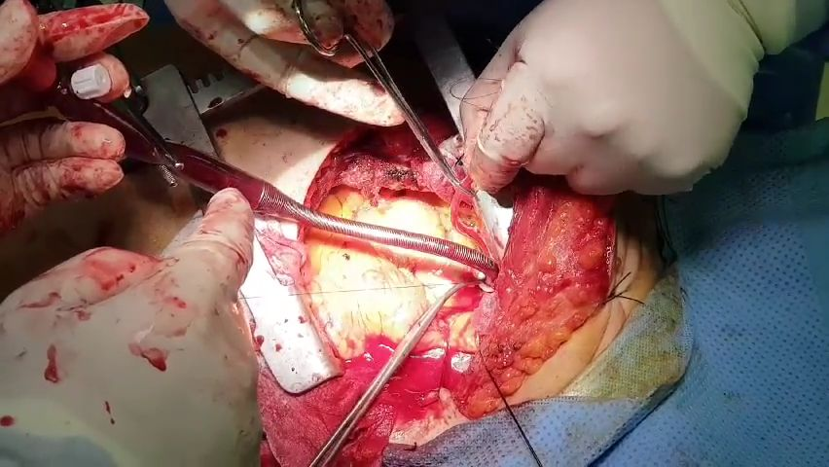
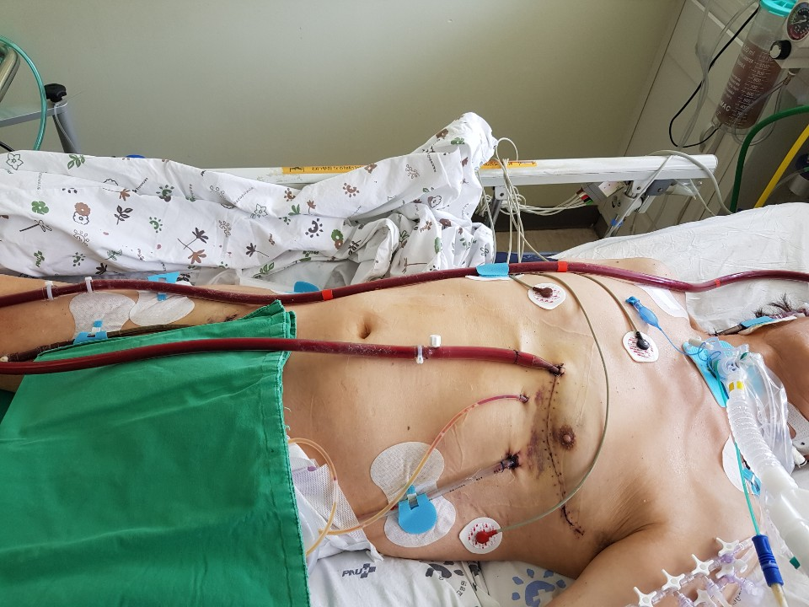
Methods
ECMO Stragerdy
How to Oxy RVAD

Slide 5
Outcome of ECMO bridge to lung transplantation(Total)
Results in
 | Overall | Before Oxy RVAD | After Oxy RVAD | P-value
Age, years | 59.4 ± 8.75 | 56.1 ± 9.8 | 63.4 ± 5.1 | 0.004
M:F | 29 : 11 | 13 : 9 | 16 : 2 | 0.038
APACHE II | 14.0 ± 7.9 | 12.4 ± 6.2 | 15.8 ± 9.4 | 0.176
RESP score | 0.3 ± 2.4 | 3.1 ± 0.7 | 1.1 ± 0.3 | 0.594
Waiting duration until LT | 21.1 ± 15.5 | 16.2 ± 3.5 | 14.5 ± 3.4 | 0.331
ECMO duration before LT | 13.8 ± 11.3 | 13.7 ± 10.4 | 13.9 ± 12.6 | 0.954
More than 2week | 17 | 10 | 7 | 0.462
Lung transplantation rate | 32 | 18 | 14 | 0.528
In-hospital mortality | 17 | 10 | 7 | 0.462

Slide 6
Outcome of ECMO bridge to lung transplantation(non LT)
Results
 | Overall | Before Oxy RVAD | After Oxy RVAD | P-value
Age, years | 64.1 ± 3.8 | 65.0 ± 3.6 | 63.3 ± 4.3 | 0.553
M:F | 6 : 2 | 2 : 2 | 4 : 0 | 0.214
APACHE II | 12.6 ± 8.6 | 10.3 ± 7.4 | 15.0 ± 10.0 | 0.478
RESP score | 0.63 ± 2.4 | 0.25 ± 3.5 | 1.0 ± 0.8 | 0.691
Waiting duration until LT | 26.1 ± 17.1 | 26.5 ± 17.9 | 25.8 ± 18.9 | 0.956
ECMO duration before LT | 17.5 ± 9.4 | 17.3 ± 10.5 | 17.3 ± 9.8 | 0.947
More than 1week | 6 | 3 | 3 | 0.786
More than 2week | 6 | 3 | 3 | 0.786
More than 3week | 5 | 2 | 3 | 0.500

Slide 7
Outcome of ECMO bridge to lung transplantation(LT patient)
Results
 | Overall | Before Oxy RVAD | After Oxy RVAD | P-value
Age, years | 58.2 ± 9.3 | 54.1 ± 9.6 | 63.5 ± 5.5 | 0.002
M:F | 23 : 9 | 11 : 7 | 12 : 2 | 0.127
APACHE II | 12.3 ± 7.9 | 12.9 ± 6.1 | 16.1 ± 9.6 | 0.262
RESP score | 0.3 ± 2.5 | 0.1 ± 3.2 | 0.4 ± 1.2 | 0.725
Dialysis (Renal) | 7 | 6 | 1 | 0.087
Waiting duration until LT | 19.8 ± 15.1 | 22.5 ± 16.3 | 16.4 ± 13.0 | 0.246
ECMO duration before LT | 12.9 ± 11.7 | 12.9 ± 10.6 | 12.9 ± 13.4 | 0.984
More than 2week | 11 | 7 | 4 | 0.410
More than 3week | 7 | 4 | 3 | 0.649
Post LT ventilator time, days | 31.5 ± 29.5 | 31.6 ± 29.9 | 31.3 ± 30.1 | 0.976
Post LT ECMO Support time | 3.4 ± 3.6 | 2.8 ± 2.2 | 4.1 ± 4.8 | 0.358
Post LT ICU Stay | 31.2 ± 27.1 | 35.0 ± 26.8 | 26.4 ± 27.7 | 0.383
Post LT hospital stay | 64.5 ± 39.9 | 64.5 ± 38.4 | 64.6 ± 43.4 | 0.996
Post LT-hospital mortality | 9 | 6 | 3 | 0.368
Post operative steroid pulse therapy | 11 | 7 | 4 | 0.410

Slide 8
Conclusion
Patients with acutely exacerbated idiopathic pulmonary fibrosis require ECMO for BTT
In Oxy-RVAD group, similar results can be achieved compared to before Oxy-RVAD in older patients
Limitation of this study is restrospectively result, small case and short duration of Oxy-RVAD group.
Oxy-RVAD is useful option in Patients with RHF caused by secondary pulmonary hypertension, who were on ECMO support as a bridge to LT.

