Slide 1
Surgical outcomes of uncrossing procedure in patients with vascular ring due to circumflex aorta

Slide 2
Purpose
A “circumflex aorta” is a vascular ring composed of right aortic arch, ligamentum arteriosum and descending thoracic aorta passing posteriorly to the trachea and esophagus.
The aortic uncrossing procedure for this anomaly is complex and rarely reported.
The purpose of this study
  To describe surgical procedure of circumflex aorta
  To describe postoperative complications of the surgical procedure

Slide 3
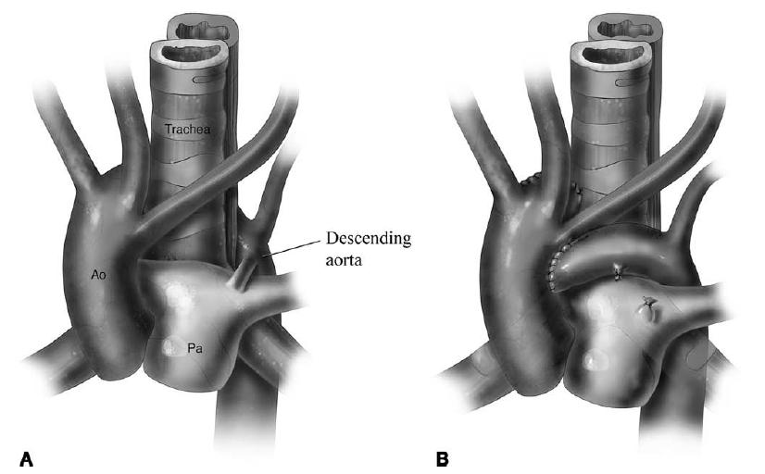
Methods
January 2004 to March 2018 : 5 patients with circumflex arch
  Ligamentum arteriosum division (n=1)
  Uncrossing procedure (n=4)
Median follow-up : 9.7 years (range 1.5-15.2)
Descriptive analysis
The aortic uncrossing procedure for circumflex aorta, CL Backer et al, Operative Techniques in Thoracic and Cardiovascular Surgery, 2013

Slide 4
Results
Surgical procedure
  Median CPB time = 128min
  Circulatory arrest with deep hypothermia and antegrade selective cerebral perfusion (3/4)
Operative results
  Mortality : no in-hospital and long-term mortality
  Postoperative complications
    Vocal cord palsy (3/4), tracheomalacia (2/4)
    Reintubation (2/4), Tracheostomy (2/4)
  Symptom improved (4/4)

Slide 5
Conclusion
Aortic uncrossing procedure is safe surgical procedure with no in-hospital and long-term mortality.
But respiratory complication is frequent because circumflex aorta is often associated with tracheomalacia and the aortic uncrossing procedure sometimes results in bilateral vocal cord palsy.

