Slide 1
Surgical Outcome of Peel Operation for Right Ventricular Outflow Tract Reconstruction

Slide 2
Purpose
Multiple reoperation is frequently needed in patients with right ventricle-to-pulmonary artery conduit.
Peel operation is one of the options in surgical techniques for conduit reoperation characterized by simple and safe procedure.
The purpose of this study is to examine the surgical results of peel operation in patients who underwent right ventricle-to-pulmonary artery conduit replacement.

Slide 3
Methods
January 1996 – July 2019
Inclusion
  Patients who underwent right ventricular outflow tract reconstruction by Peel operation
Outcome
  Freedom from reoperation
Retrospective study

Slide 4
Results
38 patients were included
Median follow-up duration: 118 months (range, 1 month – 23 years)
Operative data
 | N = 38
Age (median) | 16 (range, 1 – 40 years)
Diagnosis | PA with VSD TOF DORV TGA VSD PS others | 22 3 5 5 3
Surgical indication | Regurgitation Stenosis Both | 19 10 9
Number of conduit replacements | 2 3 >4 | 28 8 2
Previous conduit | Pericardial roll Homograft Dacron ePTFE | 22 2 10 4
Valve size (N=25) | 23 25 27 | 3 15 7

Slide 5
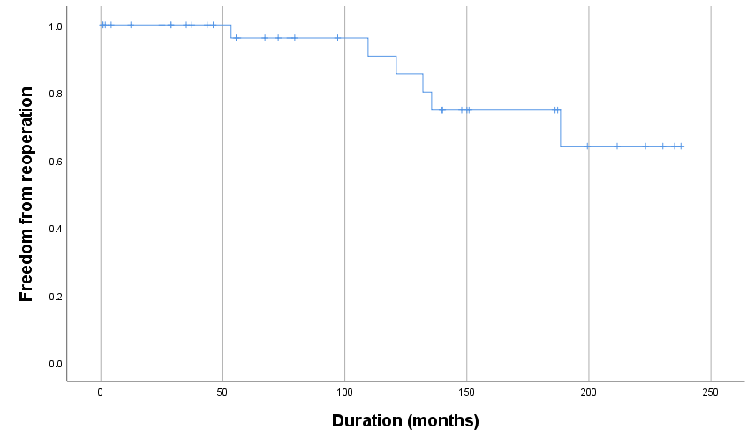
Results
No early or late death
Reoperation was required in 6 patients
Freedom from reoperation
  At 5, 10, 15 year: 96, 86, 75%

Slide 6
Conclusion
Peel operation allows implantation of a generous sized valve in right ventricular outflow tract.
The conduit created with Peel operation demonstrated excellent durability.
Peel operation is a simple surgical technique which may allow implantation of a larger sized-valve than implantation of a preformed-valved conduit. The larger sized-valve provides wide acceptability of percutaneous pulmonary valve implantation for the subsequent valve replacement.

