Slide 1
Usefulness of Mechanical Circulatory Support as a Bridge to Pediatric Heart Transplantation

Slide 2
Purpose
Donor shortage is the main problem in pediatric heart transplantation.
Mechanical circulatory support (MCS) is known to increase waiting list survival.
However, in terms of complications and usability, there are few reports of MCS before paediatric heart transplantation.

Slide 3
Patients
August 2005 – July 2019 : 22 patients younger than 18 year who underwent heart transplantation
    Cardiomyopathy (n=15), Congenital heart disease (n=7)
Group A : Patients who were supported with MCS (n=11)
Group B : Patients who were supported without MCS(n=11)

Slide 4
Methods
MCS was performed in patients classified as Interagency Registry for Mechanically Assisted Circultory Supprot(INTERMACS) profile 1 and 2
INTERMACS profile was more severe in Group A than Group B (p<0.001)

Slide 5
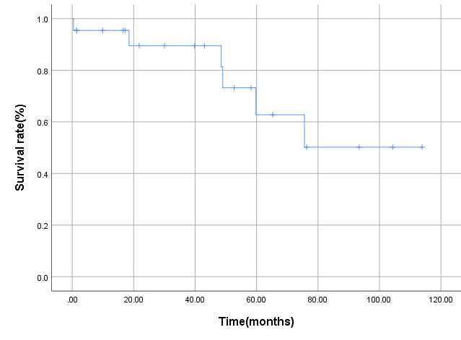
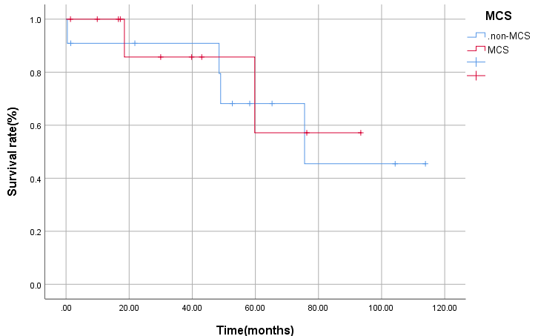
Results
Mean follow up period was 45.3±33.4 months.
1 early death: refractory thrombocytopenia
5 late death
  rejection after 18, 48 months(n=2),
  unknown sudden death after 49, 59, 75 months(n=3).
Overall survival rates at 1, 5 and 8 years were, 95.5%, 62.8%, and 50.2% respectively, with no significant difference between the two groups(p=0.774).

Slide 6
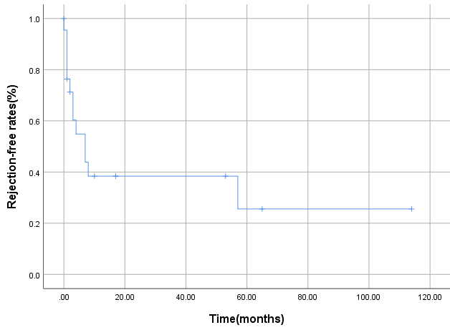
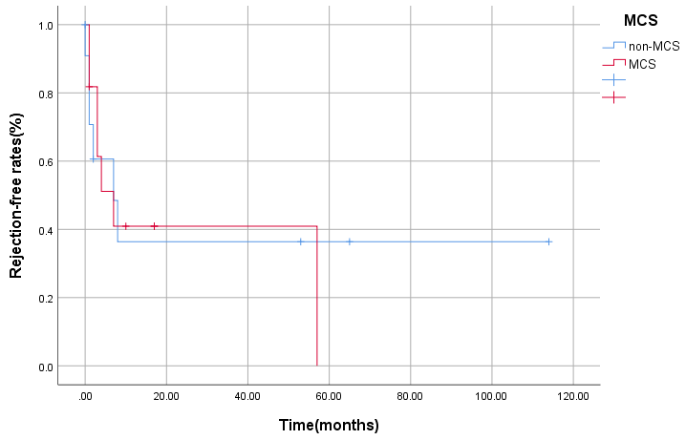
Results
Rejection-free rates at 1 and 5 years were respectively 38.4% and 25.6%, with no significant difference between the two groups(p=0.927).
There were no significant differences in morbidity including Acute kidney injury(p=0.087), and reoperation for bleeding(0.138) between two groups.

Slide 7
Conclusion
MCS support was able to bridge most INTERMACS 1 and 2 pediatric patients to transplant with an acceptable complication rate.
And, it has increased waiting list survival.

