Slide 1

The Prognostic Importance of the Number of Dissected Recurrent Laryngeal Nerve Lymph Node after Radical Esophagectomy for Early-Stage Esophageal Squamous Cell Carcinoma
Radical dissection
For RLN-LNs :
Increased morbidity?
RLN palsy, and
Aspiration risk ↑
Radical dissection
For RLN-LNs :
Oncologic benefit?
Recurrence ↓
Survival ↑
What number?
Even for T1N0?

Slide 2
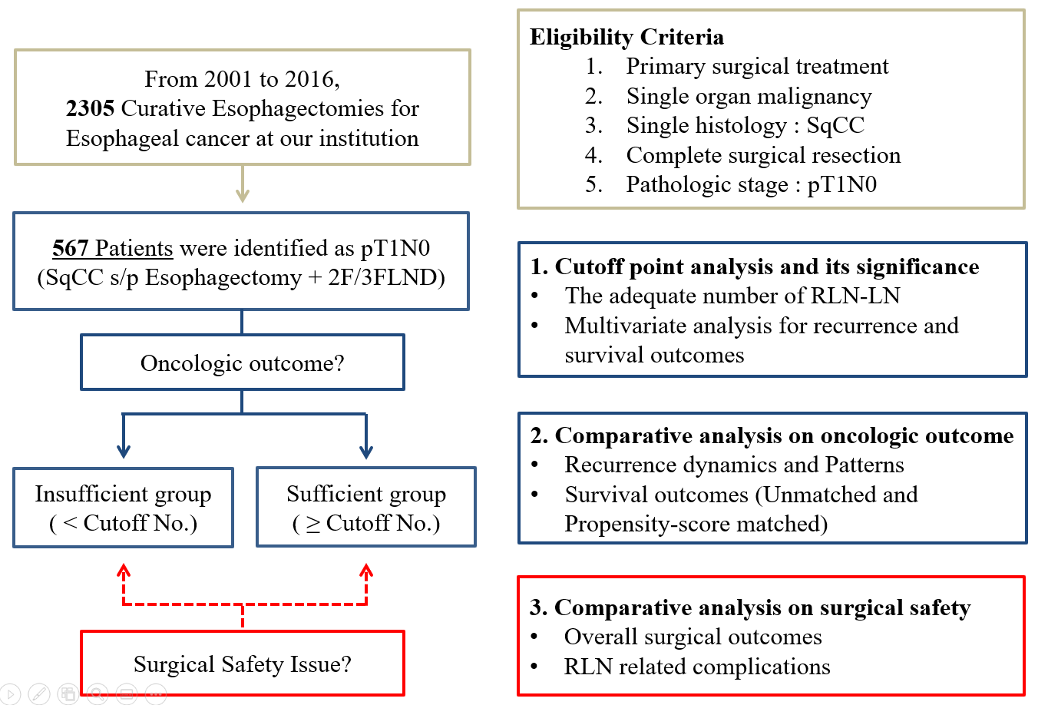
Purpose / Methods
We hypothesized that the greater number of dissected RLN-LN can improve oncologic outcome within the acceptable risk of complication.
Flow Diagram

Slide 3
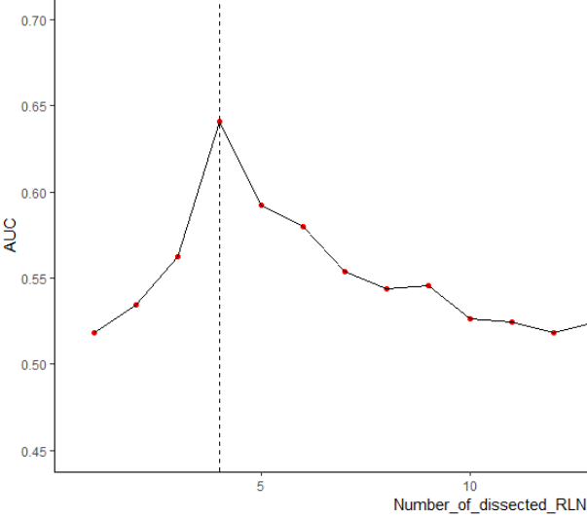
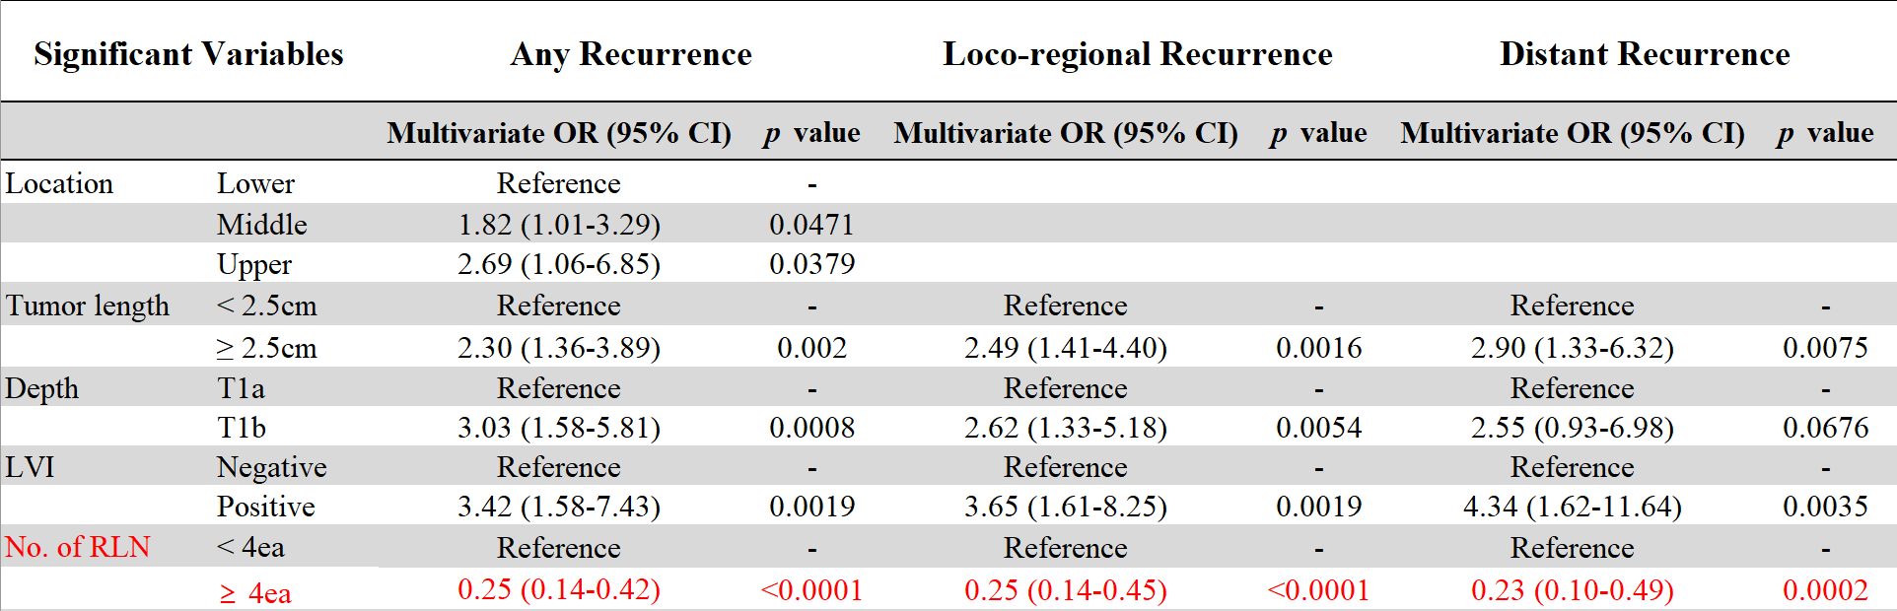
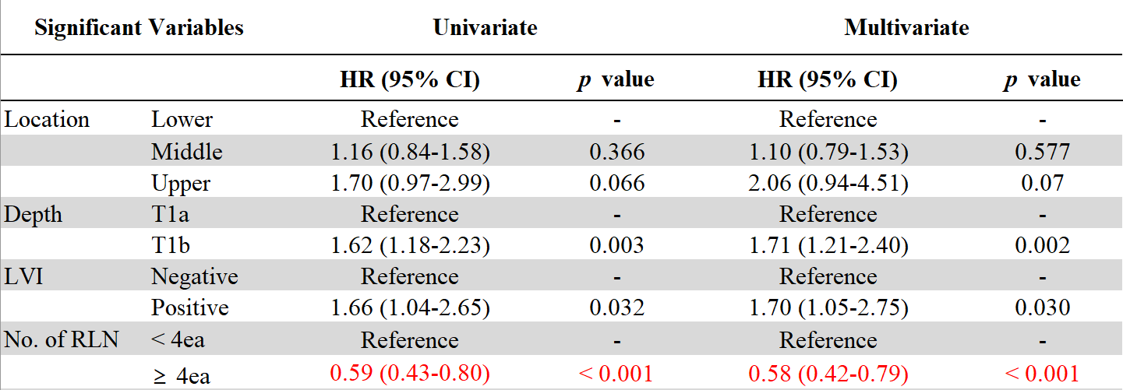
Results (1) Cut-off and its significance
ROC curve for cutoff
Risk Factors for Recurrence (Model : Multi-Logistic)
n=4
(AUC=0.64)
Risk Factors for RFS (Model : Multi-Cox PH)
Entire Cohort, pT1N0 (N=567)
Dissected RLN number
Insufficient (<4ea)
N=139
Sufficient (≥4ea)
N=428

Slide 4
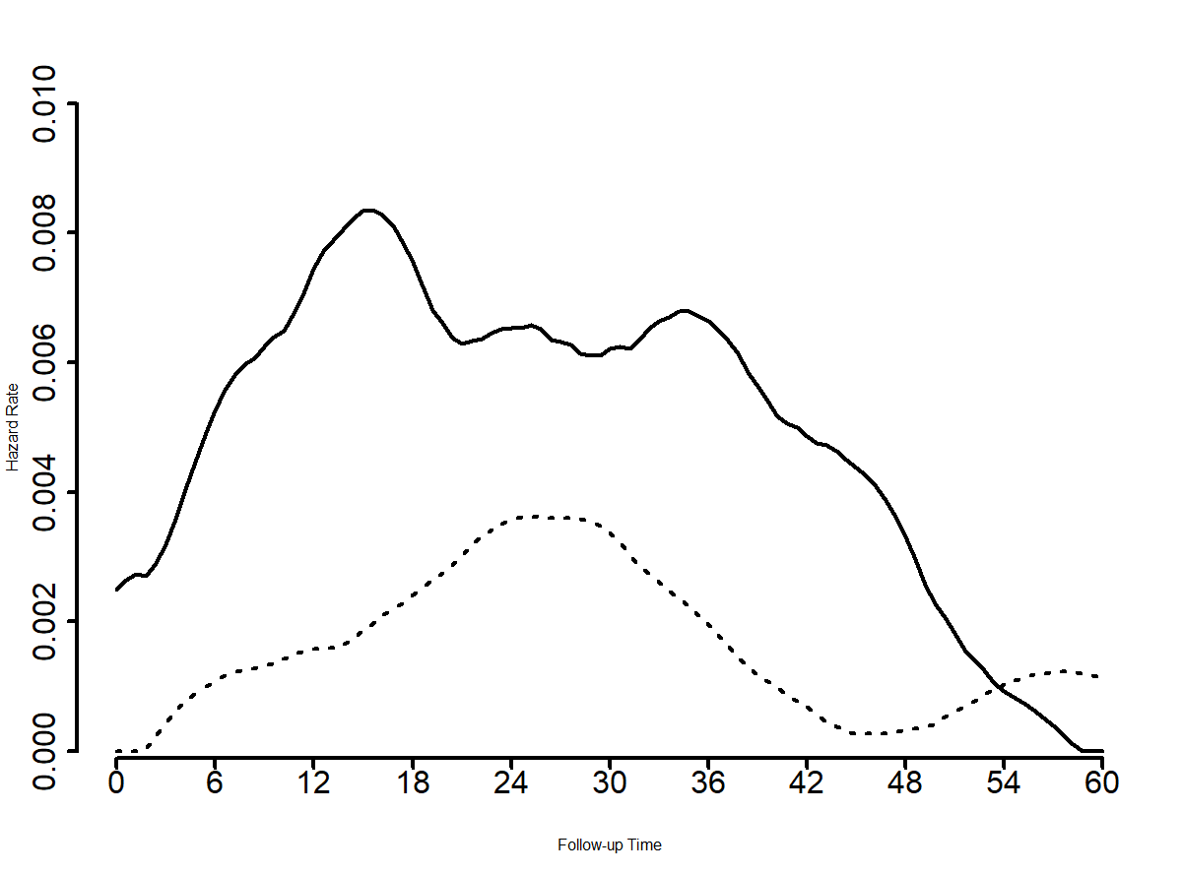
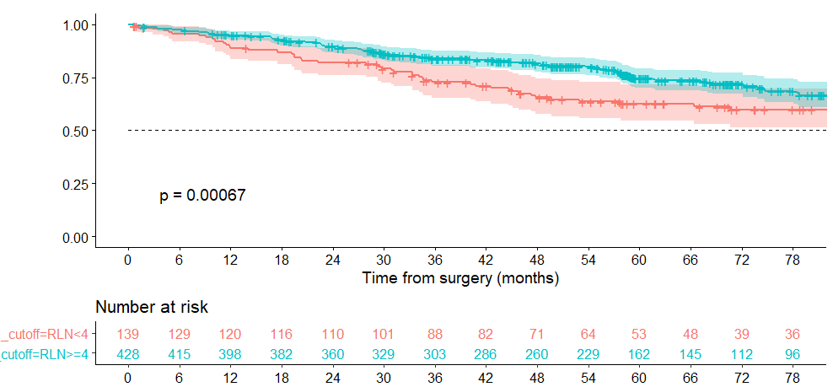
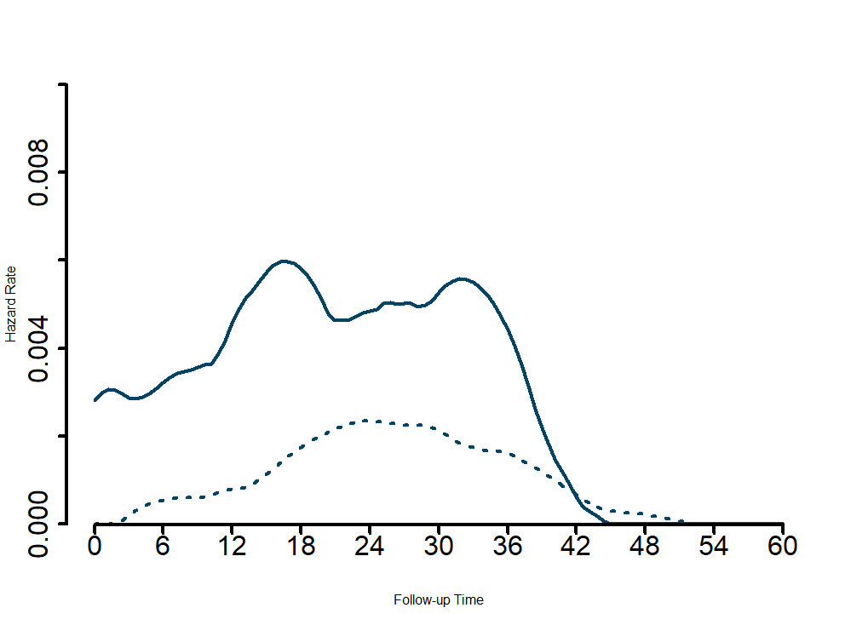
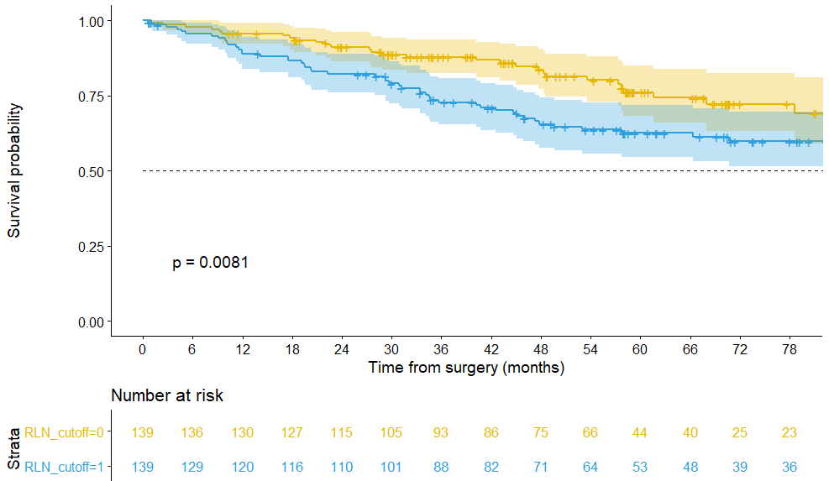
Results (2) Oncologic Outcomes
Recurrence Hazard : Total
RFS by RLN groups (Before-Matching)
RLN < 4
RLN ≥ 4
Sufficient-RLN
Insufficient-RLN
Unmatched for other LNs
Recurrence Hazard : Loco-regional
RFS by RLN groups (After PS-Matching, 1:1)
Sufficient-RLN
RLN < 4
RLN ≥ 4
Insufficient-RLN
Matched for variables
(including other LNs)

Slide 5
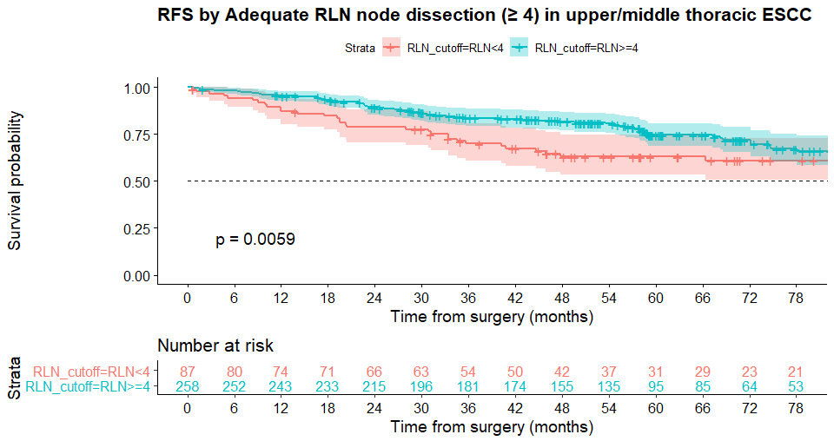
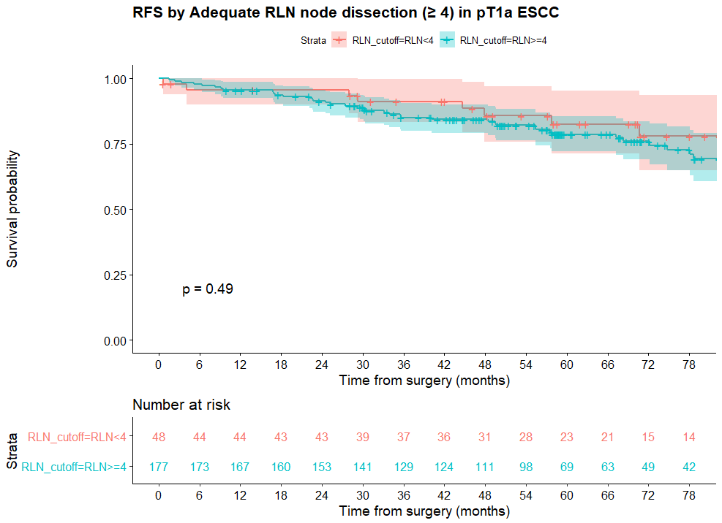
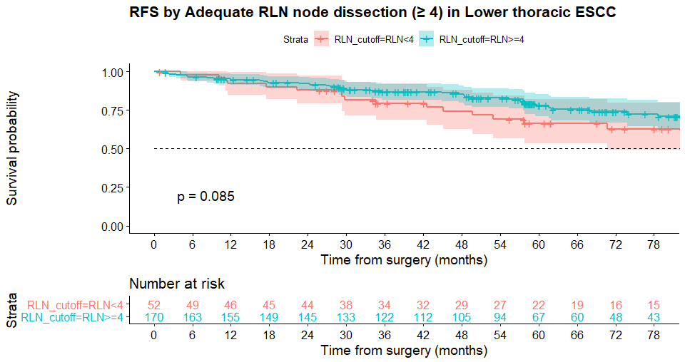
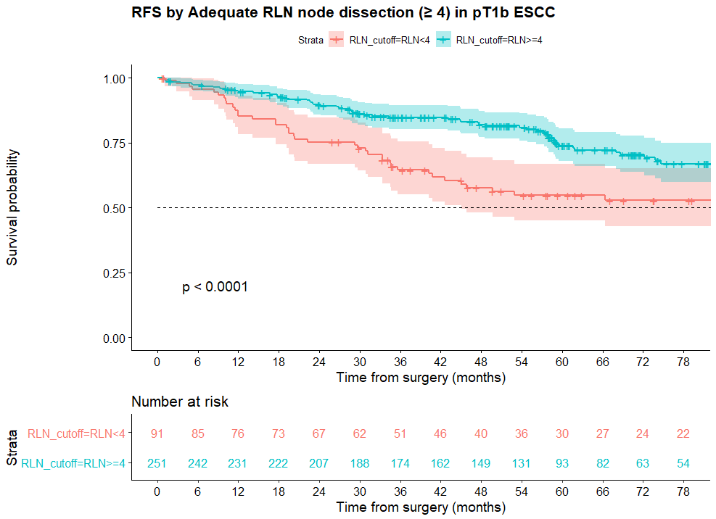
Results (2) Oncologic Outcomes
RFS by RLN-LN groups (Upper/Middle)
RFS by RLN-LN groups (T1a Subgroup)
RFS by RLN-LN groups (Lower)
RFS by RLN-LN groups (T1b Subgroup)

Slide 6
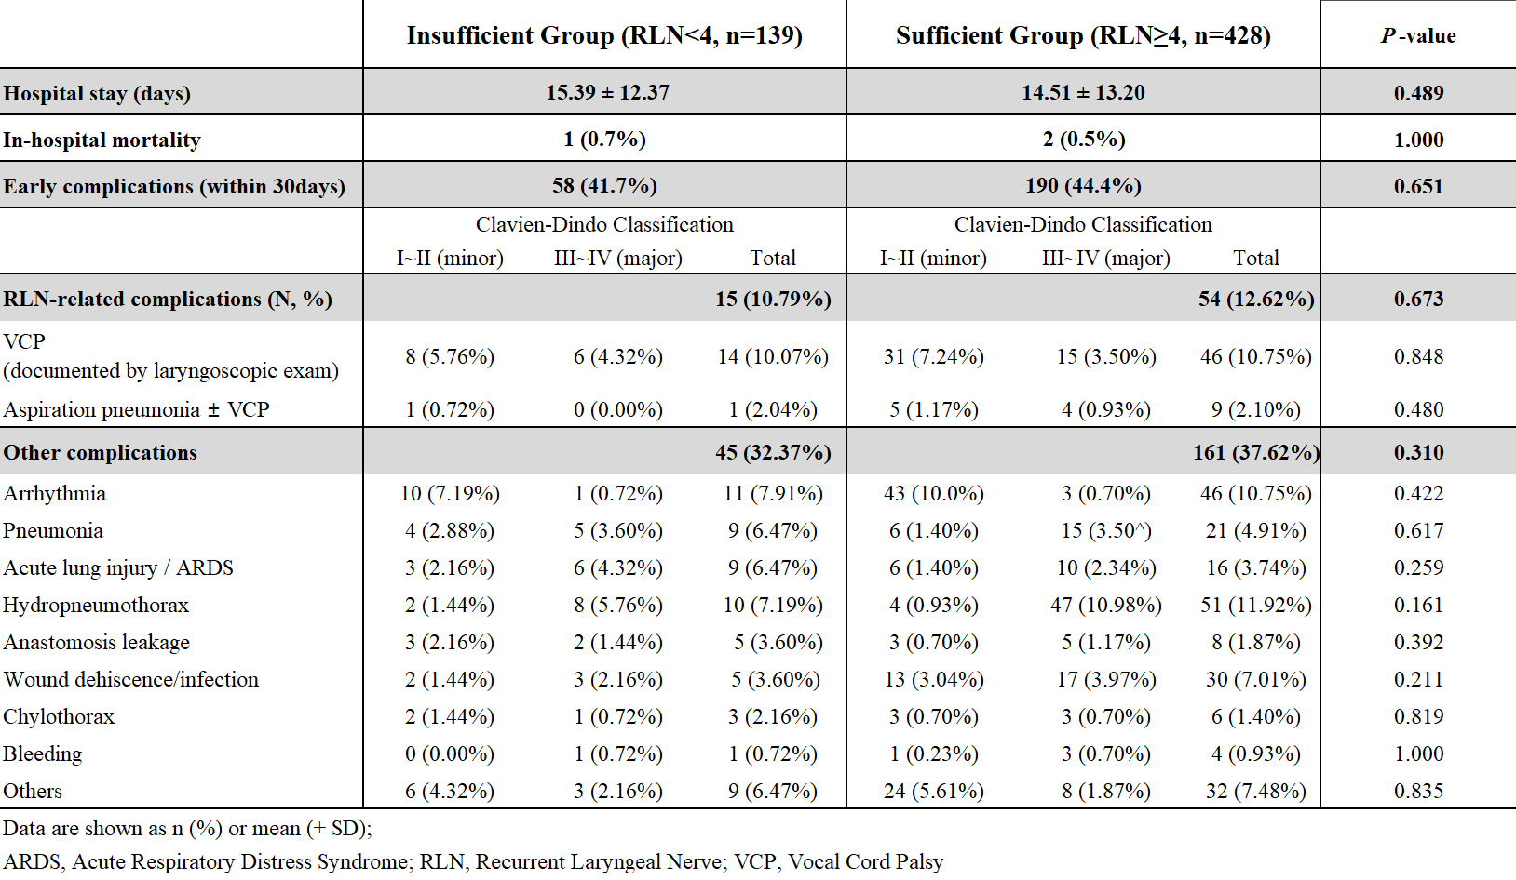
Results (3) Perioperative Outcomes

Slide 7
Conclusion
The number of dissected RLN-LN (cutoff=4) is an independent risk factor for locoregional failure and decreased recurrence-free survival in patients with pT1N0 ESCC.
Sufficient dissection for RLN-LN might be feasible while not compromising surgical safety.
The benefit of thorough dissection for RLN-LNs is prominent in
  Tumors of upper/middle-thoracic location, and/or
  Tumors with pathologic T1b.
Prudent follow-up strategies after esophagectomy is advisable in pT1N0 patients with insufficient (<4) RLN-LN dissection, based on alterations in recurrence dynamics.

