Slide 1
Successful Surgical Management of Right Ventricular Thrombosis and Chronic Pulmonary Thromboembolism in a Child With Acute Lymphoblastic Leukemia

Slide 2
Purpose
Acute lymphoblastic leukemia (ALL) is the most common malignancy in children.
In children with ALL, the incidence of intracardiac thrombosis and pulmonary thromboembolism (PTE) is around 1%.
The pathogenesis of intracardiac thrombosis in ALL is not fully understood, but it is affected by combination of risk factors; malignancy itself, its treatment (asparaginase and corticosteroids), and the host (severe infections, central venous catheters, and immobilization).
We present the case of a 9-year-old girl with ALL, right ventricular (RV) thrombosis, and chronic PTE.

Slide 3
Methods
A 9-year-old girl presented with general weakness and sustained fever for 8 days. The patient was diagnosed as T-cell acute lymphoblastic leukemia.
Echocardiography and computed tomography (CT) showed a large thrombus in the right ventricle (RV) and a separate thrombus completely obstructing the right lower pulmonary artery (Fig. 1).
Although urgent surgical removal of the thrombus was necessary, surgery had to be delayed until the completion of induction chemotherapy due to the high risk of bleeding and infection.
Low molecular weight heparin was administered during the induction chemotherapy without significant resolution of the thrombi.

Slide 4
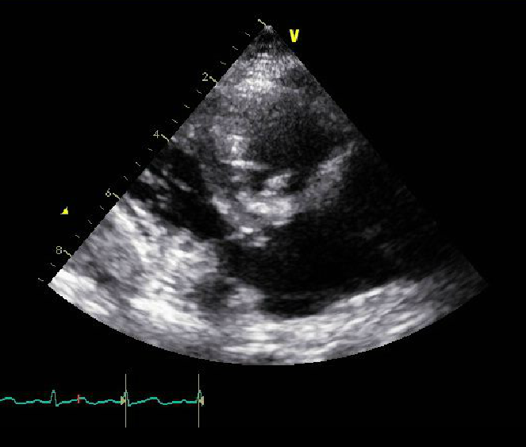
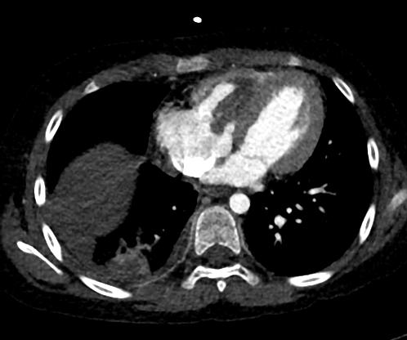
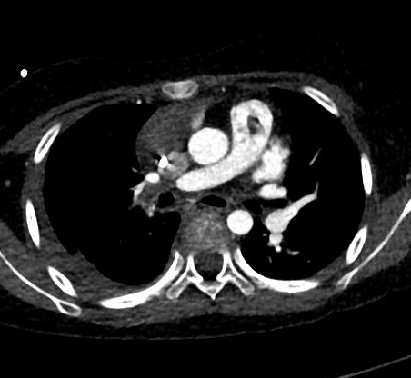
Methods
A
B
RV
*
*
LV
Ao
*
RV
RA
LA
*
RPA
RA
Fig. 1. (A) Transesophageal echocardiography revealed a large mobile mass in the RV. (B) Computed tomography showed filling defects in the RV and the right lower pulmonary artery.
*, thrombus; RA, right atrium; RV, right ventricle; Ao, aorta; RPA, right pulmonary artery; LA, left atrium; LV, left ventricle

Slide 5
Results
After complete remission with the induction chemotherapy, the patient underwent RV thrombectomy and pulmonary thromboendarterectomy (Fig. 2).
Pathologic examination of the removed masses confirmed organizing thrombi.
The child had no postoperative complication. Postoperative CT and echocardiography revealed no residual thrombus in the RV and right lower pulmonary artery except for the minimal thrombus attached to the tricuspid valve.

Slide 6
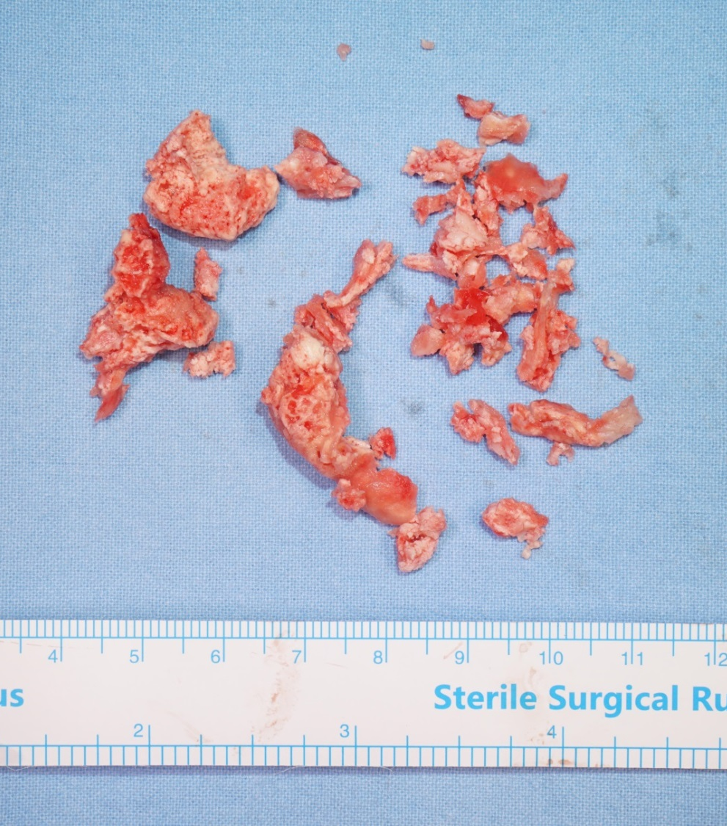
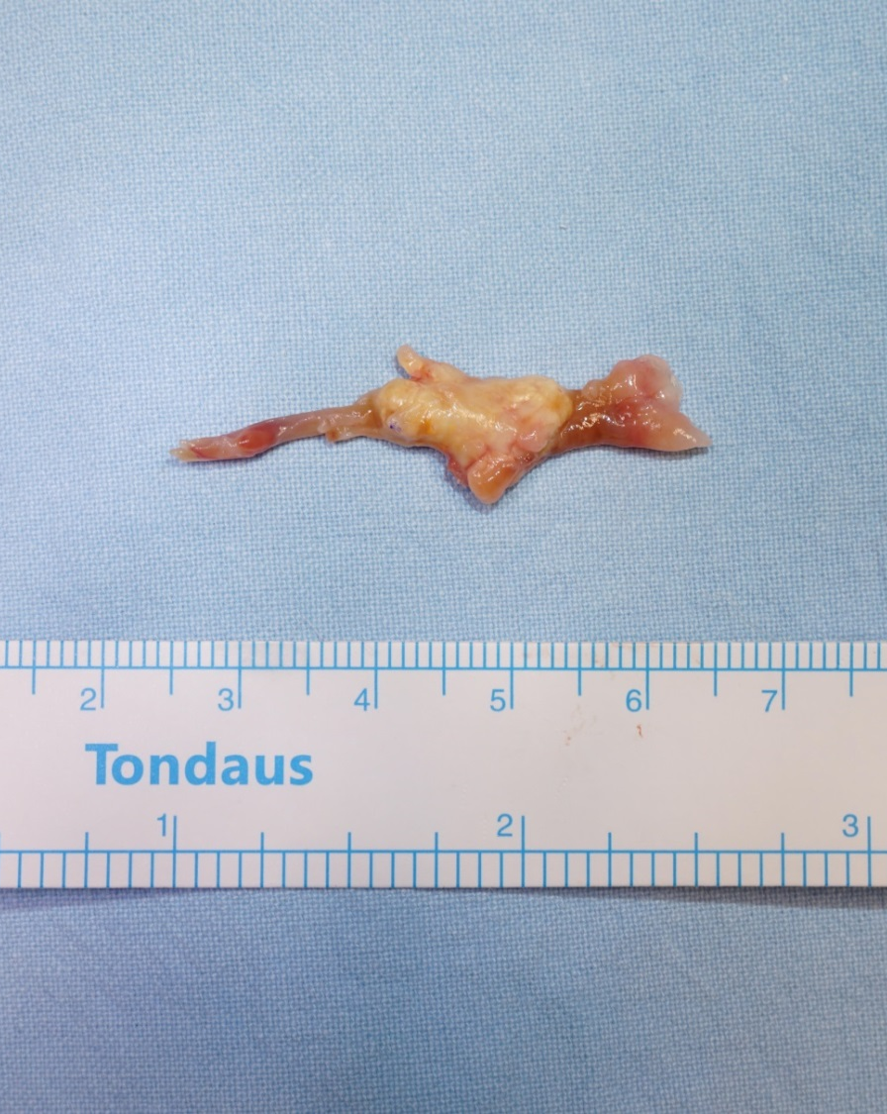
Results
A
B
Fig. 2. (A) Removed right ventricular thrombi. (B) Removed pulmonary arterial thromboembolus.

Slide 7
Conclusion
RV thrombosis and PTE in children with ALL are extremely rare, and to our knowledge, no surgical case has been reported to date.
Surgical management of RV thrombosis and PTE in children with ALL is challenging due to the high risk of bleeding and infection.
We have successfully performed RV thrombectomy and pulmonary thromboendarterectomy in a child with ALL just after completion of the induction chemotherapy without any postoperative complication.

