Slide 1
Long-term result of Sandwich technique for multiple ventricular septal defect repair

Slide 2
Purpose
The management for multiple ventricular septal defects (VSDs) remains a surgical challenge.
In the neonate and infant, primary repair can be demanding.
This study aimed to review the long-term clinical outcomes in the single center.

Slide 3
Patients
June 2006 ~ April 2019
14 patients with multiple VSD
  Male (n=6), Female (n=8)
  Associated with ASD/PFO (n=13), CoA (n=1)
Ages at operation ranging from 4days to 27 months
  Median, 7.23±8.8 months

Slide 4
Methods
Evaluated by echocardiography
  Preoperative / Postoperative (before discharge) / Latest follow-up
Previous sternotomy with PA banding
  2 patients (14.3%)
Concomitant cardiac surgery
  TOF repair (n=2), CoA repair (n=1)

Slide 5
Results
CPB time : 148.9±34.8 min
ACC time : 91.9±29.5 min
ICU stay : 4.8±4.5 days
Ventilator care : 3.4±4.5 days
Mean follow-up duration : 4.2±3.7 years
Postop complications
  LCOS (n=1) : inotropics support
  Cardiac arrest (n=1) : ECMO support
  Arrhythmia (n=1) : PSVT

Slide 6
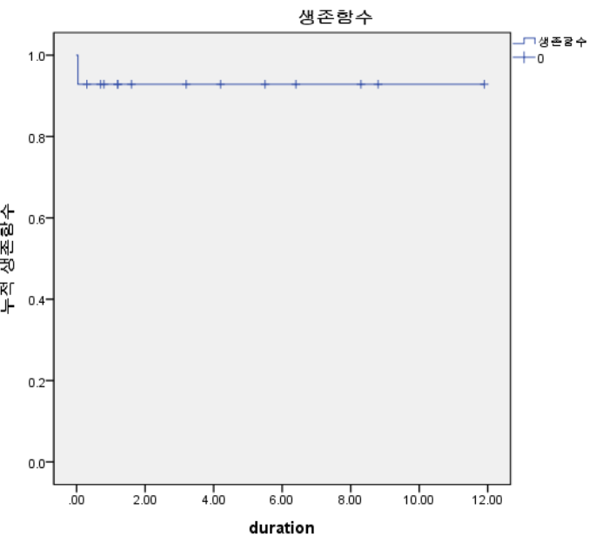
Results
Postoperative mortality : 1 patient
  Cardiogenic shock, multi-organ failure
No late deaths
No reoperation d/t residual shunt
Residual shunt (+) postoperatively
  Spontaneous closure during follow-up
LV function slightly decreased postoperatively
  Improved on latest echocardiography
Overall survival 92.9%

Slide 7
Conclusion
Methods for the repair of multiple VSDs have evolved over the years, with improved outcomes owing to advancements in surgical and interventional techniques.
However, the absence of specific guidelines for the treatment of this specific congenital heart lesion makes decision-making difficult.
In our center, Sandwich technique appeared to be a good option for multiple VSDs in terms of clinical outcomes.

