Slide 1
Left ventricular outflow tract obstruction after arch repair

Slide 2
Purpose
We sought to evaluate the risk factor including LVOT size on the postoperative development of LVOTO after arch repair without primary LVOT intervention.

Slide 3
Methods
Single center retrospective review
From March 2001 to January 2018
Inclusion
  CoA or IAA
  Neonatal total correction under the age of 30 days
Exclusion
  Concomitant anomaly of transposition of great arteries, double outlet right ventricle, atrioventricular septal defect, truncus arteriosus, aortopulmonary window
  Patients who underwent primary LVOT bypass surgery or LVOTR
  Patients without preoperative computed tomography (CT) scan
LVOT dimension were measured by CT scan.
127 patients were finally included for study.

Slide 4
Results
Cox proportional hazard ratio analysis for mortality (n=6)
 | Univariable |  |  |  | Multivariable
 | HR | 95% CI | P |  | HR | 95% CI | P
Sex | 0.58 | 0.11 to 3.15 | 0.53 |  | 0.41 | 0.07 to 2.30 | 0.31
Age at operation (days) | 1.09 | 0.98 to 1.22 | 0.13 |  | 1.08 | 0.96 to 1.22 | 0.21
Body weight at operation (kg) | 0.31 | 0.11 to 0.87 | 0.027 |  | 0.36 | 0.14 to 0.92 | 0.03
Interrupted aortic arch | 0.98 | 0.11 to 8.38 | 0.98
LVOT dimension | 1.09 | 0.51 to 2.38 | 0.82

Slide 5
Results
Cox proportional hazard ratio analysis for LVOT reintervention (n=13)
 | Univariable |  |  |  | Multivariable
 | HR | 95% CI | P |  | HR | 95% CI | P
Sex | 2.77 | 0.85 to 9.02 | 0.09 |  | 1.58 | 0.46 to 5.47 | 0.47
Age at operation (days) | 0.92 | 0.82 to 1.05 | 0.21
Body weight at operation (kg) | 0.63 | 0.27 to 1.47 | 0.29 |  | 1.07 | 0.41 to 2.84 | 0.89
Interrupted aortic arch | 1.39 | 0.38 to 5.04 | 0.62
Bicuspid aortic valve | 1.66 | 0.51 to 5.40 | 0.40
VSD | 1.01 | 0.28 to 3.66 | 0.99
LVOT dimension | 0.22 | 0.11 to 0.43 | <0.001 |  | 0.23 | 0.12 to 0.46 | <0.001

Slide 6
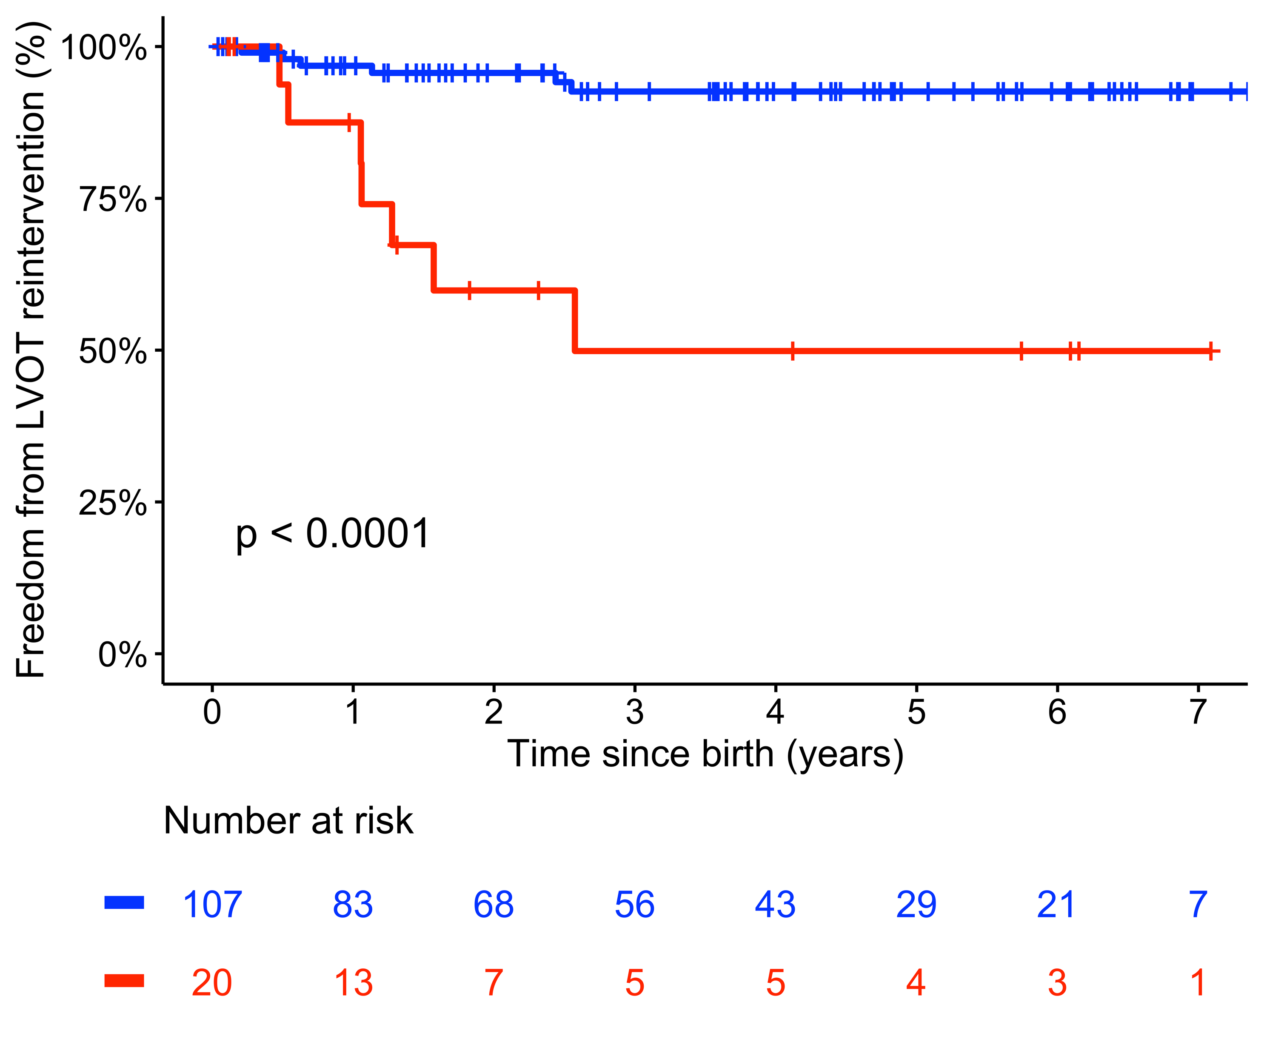
Results
Cut-off value of LVOT dimension for LVOT reintervention using
maximal chi-square test : at 4.57 mm (P = 0.001)
LVOT>4.57mm
92.6% at 3 years
LVOT≤4.57mm
49.9% at 3 years
Log-rank
P < 0.001

Slide 7
Conclusion
In patients who underwent CoA or IAA repair, pulmonary artery band placement after arch repair, low body weight at repair were deemed significant risk factor for mortality.
LVOT reintervention is significantly related with LVOT dimension, therefore, risk for development of LVOTO in patients with small LVOT dimension, especially below 4.57 mm.
It would be reasonable approach to perform primary LVOT bypass surgery or additional procedures to reduce postoperative LVOTO in selected patients.

