Slide 1
Is the blanking period of 3 months after surgical ablation appropriate?

Slide 2
Purpose
Early recurrence of atrial tachyarrhythmia (ERAT) after ablation of AF was not considered as a treatment failure nor predictor of AF recurrence despite of its common incidence (6.7%~65%)
On the other hand, recent studies have shown that EART predicts late recurrence
The study aims to evaluate the significance of ERAT as a predictor of late recurrence and to verify empirical blanking period in patients with AF underwent maze procedure

Slide 3
Methods
Single center, retrospective review, Oct. 2008 to Mar. 2016
Definitions
  Recurrence : atrial tachyarrythmias (ATAs; AF,AFL,AT) ≥ 30 seconds
  ERAT : recurrence within 90 days
  Late recurrence of atrial tachyarrythmia (LRAT) : recurrence from
  3 to 12 months
Exclusion : N = 31
Follow up < 12 months
Surgical ablation for AF
Total N = 290
Study cohort
N = 259

Slide 4
Results
Characteristic
Overall (n=259) |  | ERAT (n=127) | No ERAT (n=132) | P-value
Age, years | 60.6±11.4 | 63.2±9.5 | 58.2±12.5 | <0.001
Male, n(%) | 131 (50.6%) | 66 (52.0%) | 65 (49.2%) | 0.710
Persistent AF, n(%) | 215 (83.0%) | 116 (91.3%) | 99 (75.0%) | <0.001
Hypertension, n(%) | 119 (45.9%) | 62 (48.8%) | 57 (43.2%) | 0.385
Ischemic heart disease, n(%) | 11 (4.2%) | 9 (7.1%) | 2 (1.5%) | 0.026
CHF, n(%) | 61 (23.6%) | 29 (22.8%) | 32 (24.2%) | 0.884
DM, n(%) | 41 (15.8%) | 24 (18.9%) | 17 (12.9%) | 0.233
LA diameter, mm | 54.2±10.8 | 56.1±12.1 | 52.3±8.9 | 0.004
LRAT, n(%) | 55 (21.2%) | 52 (40.9%) | 3 (2.3%) | <0.001
Notes:
LRAT :

Slide 5
Results :
Risk factor analysis for late recurrence
Univariate | Odds ratio (95% CI) | P-value | Multivariate | Odds ratio (95% CI) | P-value
Age | 1.043 (1.016-1.070) | 0.002 | Age | 1.024 (0.994-1.056) | 0.122
Male | 0.590 (0.342-1.016) | 0.057
Persistent AF | 2.323 (0.926-5.827) | 0.073
Hypertension | 1.766 (1.033-3.018) | 0.038 | HT | 1.452 (0.817-2.580) | 0.204
IHD | 1.288 (0.402-4.124) | 0.670
CHF | 1.037 (0.556-1.931) | 0.901
DM | 1.812 (0.973-3.377) | 0.061
LA size | 1.053 (1.033-1.072) | <0.001 | LA size | 1.009 (0.991-1.027) | 0.351
LVEF | 0.994 (0.971-1.018) | 0.627
ERAT | 24.6 (8.12-79.24) | p<0.001 | ERAT | 23.7 (7.38-75.86) | p<0.001
1st month | 2.164 (0.436-10.736) | 0.345 | 1st month | 2.000 (0.403-9.934) | 0.397
2nd month | 19.030 (4.543-79.722) | <0.001 | 2nd month | 15.638 (3.701-66.077) | <0.001
3rd month | 107.995 (32.941-354.057) | <0.001 | 3rd month | 97.389 (29.120-325.704) | <0.001

Slide 6
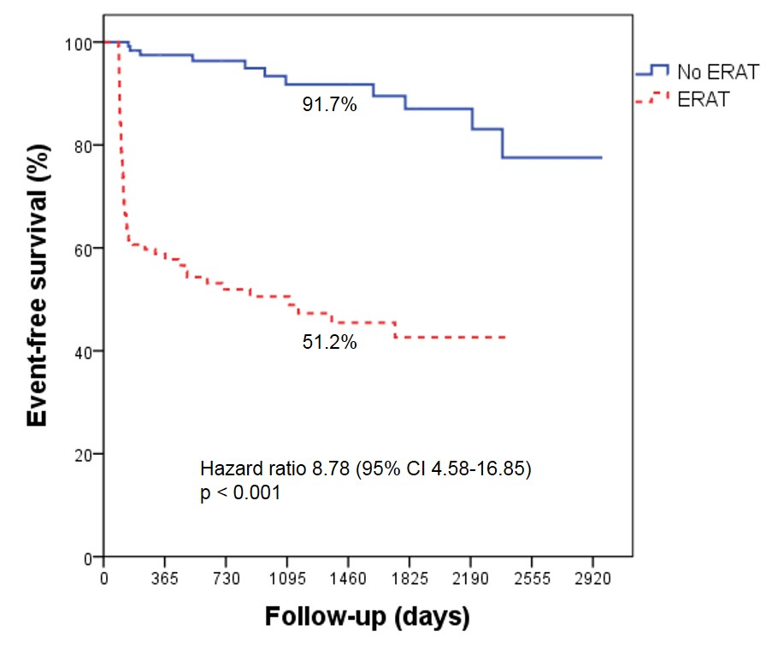
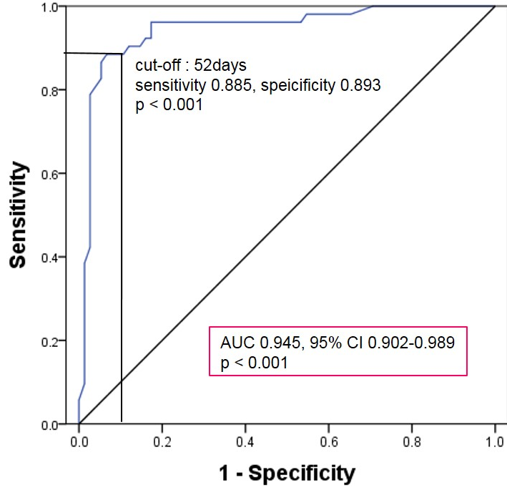
Results : Long term f/u
Sensitivity
1
2
3
4
5
6
7
8
Follow-up(years)
In No ERAT group, freedom from AF recurrence at 3 year was 91.7%
ROC curve analysis to assess the correlation between timing of ERAT and late recurrence shows 52 days as the optimal timing

Slide 7
Conclusion
ERAT is significantly associated with late recurrence of ATAs
The 52nd day after surgical ablation may appear to be an appropriate cut off for the blanking period
Patients without early recurrence showed excellent long-term rhythm outcomes

