Slide 1
Case 1

Slide 2
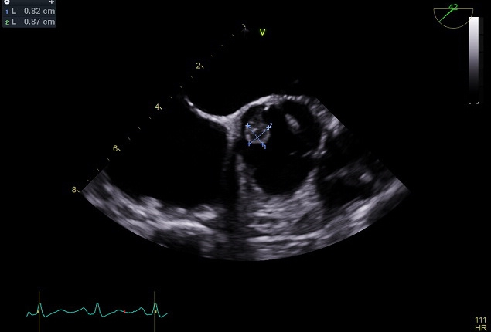
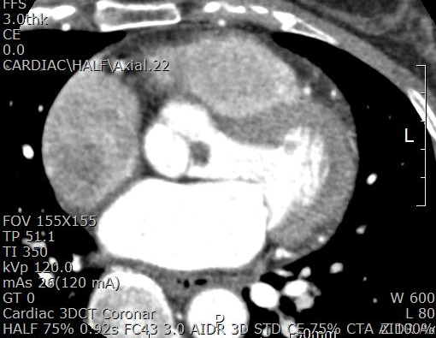
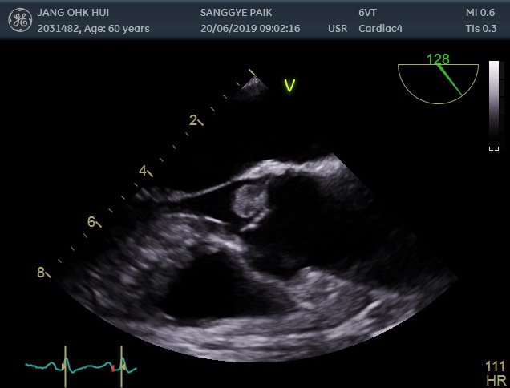
A
C
B
Figure Legends
Preoperative echocardiography shows a mobile mass on ventricular surface of non coronary cusp of the aortic valve(A and B). Computed tomography shows mass lesion on the aortic valve (C).

Slide 3
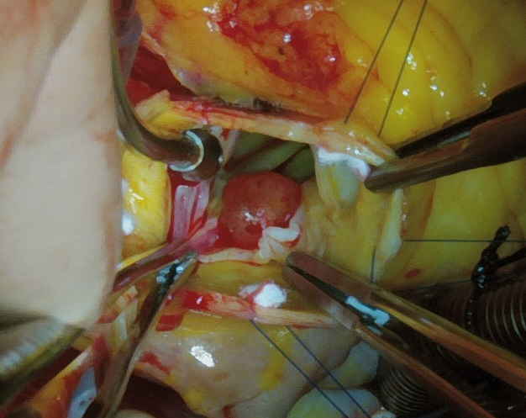
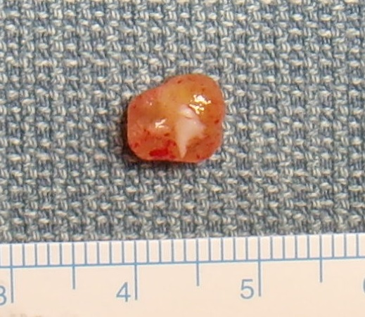
A
B
Figure Legends
The mass is morphologically round and attached on ventricular surface of non coronary cusp of the aortic valve (A). A pinkish round mass is measured as 0.9cm in greatest dimension and one tip showed a piece of whitish fibrous tissue, which might be attached to the aortic valve(B).

Slide 4
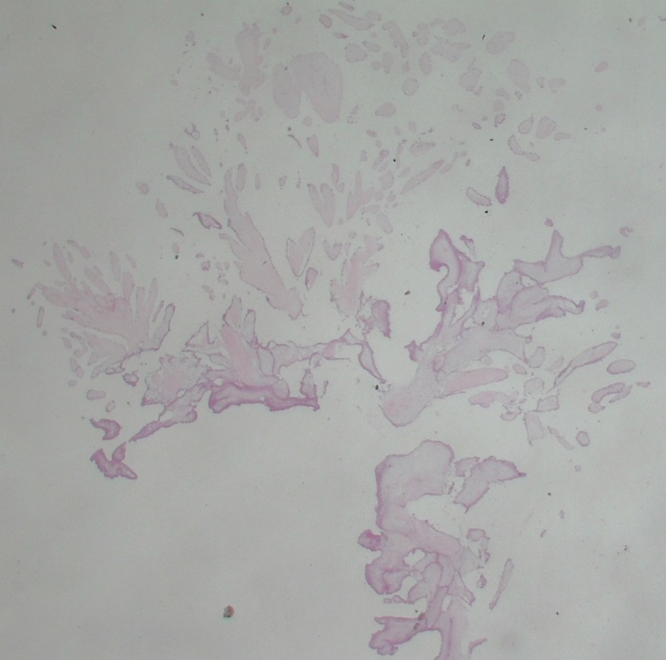
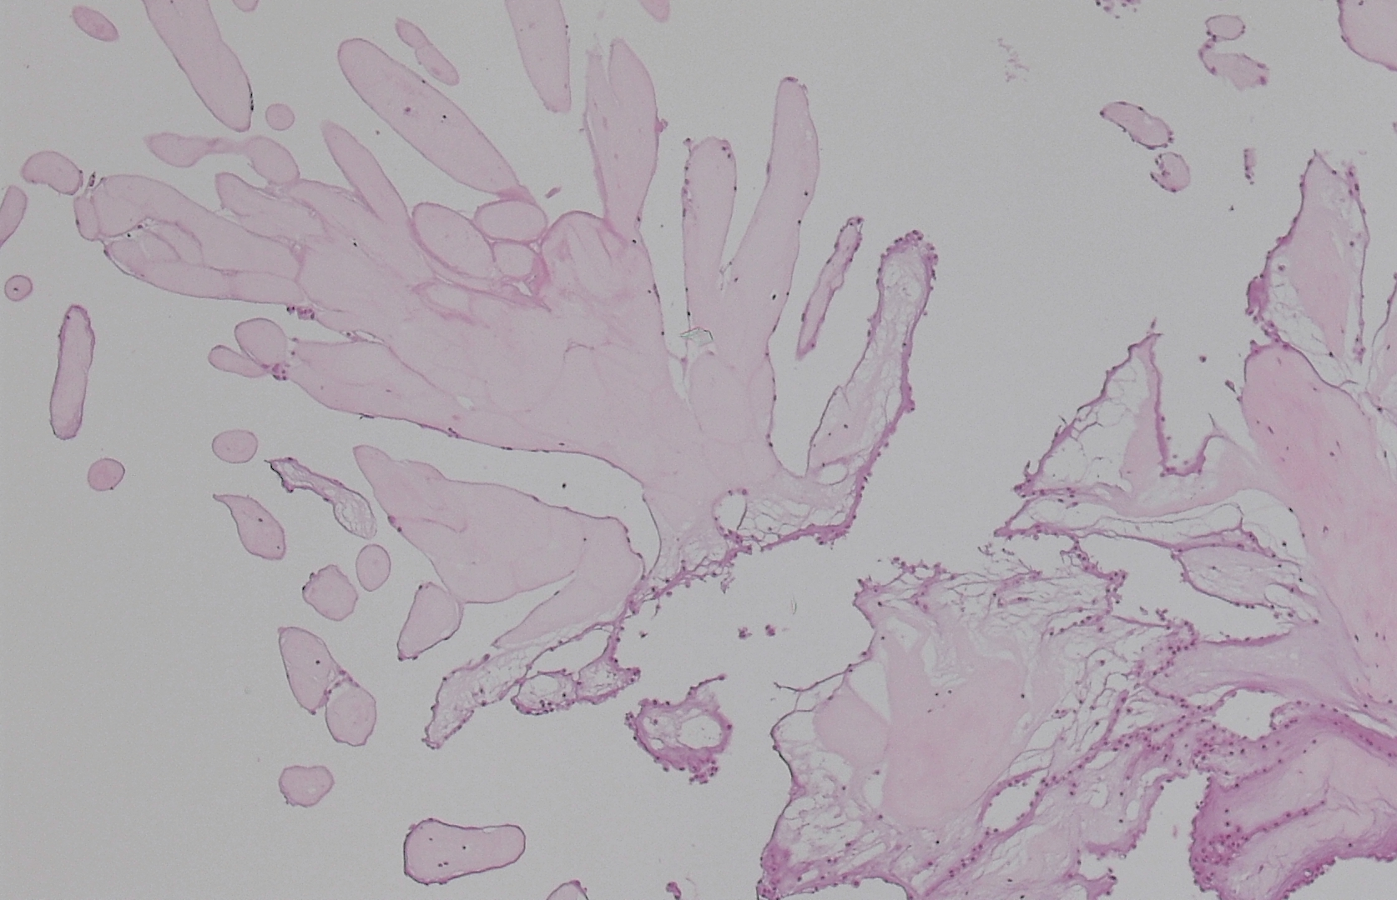
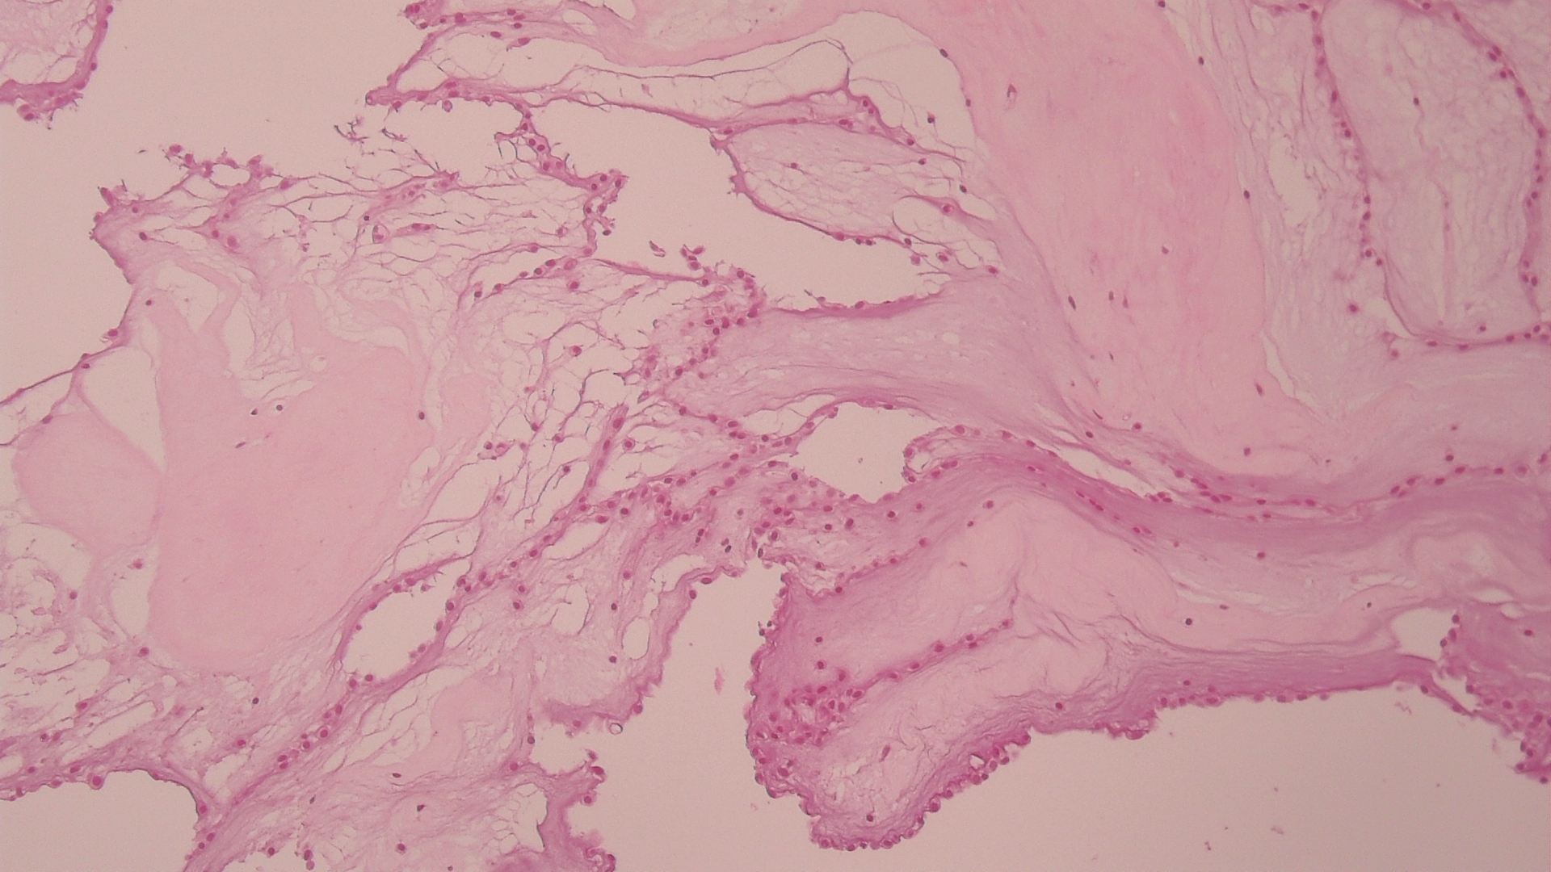
B
A
Figure Legends
A papillary mass of low power view showed numerous arborizing fronds from a common central stalk. (HE, x10)
The papillae is composed of avascular fronds with hyalinized stroma and partly denuded lining cells. (HE, x40)
The fronds are coated by a single layer of endothelium (blue arrows). (HE, x100)
C

Slide 5
Case 2

Slide 6
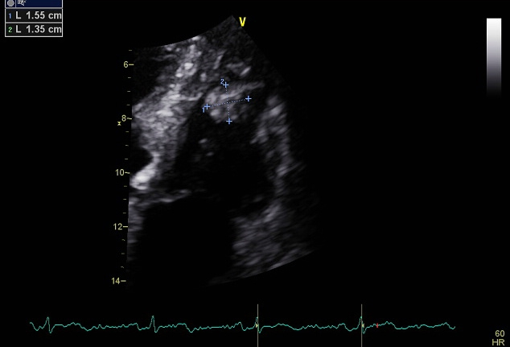
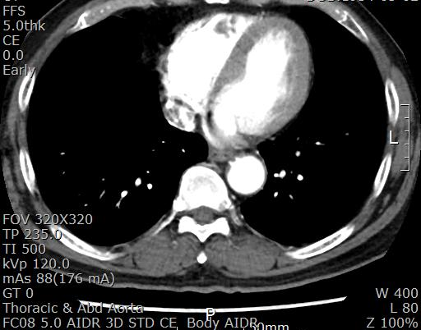
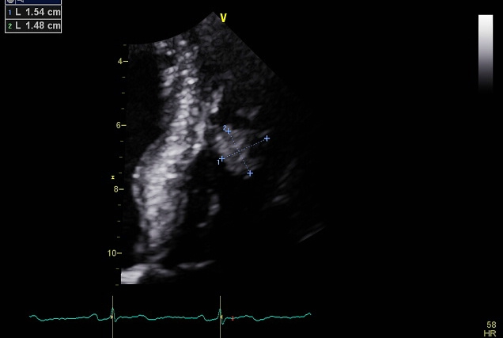
A
C
B
Figure Legends
Preoperative echocardiography shows a round mass in the right ventricle (A and B). Computed tomography shows mass lesion in the right ventricle (yellow arrow) (C).

Slide 7
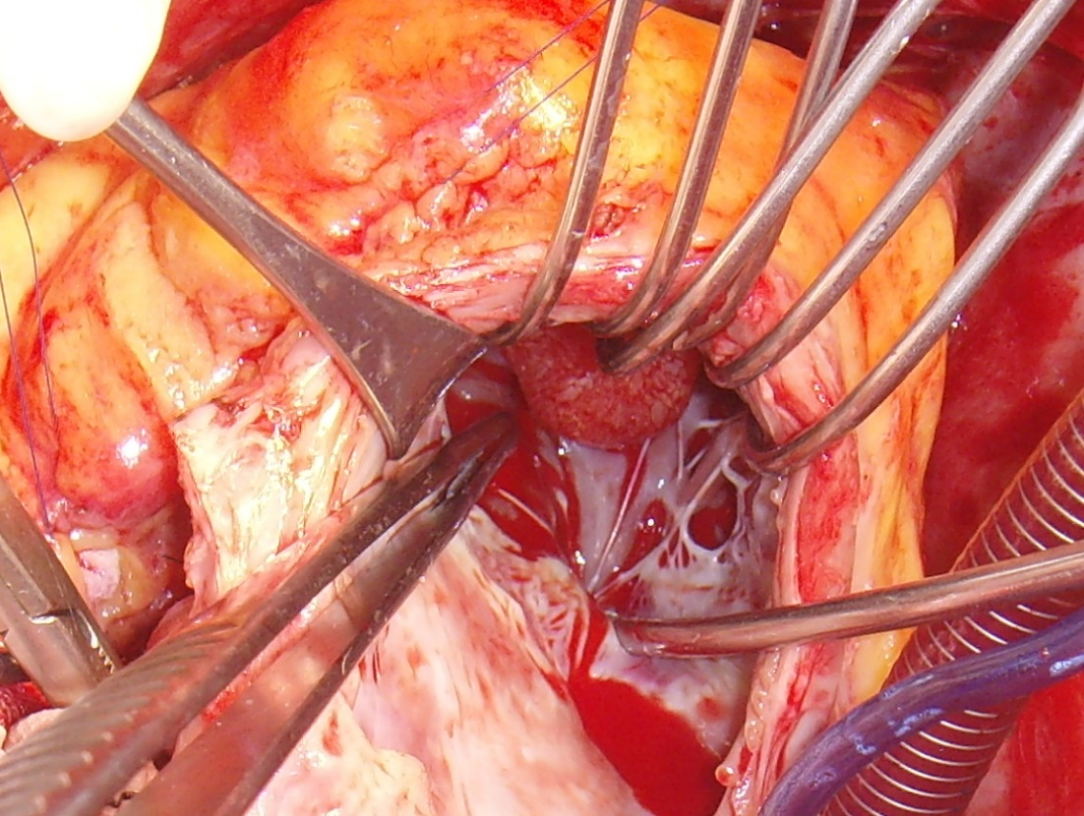
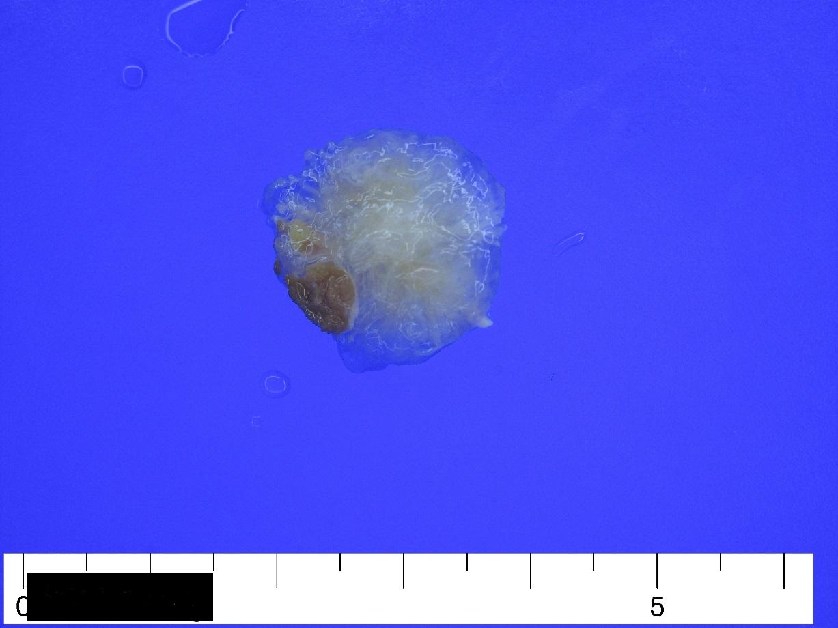
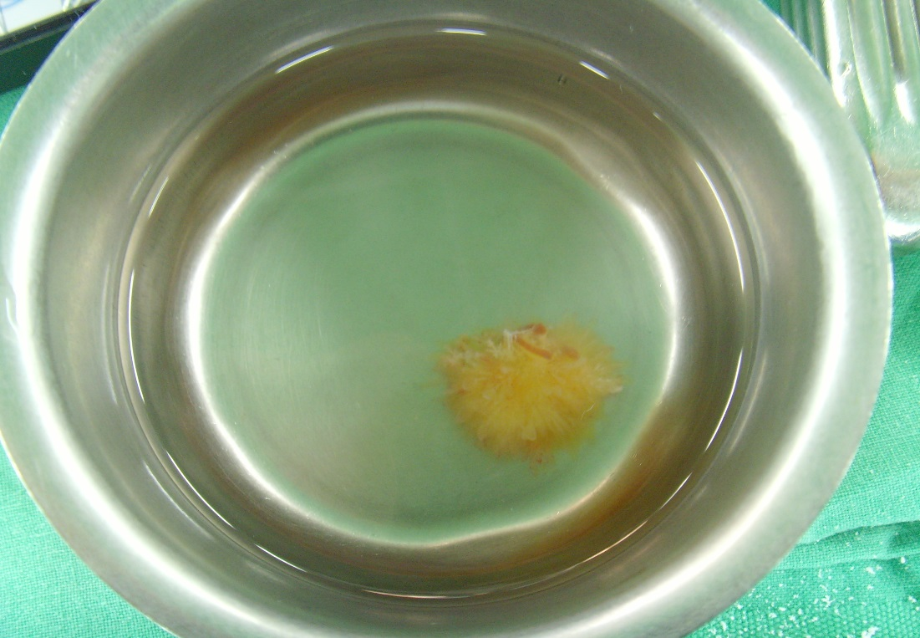
C
A
Figure Legends
The mass is morphologically round and attached on the right ventricular wall (A). Immersion in water after resection results in a typical sea anemone appearance (B). A whitish papillary mass is measured as 1.5cm in greatest dimension and one tip showed a piece of brownish muscular tissue, which might be attached to myocardial wall (C).
B

