Slide 1
Preoperative fine needle aspiration biopsy increased the risk of recurrence in early stage lung cancer without visceral pleural invasion
공지사항
  소속기관이나 저자명이 드러나지 않도록 해주세요.
  제목 슬라이드 제외 최대 6장, Font size 20 이상
  사진/illustration등으로 인해 용량이 큰 경우 PDF로 전환해서 접수

Slide 2
Purpose
The fine needle aspiration biopsy (FNAB) was known to spread cancer cells in different types of cancer during procedure.
However, the oncological long-term effects of the recurrence have not yet been elucidated, especially after curative resection for lung cancer.
Therefore, this retrospective study is to test the hypothesis that preoperative FNAB could be an independent risk factor for the recurrence of lung cancer.

Slide 3
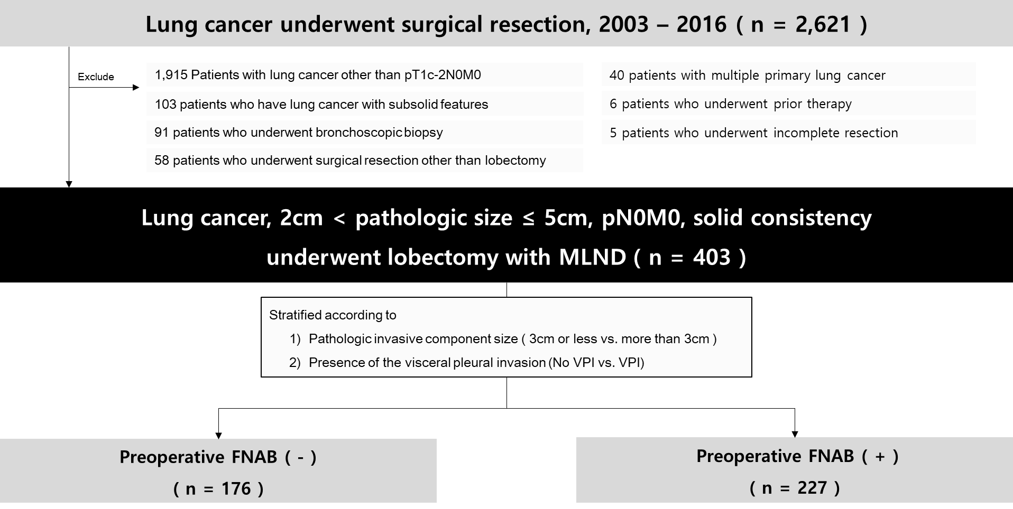
Methods
Inclusion criteria

Slide 4
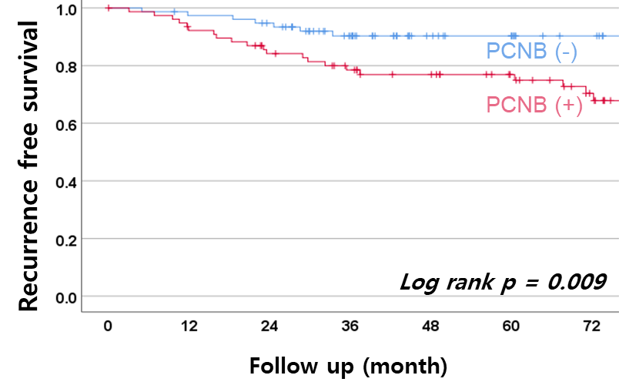
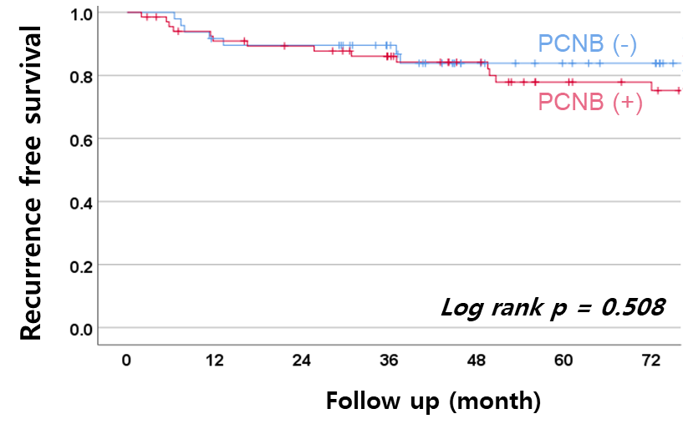
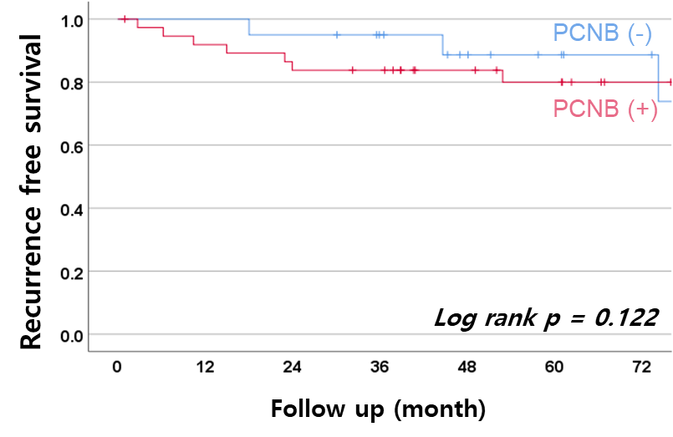
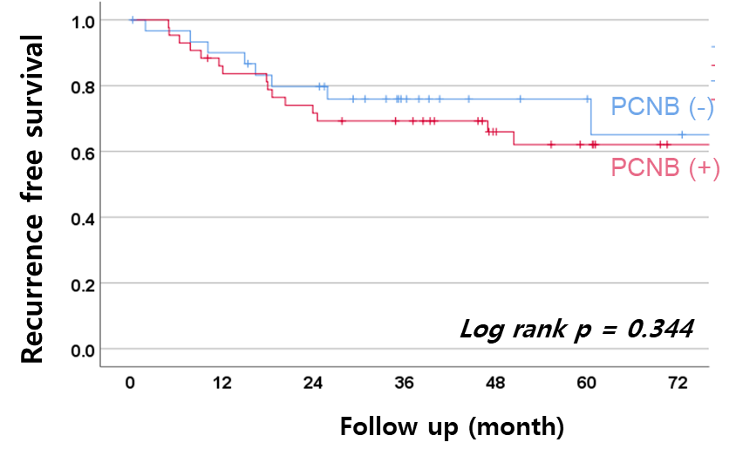
Results
KM curves for the recurrence-free survival rate
2cm < pathologic size ≤ 3cm
3cm < pathologic size ≤ 5cm
VPI (-)
VPI (+)

Slide 5
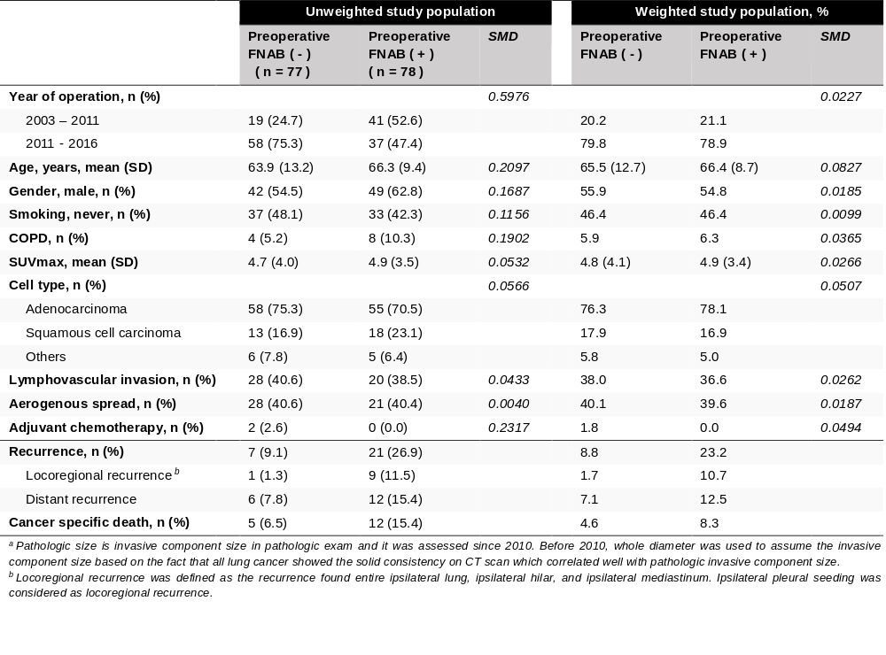
Results
2cm < pathologic size ≤ 3cm, pN0M0, VPI (-) before and after IPTW

Slide 6
Results
2cm < pathologic size ≤ 3cm, pN0M0, VPI (-) before and after IPTW^{b}
 | Multivariate HR ª | p value
Year of operation
Before 2012 | 1 ( Reference )
After 2012 | 2.121 (0.434 – 10.372) | 0.353
Lymphovascular invasion
Absent | 1 ( Reference )
Present | 1.760 (0.596 – 5.194) | 0.306
Aerogenous spread
Absent | 1 (Reference)
Present | 3.042 (0.996 – 9.287) | 0.051
Preoperative FNAB
No | 1 (Reference)
Yes | 3.253 (1.058 – 10.006) | 0.040
ª Adjusted by year of operation, age, gender, smoking status, COPD, SUVmax, cell type, lymphovascular invasion, aerogenous spread, adjuvant chemotherapy, and preoperative FNAB. ^{B} IPTW=Inverse Probability of Treatment Weighting

Slide 7
Conclusion
Preoperative FNAB increased the risk of recurrence in early stage lung cancer with tumor size (2cm <, ≤ 3cm), pN0M0, and without visceral pleural invasion.
The FNAB was identified as a statistically significant risk factor of recurrence after IPTW.
The FNAB should be carefully performed only if it is essential for patients with old age, severe comorbidity, or central lesions.

