Slide 1
Coronary artery bypass grafting in pediatric patients for Kawasaki disease

Slide 2
Purpose
Kawasaki disease in pediatric patients is the most common cause of coronary disease.
It is the first indication for pediatric coronary artery bypass grafting.
This study aimed to review the long-term clinical outcomes and graft patency of coronary artery bypass graft surgery.

Slide 3
Patients
March 2004 ~ March 2013
6 patients with Kawasaki disease underwent coronary artery bypass grafting surgery
Male patients (100%)
Ages at operation ranging from 7 to 20 years
  Median 13.0±5.1 years

Slide 4
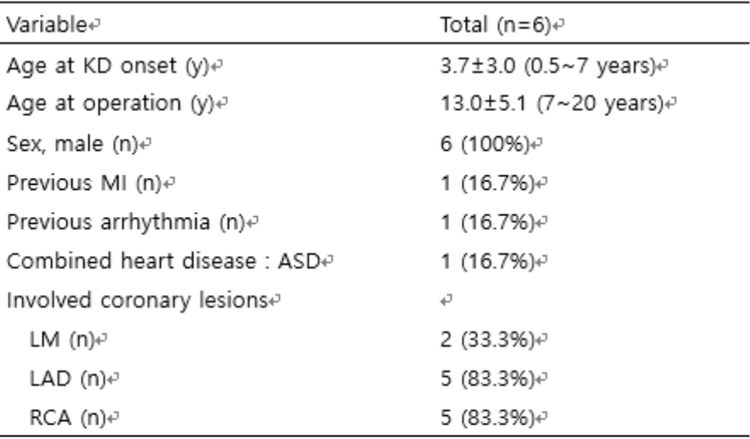
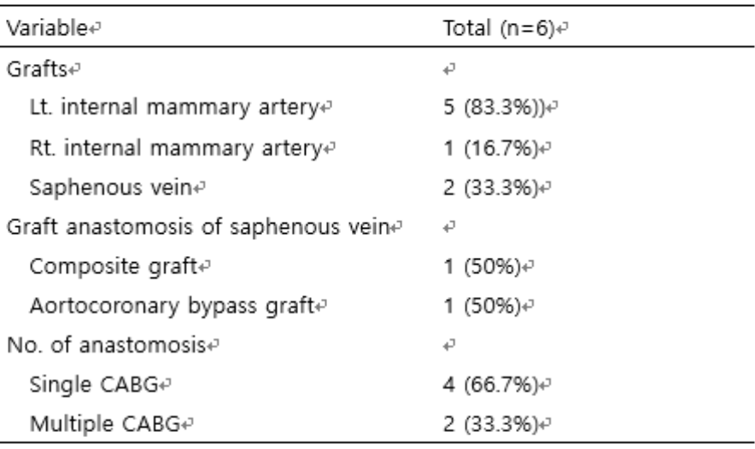
Methods
Evaluated by coronary angiography or computed tomography angiography, SPECT

Slide 5
Results
Mean follow-up 9.7±4.7 years
No postoperative complication and operative mortality
No late deaths

Slide 6
Results
Preoperative symptoms
  Exertional chest pain : 1 (16.7%)
  Ventricular tachyarrhythmia : 1 (16.7%)
All improved after operation
Postoperative SPECT findings showed the improved perfusion, compared with preoperative SPECT.
All Grafts were patent, even in saphenous vein grafts.

Slide 7
Conclusion
The most often quoted results in published reports regarding graft patency after CABG in adults are that at 10 years, saphenous vein graft have about a 40~50% patency and that internal mammary artery grafts have a 90~95% 10-year patency.
Long-term clinical results of the coronary artery bypass grafting for Kawasaki disease were good in our study.
Coronary artery bypass graft surgery is a good surgical option in pediatric patients with coronary lesions caused by Kawasaki disease, in terms of graft patency and myocardial perfusion.

