Slide 1
Anatomical characteristics and clinical outcomes of criss-cross heart

Slide 2
Purpose
Criss-cross heart (CCH), which is defined as crossing of the two atrioventricular blood streams, is a rare entity among the congenital cardiac anomalies.
Various concomitant intra-cardiac anomalies can be found in
CCH.
Construction of two concordant atrioventricular (AV) and
ventriculoarterial (VA) connection can be achieved only in a
small subset of patients, and single ventricle palliation strategy is more frequently adopted.
We evaluated the anatomical characteristics and clinical
outcomes of this rare anomaly.

Slide 3
Methods
Single center retrospective review
1993 to 2019, diagnosed as CCH
Echocardiographic, catheterization, radiologic findings and medical records were reviewed

Slide 4
Results
Study population : 12 patients with CCH
Anatomical findings
  2 patients (16.7%) : left ventricular hypoplasia
  2 patients (16.7%) : right ventricular hypoplasia
  7 patients (58.3%) : double outlet right ventricle
  6 patients (50%) : concordant atrioventricular connection
  4 patients (33.3%) : discordant atrioventricular connection
  2 patients : (16.7%) : concordant ventriculoarterial connection
  3 patients (25%) : discordant ventriculoarterial connection

Slide 5
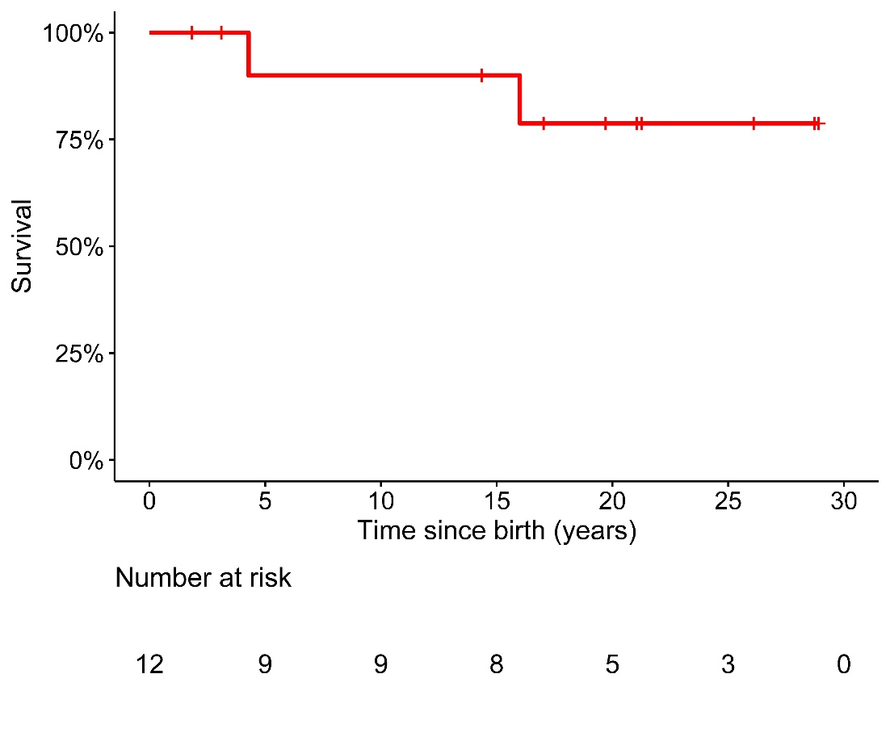
Results
Single ventricular palliation strategy (n=10)
  9 patients underwent Fontan operation
  1 patients is awaiting Fontan operation
Biventricular repair with arterial switch operation (n=2)
Survival at 10, 20 years was 90%, 78.7%

Slide 6
Conclusion
CCH is rare cardiac anomaly however clinical outcome
after Fontan operation is comparable to other Fontan
candidates
Anatomical correction can be performed in a small subset with favorable intracardiac anatomy

