Slide 1
Clinical Outcome of Surgical Repair with Composite Prosthetic Graft for
Abdominal Aortic Aneurysm
Accompanied by Iliac Artery Aneurysm

Slide 2
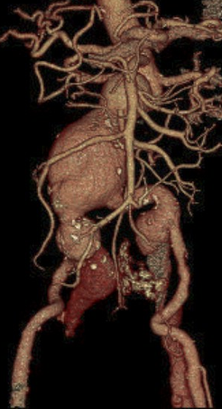
Purpose
In the era of endovascular repair, concomitant iliac artery aneurysm is found frequently in patients undergoing surgical repair of
abdominal aortic aneurysm (AAA).
As aggressive resection of dilated iliac arteries and hand-made composite grafting has been the procedure of choice in our center,
we aimed to evaluate the efficacy of such procedure.

Slide 3
Methods
Study patients
  233 patients who underwent open surgery for AAA (2003-2019)
  conventional straight or bifurcation graft in 155 (67%)
  hand-made composite graft in 78 (33%)
Retrospective study
  Operative characteristics and detailed technique
  Postoperative outcome and Postoperative CT imaging
Variables
Age (year) | 71.5±10.3
Male:female | 196:37
Emergency for rupture, n (%) | 57 (24.5)
Previous EVAR, n (%) | 16 (6.9)
Previous laparotomy, n (%) | 8 (3.4)

Slide 4
Result (1)
There was no difference in the major outcomes between two groups.
The composite graft technique took longer by 15 minutes.
The incidence of target vessel (iliac arteries) occlusion did not differ.
 | Elective surgery |  |  | Emergency surgery
 | Conventional (n=112) | Composite (n=64) | p-value | Conventional (n=43) | Composite (n=14) | p-value
Early death, n (%) | 1 (0.9) | 0 (0) | >0.999 | 9 (20.9) | 2 (14.3) | 0.714
Operation time (min) | 199.2±63.1 | 215.9±42.7 | 0.037 | 203.1±60.4 | 217.1±41.9 | 0.422
RBC transfusion (units) | 2.8±4.7 | 3.1±4.7 | 0.680 | 11.5±10.4 | 17.9±24.9 | 0.361
ICU stay (day) | 1.9±6.6 | 1.6±2.4 | 0.680 | 3.9±5.5 | 4.3±8.9 | 0.828
Hospital stay (day) | 14.9±14.7 | 15.1±12.1 | 0.917 | 24.9±26.2 | 28.4±35.9 | 0.703
Reoperation for EIA stenosis/occlusion, n (%) | 5 (4.5) | 2 (3.1) | >0.999 | 1 (2.4) | 1 (7.1) | 0.441
Bleeding – reoperation, n (%) | 3 (2.7) | 2 (3.1) | >0.999 | 3 (7.1) | 2 (14.3) | 0.590
Chyloperitoneum, n (%) | 2 (1.8) | 3 (4.7) | 0.355 | 3 (7.0) | 0 (0) | 0.568
EIA = external iliac artery

Slide 5
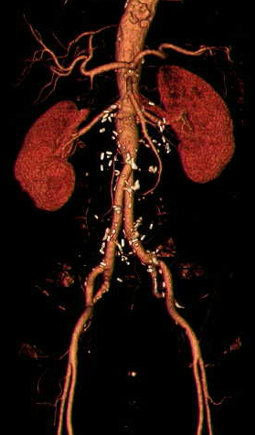
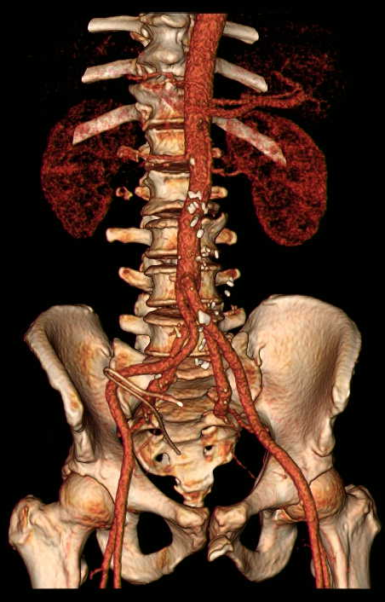
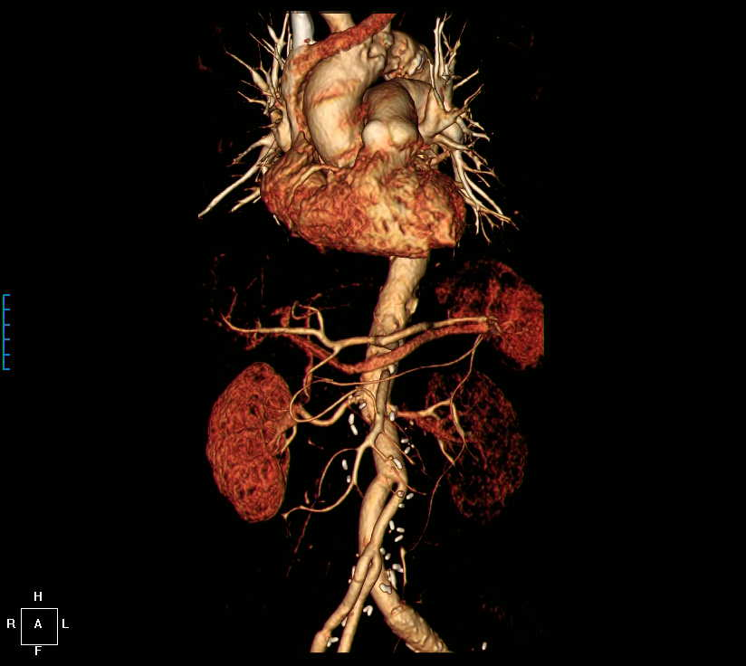
Result (2)
Among 75 internal iliac arteries reimplanted with composite graft technique, 70 (93%) were patent in the early postoperative CT scan.
Sequential anastomosis
Quadrifurcation graft
Asymmetrical / secondary Y graft

Slide 6
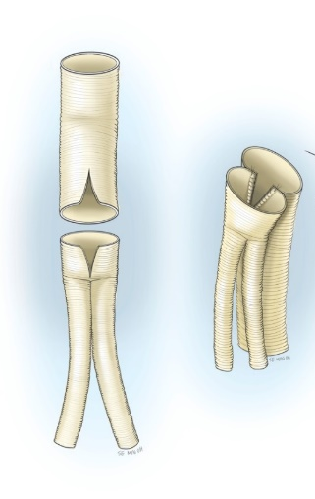
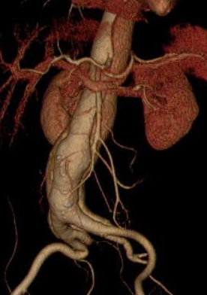
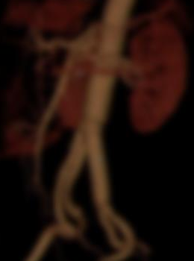
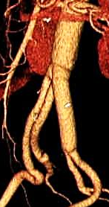
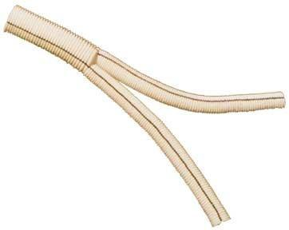

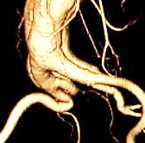
Conclusion
The increased technical demand of composite grafting did not impose a negative impact on the outcome of AAA repair.
Such technique may be considered an alternative to the conventional repair using aortofemoral bypass and obliteration of the dilated iliac artery.

