Slide 1
Surgical management of Descending Necrotizing Mediastinitis using video-assisted thoracoscopic surgery ; about 20 years of experience at 2 centers

Slide 2
Purpose
DNM is a severe infection with a high mortality rate, but there are few reports of surgical outcomes in recent years.
In the last two decades, there have been many paradigm shifts in thoracic surgery, but data on thoracoscopic surgery for DNM are lacking.
We have applied thoracoscopic surgery to the treatment of mediastinitis includind DNM since 2000 and have reported it in 2008(Eur J Cardiothorac Surg 2008).
The purpose of this study was to evaluate our clinical results about treatment of DNM using VATS for about 20 years

Slide 3
Methods
From April 2000 to May2019
24 patients underwent VATS mediastinal drainage and cervical drainage for DNM
The study was retrospectively performed and two hospitals participated.
Surgery for mediastinitis
N=41
Exclusion
Esophageal perforation
n=7
Chest wall or SCJ joint infection
n=6
Post operative
n=2
After radical neck surgery for cancer
n=1
Unknown origin
n=1
VATS + cervical drainage
for DNM
n=24
Inclusion

Slide 4
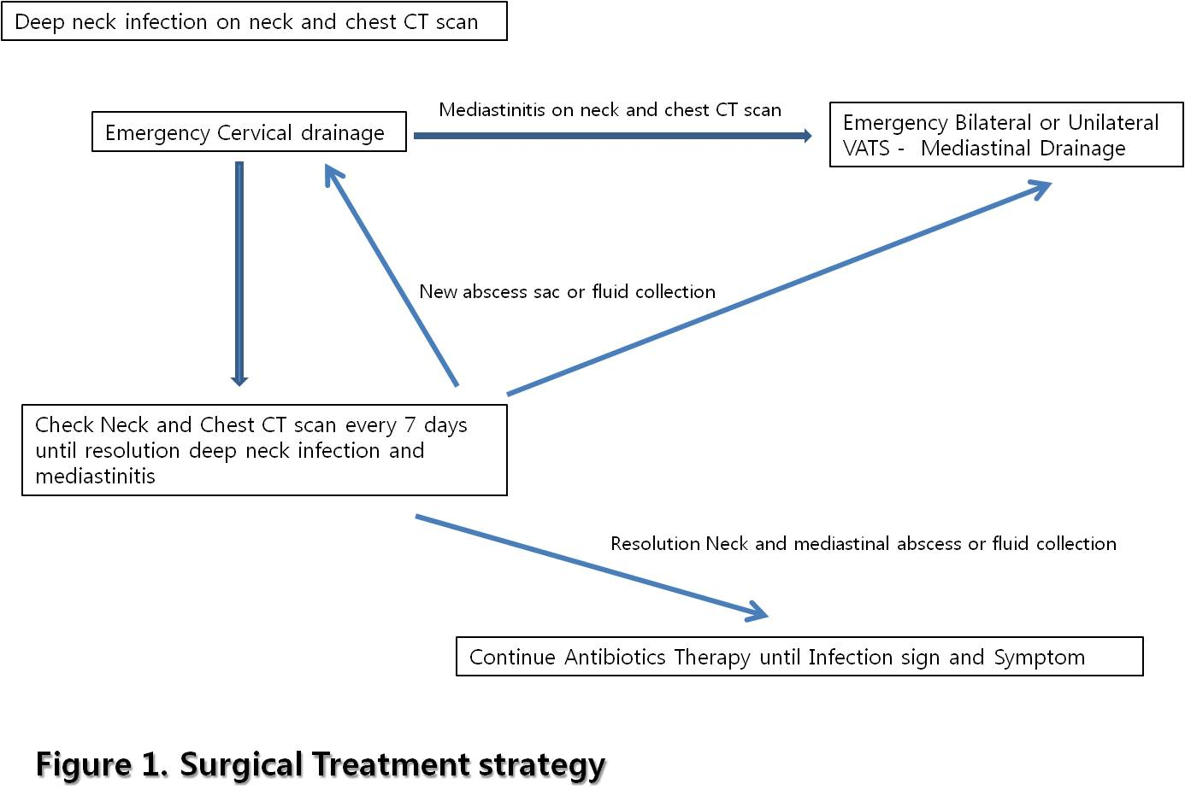
Methods
Surgical Treatment strategy is shown in figure 1.

Slide 5
Results
Site and Extension of mediastinitis
Surgical approach and outcomes
n=24
Gender
Male : Female | 14 : 10
Mean Age (years) | 54.6 ± 13.8
Source of infection
odontogenic | 6 (25%)
pharyngeal | 18 (75%)
Endoclassification
Type Ⅰ | 7 (29.2%)
Type Ⅱa | 3 (12.5%)
Type Ⅱb | 14 (58.3%)
Cervical extension
Right | 4 (16.7%)
Left | 3 (12.5%)
bilateral | 17 (70.8%)
Pleural effusion
no | 12 (50%)
Right | 7 (29.2%)
Left | 1 (4.2%)
Bilateral | 4 (16.7%)
n=24
Surgical approach
Cervical drainage
Unilateral | 11 (45.8%)
Bilateral | 13 (54.2%)
VATS drainage
Unilateral | 18 (75%)
Bilateral | 6 (25%)
Open Conversion | 3 (12.5%)
Operation time (min) | 253.5 ±124.9
EBL (ml) | 482.1 ± 632.2
ICU stay (day) | 39.3 ± 15.8
Hospital stay (day) | 10.2 ± 13.8
Re-operation | 11 (45.8%)
Mortality | 2 (8.3%)

Slide 6
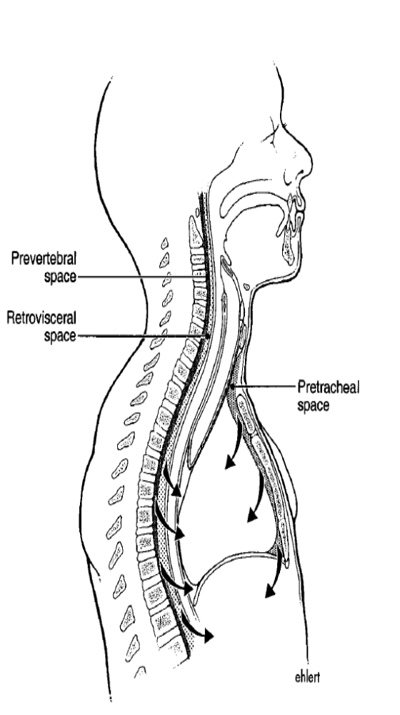
Results
Pleural effusion
Re-operation
Mortality
EndoclassificatioⅠ
n=7
No effusion : 6
Unilateral : 1
Bilateral : 0
2 cases
( 29%)
0 case
Endoclassification Ⅱa
n=3
No effusion : 2
Unilateral : 1
Bilateral : 0
1 case
(33%)
0 case
Endoclassification Ⅱb
n=14
No effusion : 4
Unilateral : 6
Bilateral : 4
8 cases
(57%)
2 cases
(14%)

Slide 7
Conclusion
We reported acceptable results in managing DNM with an relatively low mortality rate and few complications using mediastinal drainage with VATS including neck drainage.
VATS can be a useful, safe treatment option for the treatment of DNM.
Extension of mediastinits and presence of pleural effusion tend to affect prognosis.
  Early surgical intervention is needed.

