Slide 1
Early Total Repair Versus Shunt Palliation in Ductal Dependent Neonates
With Pulmonary Atresia and Ventricular Septal Defect
: Results Of Two Hospitals

Slide 2
Purpose
Ductal dependent neonates with ductal-dependent pulmonary atresia and ventricular septal defect (PA VSD)
Surgical strategy :
  Primary biventricular repair (BVR)
  Initial palliation with modified Blalock-Taussig shunt (BTS) + second stage total repair
In this study, we report the combined outcomes of 2 hospitals with different strategies.

Slide 3
Methods
Between 2004 and 2017
Total 66 neonates :
  Palliative shunt (BTS group: n=30, 45.5%)
  Early total repair (BVR group: n=36, 54.5%)
  Hospital A : predominantly BTS
  (80.6%, 29 out of 36)
  Hospital B : almost always performed BVR
  (93%, 28 out of 30)

Slide 4
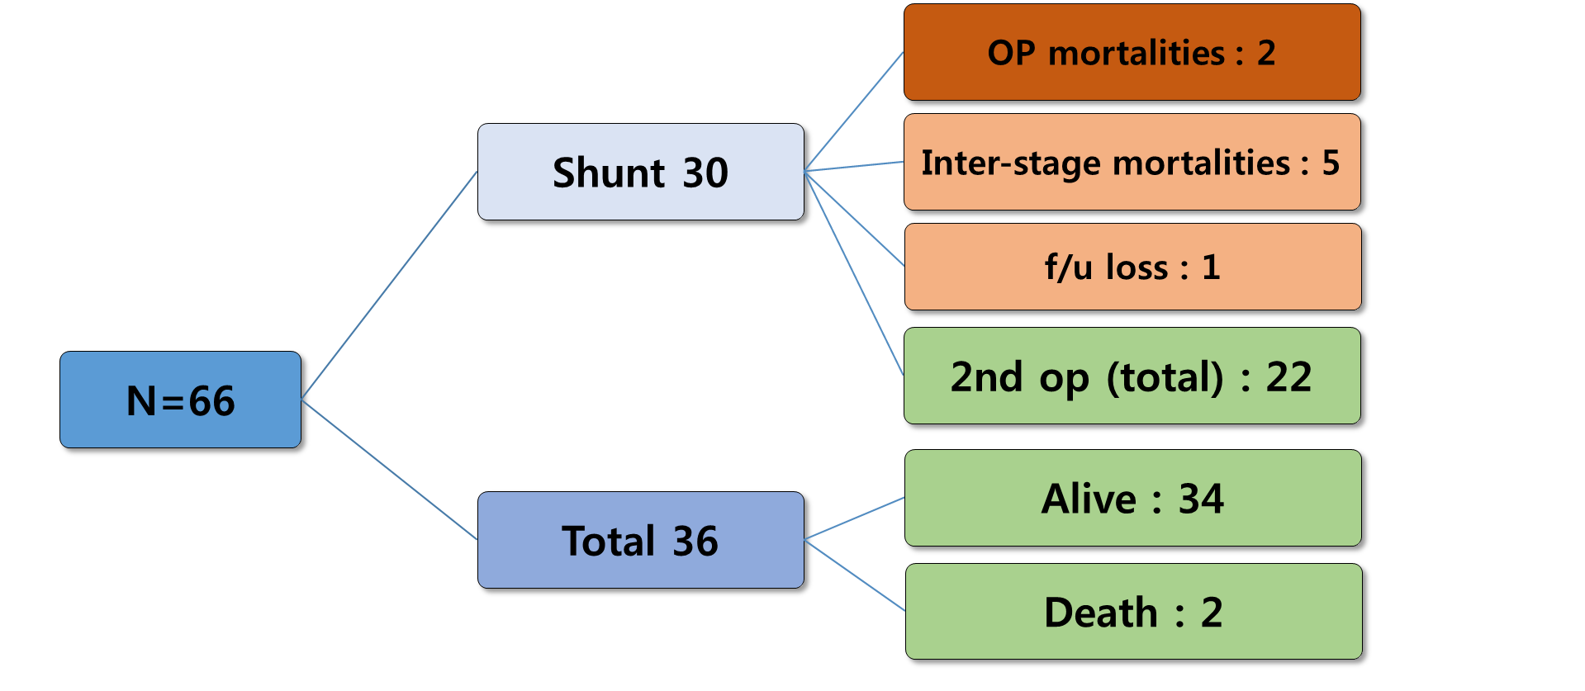
Results
Overall mean follow-up : 7.51 ± 4.35 years
Inter-stage period : 0.69 years
1 interstage mortality after 2012

Slide 5
Results
Initial operation
N=66, median | Shunt (n=30) | Total (n=36)
OP age | 19.5 days | 15 days
OP bwt | 3.21 kg | 3.15 kg
Extra-cardiac abnormalities | 6/30 | 4/36
NAKATA index | 107.9 | 119.7
OP Morbidity / Mortality | 10 / 2 | 14 / 0
Unplanned re-operation | 4 | 1
Total correction
N=64, median | Shunt (n=28) | Total (n=36)
Total op. age | 0.72 years | -
Total op. bwt. | 8.4 kg | -
NAKATA index | 155.2 | -
OP mortality | 0% (0/22) | -

Slide 6
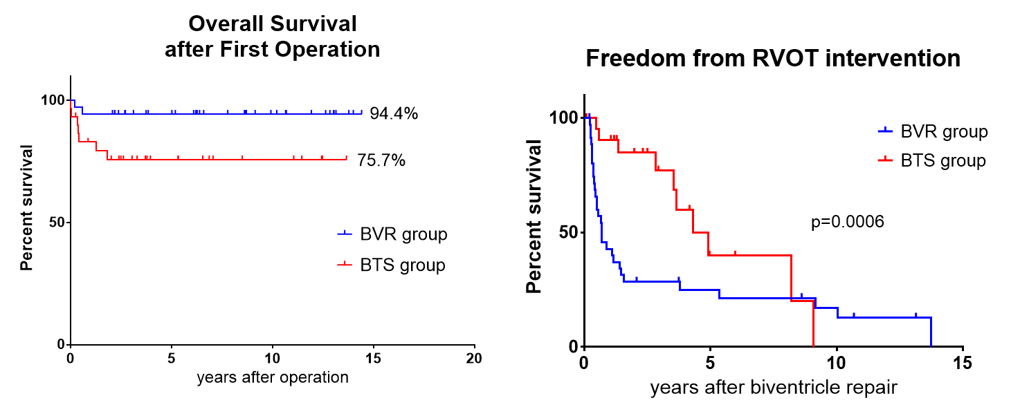
Results
f/u after total correction | Shunt (n=21) | Total (n=32)
f/u period (years) | 5.06 ± 3.75 | 7.51 ± 4.35
Intervention | 1 | 53
Operation | 8 | 29

Slide 7
Conclusion
Primary BVR :
  Pros : better survival & stable postop. course
  Cons : heavy burden of RVOT intervention
Staged approach with BTS :
  Pros : may improve quality of biventricle repair
  Cons : significant operative and interstage mortality

