Slide 1
The 10-year Single Institute Experience of Minimally Invasive Cardiac Surgery
: From 0 to 1085 case

Slide 2
Purpose
Although MICS has been adopted widely, but few study showed the results of newcomer
Aim of the study:
  To review the clinical result of consecutive patients
  To detect learning curve of MICS program
Total : 1085

Slide 3
Methods
Prospectively collected data from the 1st case
82% (n=888/1085) of MICS was done by new independent surgeon
Group 1, n=334
Jan. 2009 ~ July. 2013
Group 2, n=333
Aug. 2013 ~ Dec. 2016
Group 3, n=418
Jan. 2017 ~ June. 2019
Group | Group 1, (N=334) | Group 2, (N=333) | Group3, (N=418) | p
Age | 52.0 [41.0;63.0] | 57.0 [46.0;68.0] | 60.0 [49.0;70.0] | <0.001
Female gender | 184 (55.1%) | 175 (52.6%) | 219 (52.4%) | 0.725
Hypertension | 107 (32.0%) | 149 (44.7%) | 218 (52.2%) | <0.001
Diabetes | 39 ( 11.7%) | 55 (16.5%) | 81 (19.3%) | 0.044
Stroke | 56 (16.8%) | 39 (11.7%) | 81 (19.4%) | 0.062
NYHA 3 or 4 | 90 (27.0%) | 119 (35.7%) | 147 (35.2%) | <0.001
EuroSCORE II | 2.8 ± 5.3 | 3.1 ± 4.7 | 3.8 ± 7.1 | 0.026
Mitral valve surgery | 164 (49.1%) | 141 (42.3%) | 156 (37.3%) | 0.005
Aortic valve surgery | 36 (10.8%) | 86 (25.8%) | 131 (31.3%) | <0.001
Atrial septal defect repair | 93 (27.8%) | 73 (21.9%) | 80 (19.1%) | 0.017

Slide 4
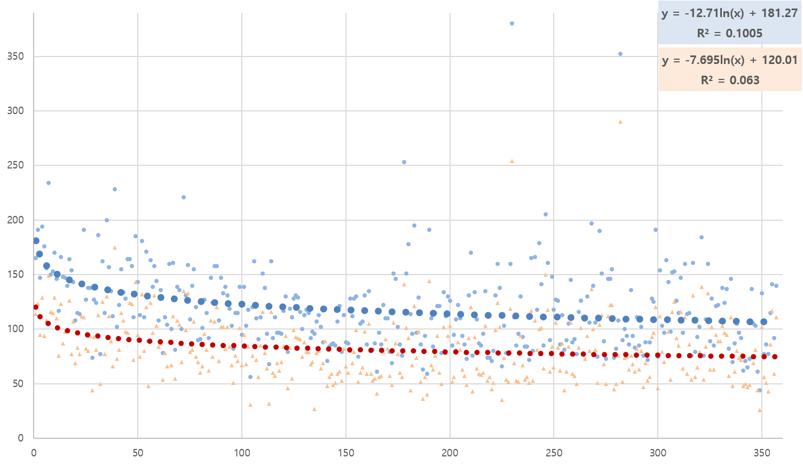
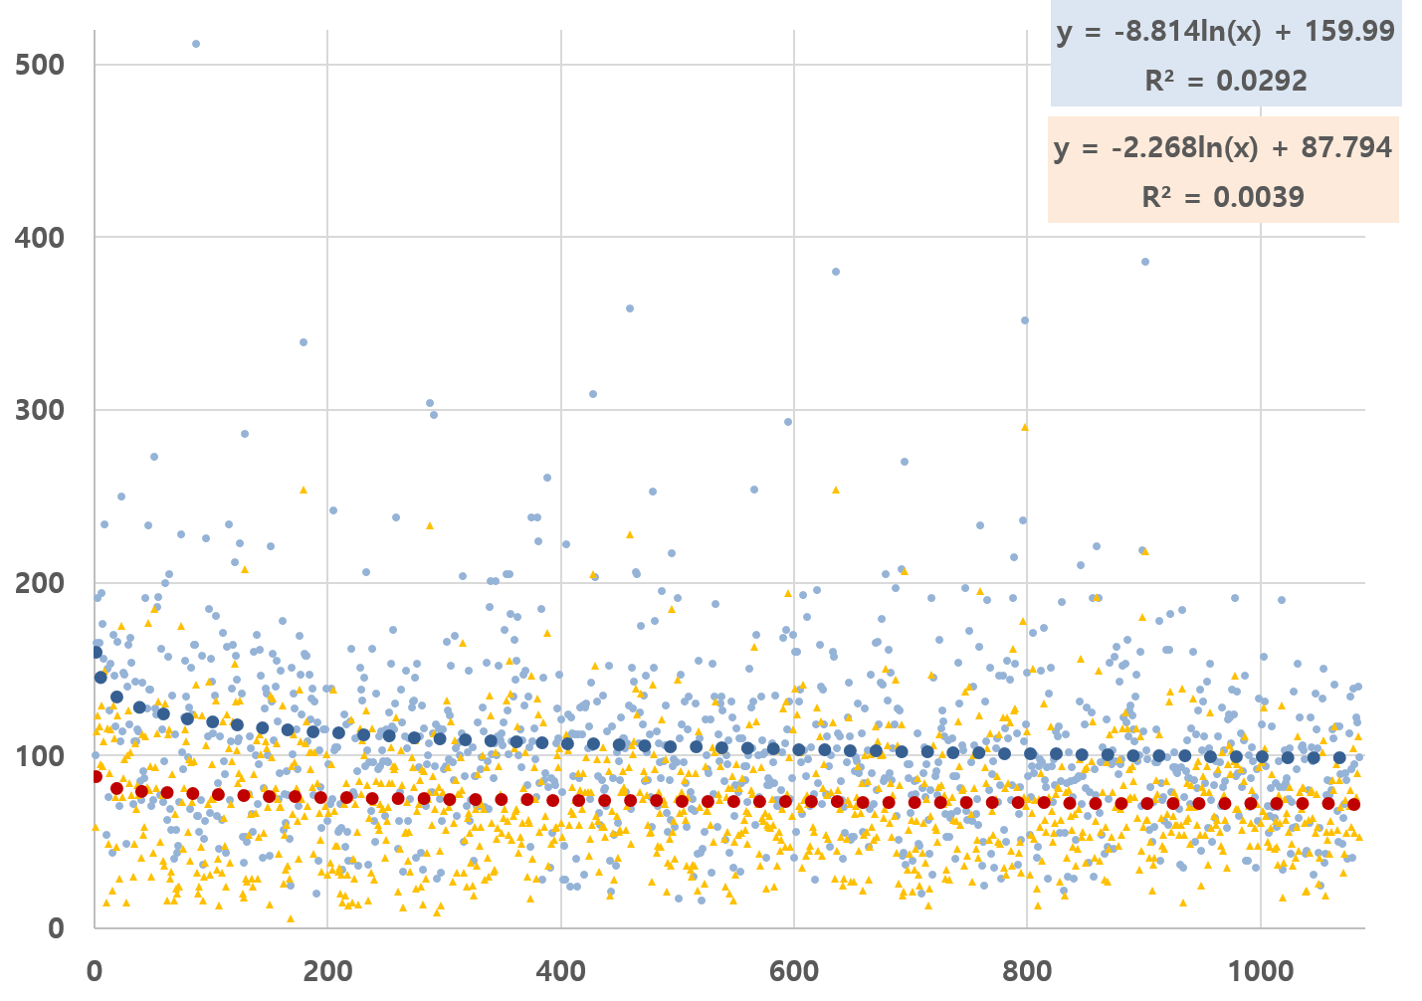
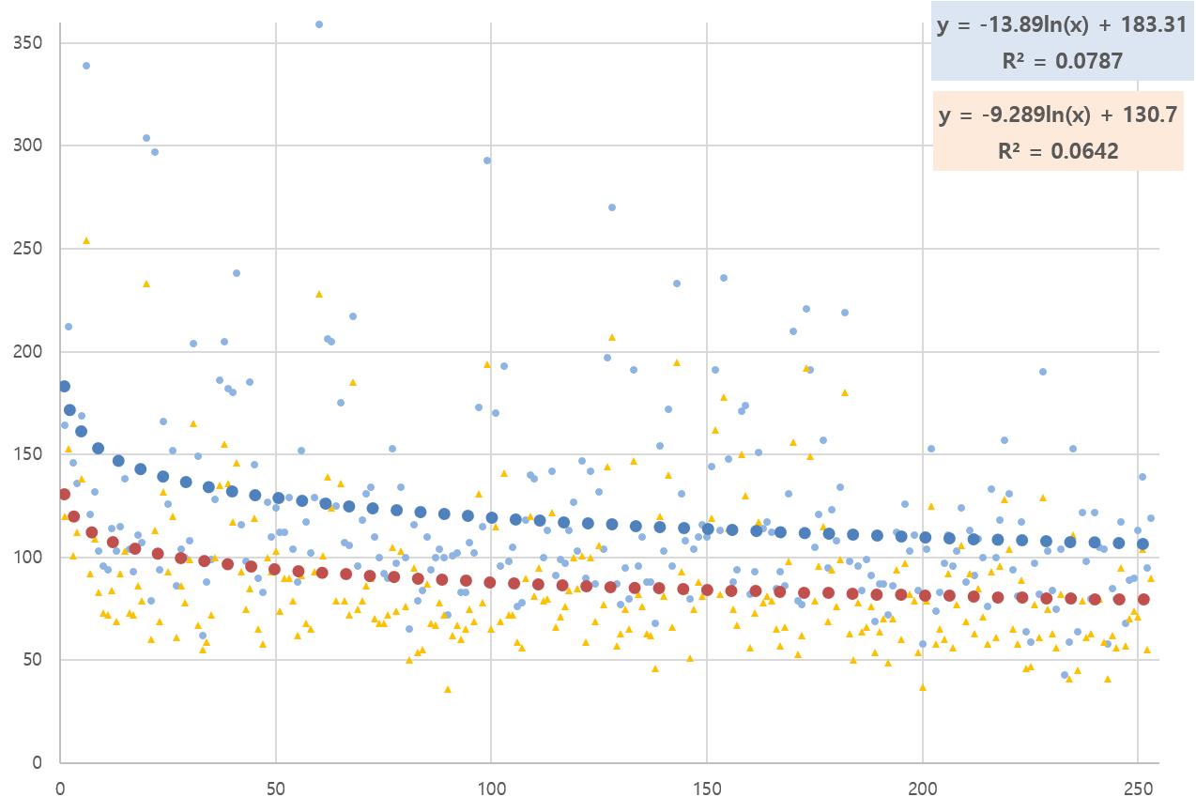
Results I
Mitral Valve
Evolution of CPB and ACC time
in 1085 MICS patients
Minutes
Aortic Valve
Case
Logarithmic curve-fit regression analysis

Slide 5
Results II
Group | Group 1, (N=334) | Group 2, (N=333) | Group3, (N=418) | p
Operative mortality | 5 (1.5%) | 2 (0.6%) | 6 (1.4%) | 0.483
CPB time (minute) | 110.0 [74.0;144.0] | 102.0 [78.5;130.0] | 93.0 [71.5;120.5] | <0.001
ACC time (minute) | 73.0 [40.5;99.5] | 69.0 [53.0;93.0] | 68.0 [51.0;92.0] | 0.941
Conversion sternotomy | 4 (1.2%) | 6 (1.8%) | 2 (0.5%) | 0.223
OR extubation | 111 (33.2%) | 243 (73.0%) | 298 (71.3%) | <0.001
Stroke | 3 (0.9%) | 0 (0.0%) | 8 (1.9%) | 0.033
Postoperative ECMO | 1 (0.3%) | 2 (0.6%) | 1 (0.2%) | 0.697
Acute renal failure | 3 (0.9%) | 3 (0.9%) | 8 (1.9%) | 0.354
Bleeding reoperation | 7 (2.1%) | 6 (1.8%) | 8 (1.9%) | 0.962
Atrial fibrillation | 63 (18.9%) | 74 (22.2%) | 84 (20.1%) | 0.551
Permanent pacemaker | 0 (0.0%) | 8 (2.4%) | 4 (1.0%) | 0.011
Hospital stay (days) | 6.0 [4.0; 8.0] | 5.0 [4.0; 7.0] | 5.0 [4.0; 7.0] | 0.033
Discharge to home | 284 (85.0%) | 265 (79.6%) | 333 (79.7%) | 0.448
Early reoperation | 6 (1.8%) | 4 (1.2%) | 6 (1.4%) | 0.813
Notes:
Early reoperation: 수술 1개월 이내 재수술

Slide 6
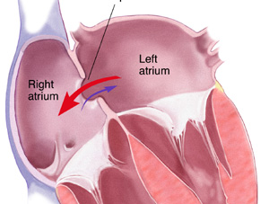
Results III Adoption rate
Atrial Septal Defect

Slide 7
Conclusion
MICS can be safely performed by new surgeon
  Complications is low
  Early and late outcomes is acceptable
Learning curves: 50 cases
MICS: standard approach
in valves, congenital defect
1.00
5YSR: 93.2%
9YSR: 91.4%
0.75
0.50
Survival Probability
0.25
0.00
0
365
730
1095
1460
1825
2190
2555
2920
3285
3650
Days
All
1085
863
706
578
442
340
295
207
147
91
25
Numbers at risk

