Slide 1
Outcome after Surgical Repair of Coronary Arteriovenous Fistulae

Slide 2
Purpose
To investigate characteristics of CAVF
To summarize outcome of surgical repair of CAVF investigate characteristics of CAVF

Slide 3
Methods
Jan, 1996 ~ Mar, 2018
Surgical repair of CAVF: n=20
Age(month): 76.2 (29-91.5)
Weight: 3.19 (3.04-3.4)
Male: n=10 (50%) Female: n=10 (50%)
Diagnosis tool: Cardiac cath, CT, TTE

Slide 4
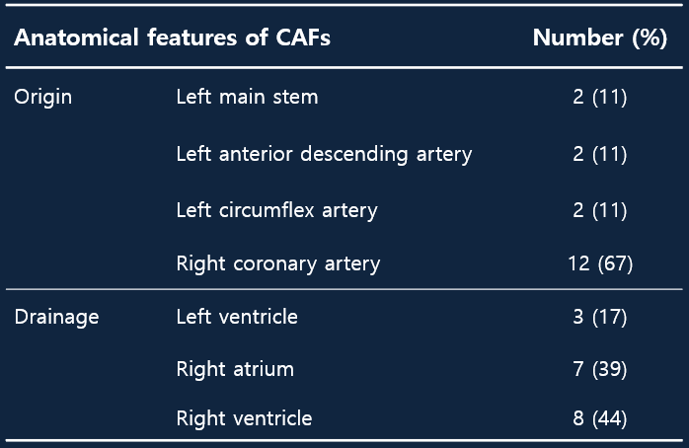
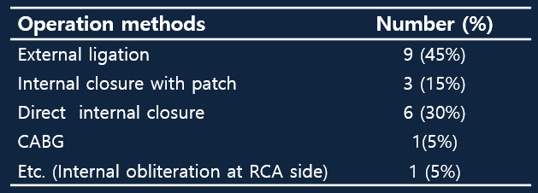
Results
With CPB : n=14 (70%)
- CPB time: 75min
- ACC time (n=13): 35min
Without CPB: n=6 (30%)

Slide 5
Results
Early death: n=0
Major surgical complication: n=0
Length of hospital stay (days): 6 (5-7)
Postop Echo cardiography at discharge (n=20)
  - RV dysfunction (or RWMA): none
  - LV dysfunction (or RWMA): none
  - Residual CAVF: none
Follow-up duration: 175 months (125~232 months)
Late death: n=0
Reoperation or reintervention: n=0

Slide 6
Results
At latest follow-up
  All in NYHA Fc I
  Medication : Anti coagulation for CABG (n=1)
Beta blocker for atrial flutter (n=2)
Follow-up evaluation
  EchoCG (n=20): 31.5months (6-96)
    Residual CAVF : none
    LV dysfunction (or RWMA): none
    RV dysfunction (or RWMA): none
  Others
    CT (n=3): no residual CAVF
    MRI (n=1): no residual CAVF

Slide 7
Conclusion
The outcome after surgical repair of CAVF is excellent.
Surgery should be considered as an option for treatment of CAVF in any circumstances where the catheter-based intervention is unfavorable.

